Slide 1
Pascal's triangle
7G

Slide 2
Pascal's triangle
The diagram below consists of the binomial coefficients $0^{n}C_{r}$ for 0≤n≤5. They form the first 6 rows of Pascal’s triangle.

Slide 3
Pascal’s rule
Each entry in Pascal’s triangle is the sum of the two entries immediately above.
$0^{n}C_{r}$= $0^{n−1}C_{r−1}$+ $0^{n−1}C_{r}$
where 1≤r<n

Slide 4
Proof
The number of subsets of {1,2,…,n} containing exactly r elements is $0^{n}C_{r}$. Each of these subsets can be put into one of two groups:
those that contain n
those that do not contain n.
If the subset contains n, then each of the remaining r−1 elements must be chosen from {1,2,…,n−1}. Therefore the first group contains $0^{n−1}C_{r−1}$subsets.
If the subset does not contain n, then we still have to choose r elements from {1,2,…,n−1}. Therefore the second group contains $0^{n−1}C_{r}$subsets.
The two groups together contain all $0^{n}C_{r}$ subsets and so
$0^{n}C_{r}$= $0^{n−1}C_{r−1}$+ $0^{n−1}C_{r}$
which establishes Pascal’s rule.

Slide 5
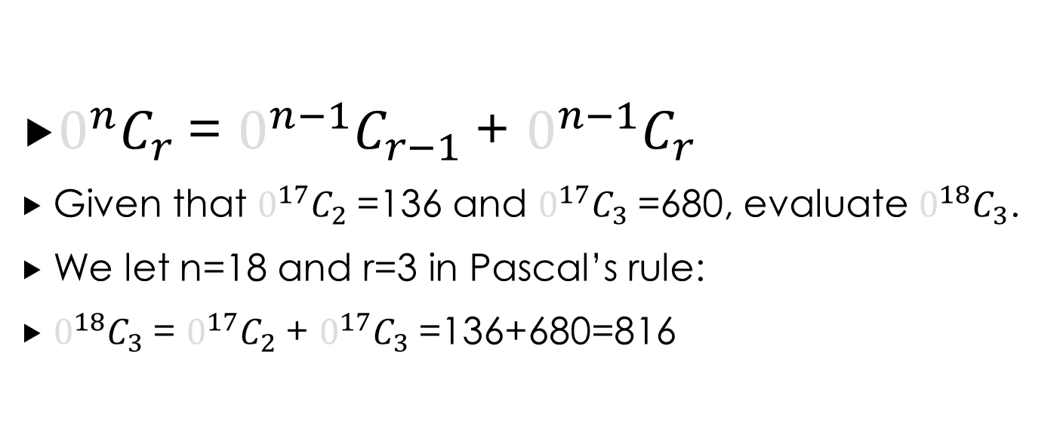
Example
$0^{n}C_{r}$= $0^{n−1}C_{r−1}$+ $0^{n−1}C_{r}$
Given that $0^{17}C_{2}$=136 and $0^{17}C_{3}$=680, evaluate $0^{18}C_{3}$.
We let n=18 and r=3 in Pascal’s rule:
$0^{18}C_{3}$= $0^{17}C_{2}$+ $0^{17}C_{3}$=136+680=816

Slide 6
example
Write down the n=6 row of Pascal’s triangle and then write down the value of $0^{6}C_{3}$.
Each entry in the n=6 row is the sum of the two entries immediately above.
$0^{6}C_{3}$=20 Note that $0^{6}C_{3}$ is the fourth entry in the row, since the first entry corresponds to $0^{6}C_{0}$.

Slide 7
Subsets of a set
Suppose your friend says to you: ‘I have five books that I no longer need, take any that you want.’ How many different selections are possible?
Solution 1
You could select none of the books ($0^{5}C_{0}$ways), or one out of five ($0^{5}C_{1}$ways), or two out of five ($0^{5}C_{2}$ways), and so on. This gives the answer
$0^{5}C_{0}$+ $0^{5}C_{1}$+ $0^{5}C_{2}$+ $0^{5}C_{3}$+ $0^{5}C_{4}$+ $0^{5}C_{5}$=32
Note that this is simply the sum of the entries in the n=5 row of Pascal’s triangle.
Solution 2
For each of the five books we have two options: either accept or reject the book. Using the multiplication principle, we obtain the answer
2×2×2×2×2=$2^{5}$=32

Slide 8
Subsets of a set
1. The sum of the entries in row n of Pascal’s triangle is $2^{n}$. That is,
$0^{n}C_{0}$+ $0^{n}C_{1}$+⋯+ $0^{n}C_{n−1}$+ $0^{n}C_{n}$= $2^{n}$
2. A set of size n has $2^{n}$ subsets, including the empty set and the set itself.

Slide 9
Examples
1. Your friend offers you any of six books that she no longer wants. How many selections are possible assuming that you take at least one book?
2. How many subsets of {1,2,3,…,10} have at least two elements?
$2^{6}$−1=63
There are $2^{6}$ subsets of a set of size 6. We subtract 1 because we discard the empty set of no books.
$2^{10}$− $0^{10}C_{1}$− $0^{10}C_{0}$= $2^{10}$−10−1=1013
There are $2^{10}$ subsets of a set of size 10. There are $0^{10}C_{1}$ subsets containing 1 element and $0^{10}C_{0}$ subsets containing 0 elements.

Slide 10
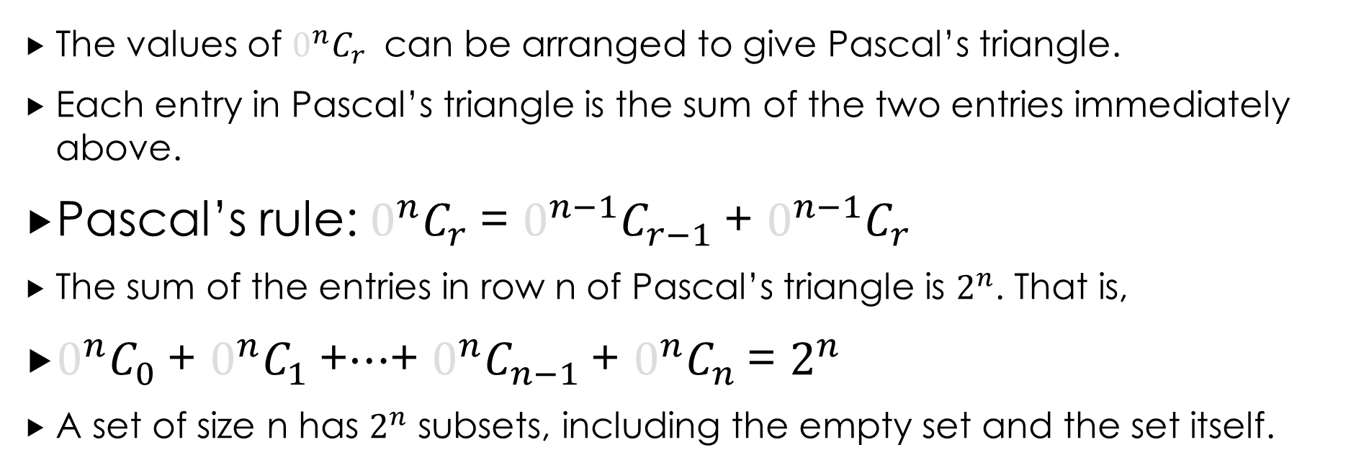
Section summary
The values of $0^{n}C_{r}$ can be arranged to give Pascal’s triangle.
Each entry in Pascal’s triangle is the sum of the two entries immediately above.
Pascal’s rule: $0^{n}C_{r}$= $0^{n−1}C_{r−1}$+ $0^{n−1}C_{r}$
The sum of the entries in row n of Pascal’s triangle is $2^{n}$. That is,
$0^{n}C_{0}$+ $0^{n}C_{1}$+⋯+ $0^{n}C_{n−1}$+ $0^{n}C_{n}$= $2^{n}$
A set of size n has $2^{n}$ subsets, including the empty set and the set itself.

