Slide 1
The pigeonhole principle
7H

Slide 2
Pigeonhole principle
If n+1 or more objects are placed into n holes, then some hole contains at least two objects.
The pigeonhole principle is an intuitively obvious counting technique which can be used to prove some remarkably counterintuitive results. It gets its name from the following simple observation: If n+1 pigeons are placed into n holes, then some hole contains at least two pigeons. Obviously, in most instances we will not be working with pigeons, so we will recast the principle as follows.

Slide 3
Example
You have thirteen red, ten blue and eight green socks. How many socks need to be selected at random to ensure that you have a matching pair?
Label three holes with the colours red, blue and green.
R B G
Selecting just three socks is clearly not sufficient, as you might pick one sock of each colour. Select four socks and place each sock into the hole corresponding to the colour of the sock. As there are four socks and three holes, the pigeonhole principle guarantees that some hole contains at least two socks. This is the required pair.

Slide 4

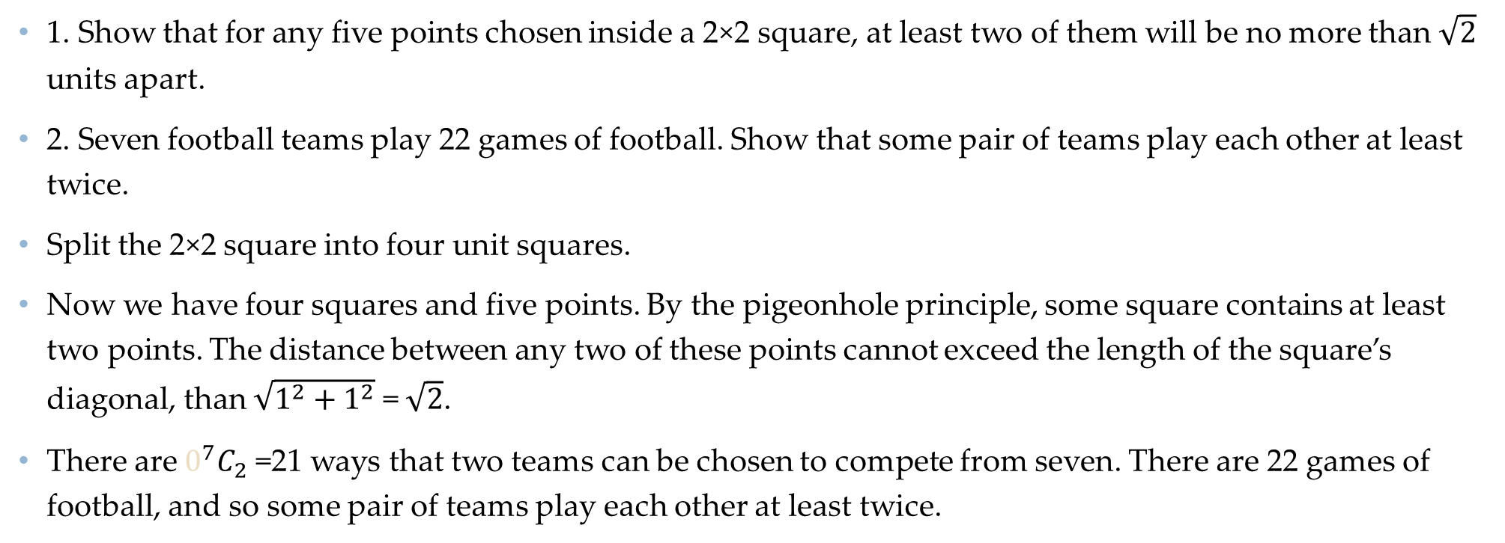
Example
1. Show that for any five points chosen inside a 2×2 square, at least two of them will be no more than $\sqrt{2}$ units apart.
2. Seven football teams play 22 games of football. Show that some pair of teams play each other at least twice.
Split the 2×2 square into four unit squares.
Now we have four squares and five points. By the pigeonhole principle, some square contains at least two points. The distance between any two of these points cannot exceed the length of the square’s diagonal, than $\sqrt{1^{2}+1^{2}}$ = $\sqrt{2}$.
There are $0^{7}C_{2}$ =21 ways that two teams can be chosen to compete from seven. There are 22 games of football, and so some pair of teams play each other at least twice.

Slide 5
Generalised pigeonhole principle
If at least mn+1 objects are placed into n holes, then some hole contains at least m+1 objects.
Suppose that 13 pigeons are placed into four holes. By the pigeonhole principle, there is some hole with at least two pigeons. In fact, some hole must contain at least four pigeons. The reason is simple: If each of the four holes contained no more than three pigeons, then there would be no more than 12 pigeons.

Slide 6
Example
Sixteen natural numbers are written on a whiteboard. Prove that at least four numbers will leave the same remainder when divided by 5.
Solution
We label five holes with each of the possible remainders on division by 5.
0 1 2 3 4
There are 16 numbers to be placed into five holes. Since 16=3×5+1, there is some hole with at least four numbers, each of which leaves the same remainder when divided by 5.

Slide 7
Pigeons in multiple holes
Seven people sit at a round table with 10 chairs. Show that there are three consecutive chairs that are occupied.
Solution
Number the chairs from 1 to 10. There are 10 groups of three consecutive chairs:
{1,2,3}, {2,3,4}, {3,4,5}, {4,5,6}, {5,6,7},
{6,7,8}, {7,8,9}, {8,9,10}, {9,10,1}, {10,1,2}
Each of the seven people will belong to three of these groups, and so 21 people have to be allocated to 10 groups. Since 21=2×10+1, the generalised pigeonhole principle guarantees that some group must contain three people.

Slide 8
Section summary
Pigeonhole principle
If n+1 or more objects are placed into n holes, then some hole contains at least two objects.
Generalised pigeonhole principle
If at least mn+1 objects are placed into n holes, then some hole contains at least m+1 objects.

