Slide 1
The inclusion–exclusion principle
7I

Slide 2
Basic set theory
A set is any collection of objects where order is not important. The set with no elements is called the empty set and is denoted by ∅. We say that set B is a subset of set A if each element of B is also in A. In this case, we can write B⊆A. Note that ∅⊆A and A⊆A.
If A is a finite set, then the number of elements in A will be denoted by |A|.

Slide 3
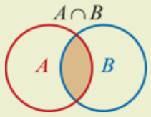
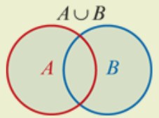
Basic set theory
Given any two sets A and B we define two important sets:
The intersection of sets A and B is denoted by A∩B and consists of elements belonging to A and B.
The union of sets A and B is denoted by A∪B and consists of elements belonging to A or B.
Note: It is important to realise that A∪B includes elements belonging to A and B.

Slide 4
Example
Consider the three sets of numbers A={2,3}, B={1,2,3,4} and C={3,4,5}.
Find B∩C.
Find A∪C.
Find A∩B∩C.
Find A∪B∪C.
Find |A|.
List all the subsets of C.
Solution
B∩C={3,4}
A∪C={2,3,4,5}
A∩B∩C={3}
A∪B∪C={1,2,3,4,5}
|A|=2
∅, {3}, {4}, {5}, {3,4}, {3,5}, {4,5}, {3,4,5}

Slide 5
Addition principle
If A and B are two finite sets of objects such that A∩B=∅, then
|A∪B|=|A|+|B|
Our aim is to extend this rule for instances where A∩B≠∅.

Slide 6
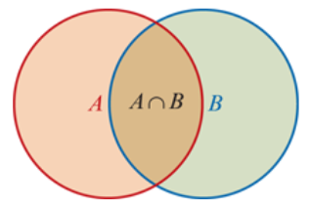
Two sets
To count the number of elements in the set A∪B, we first add (include) |A| and |B|. However, this counts the elements in A∩B twice, and so we subtract (exclude) |A∩B|.

Slide 7
Inclusion–exclusion principle for two sets
If A and B are two finite sets of objects, then
|A∪B|=|A|+|B|−|A∩B|

Slide 8
Example
Each of the 25 students in a Year 11 class studies Physics or Chemistry. Of these students, 15 study Physics and 18 study Chemistry. How many students study both subjects?
Let P and C be the sets of students who study Physics and Chemistry respectively.
Since each student studies Physics or Chemistry, we know that |P∪C|=25.
|P∪C|=|P|+|C|−|P∩C|
25 =15+18−|P∩C|
25=33−|P∩C|
∴ |P∩C| =8

Slide 9
Example
A bag contains 100 balls labelled with the numbers from 1 to 100. How many ways can a ball be chosen that is a multiple of 2 or 5?
Within the set of numbers {1,2,3,…,100}, let A be the set of multiples of 2 and let B be the set of multiples of 5.
Then A∩B consists of numbers that are multiples of both 2 and 5, that is, multiples of 10.
Therefore |A|=50, |B|=20 and |A∩B|=10. We then use the inclusion–exclusion principle.
|A∪B|=|A|+|B|−|A∩B|=50+20−10=60

Slide 10
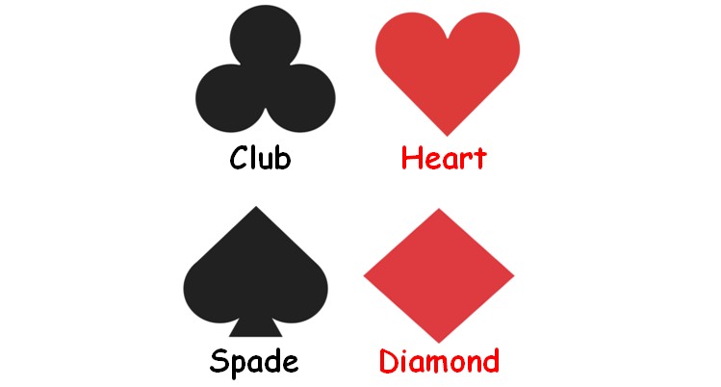
Example
A hand of five cards is dealt from a deck of 52 cards. How many hands contain exactly:
1. two clubs
2. three spades
3. two clubs and three spades
4. two clubs or three spades?
$0^{13}C_{2}$⋅ $0^{39}C_{3}$=712842 There are $0^{13}C_{2}$ ways of choosing 2 clubs from 13 and $0^{39}C_{3}$ ways of choosing 3 more cards from the 39 non-clubs.
$0^{13}C_{3}$ ⋅ $0^{39}C_{2}$ =211926 There are $0^{13}C_{3}$ ways of choosing 3 spades from 13 and $0^{39}C_{2}$ ways of choosing 2 more cards from the 39 non-spades.
$0^{13}C_{2}$ ⋅ $0^{13}C_{3}$ =22308 There are $0^{13}C_{2}$ ways of choosing 2 clubs from 13 and $0^{13}C_{3}$ ways of choosing 3 spades from 13.
|A∪B|=|A|+|B|−|A∩B|=712842+211926−22308=902460 We let A be the set of all hands with 2 clubs and let B be the set of all hands with 3 spades. Then A∩B is the set of all hands with 2 clubs and 3 spades. We use the inclusion–exclusion principle to find |A∪B|.

Slide 11
Inclusion–exclusion principle for three sets
If A, B and C are three finite sets of objects, then
|A∪B∪C|=|A|+|B|+|C|−|A∩B|−|A∩C|−|B∩C|+|A∩B∩C|
For three sets A, B and C, the formula for |A∪B∪C| is slightly harder to establish.
We first add |A|, |B| and |C|. However, we have counted the elements in A∩B, A∩C and B∩C twice, and the elements in A∩B∩C three times.
Therefore we subtract |A∩B|, |A∩C| and |B∩C| to compensate. But then the elements in A∩B∩C will have been excluded once too often, and so we add |A∩B∩C|.

Slide 12
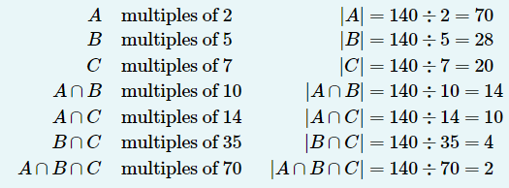
Example
How many integers from 1 to 140 inclusive are not divisible by 2, 5 or 7?
Let A, B and C be the sets of all integers from 1 to 140 that are divisible by 2, 5 and 7 respectively. We then have
We use the inclusion–exclusion principle to give
|A∪B∪C|=|A|+|B|+|C|−|A∩B|−|A∩C|−|B∩C|+|A∩B∩C|=70+28+20−14−10−4+2=92
Therefore the number of integers not divisible by 2, 5 or 7 is 140−92=48.

Slide 13
Section Summary
The inclusion–exclusion principle extends the addition principle to instances where the two sets have objects in common.
The principle works by ensuring that objects belonging to multiple sets are not counted more than once.
The inclusion–exclusion principles for two sets and three sets:
|A∪B|=|A|+|B|−|A∩B|
|A∪B∪C|=|A|+|B|+|C|−|A∩B|−|A∩C|−|B∩C|+|A∩B∩C|

