Slide 1

Quadratic equations
5B

Slide 2
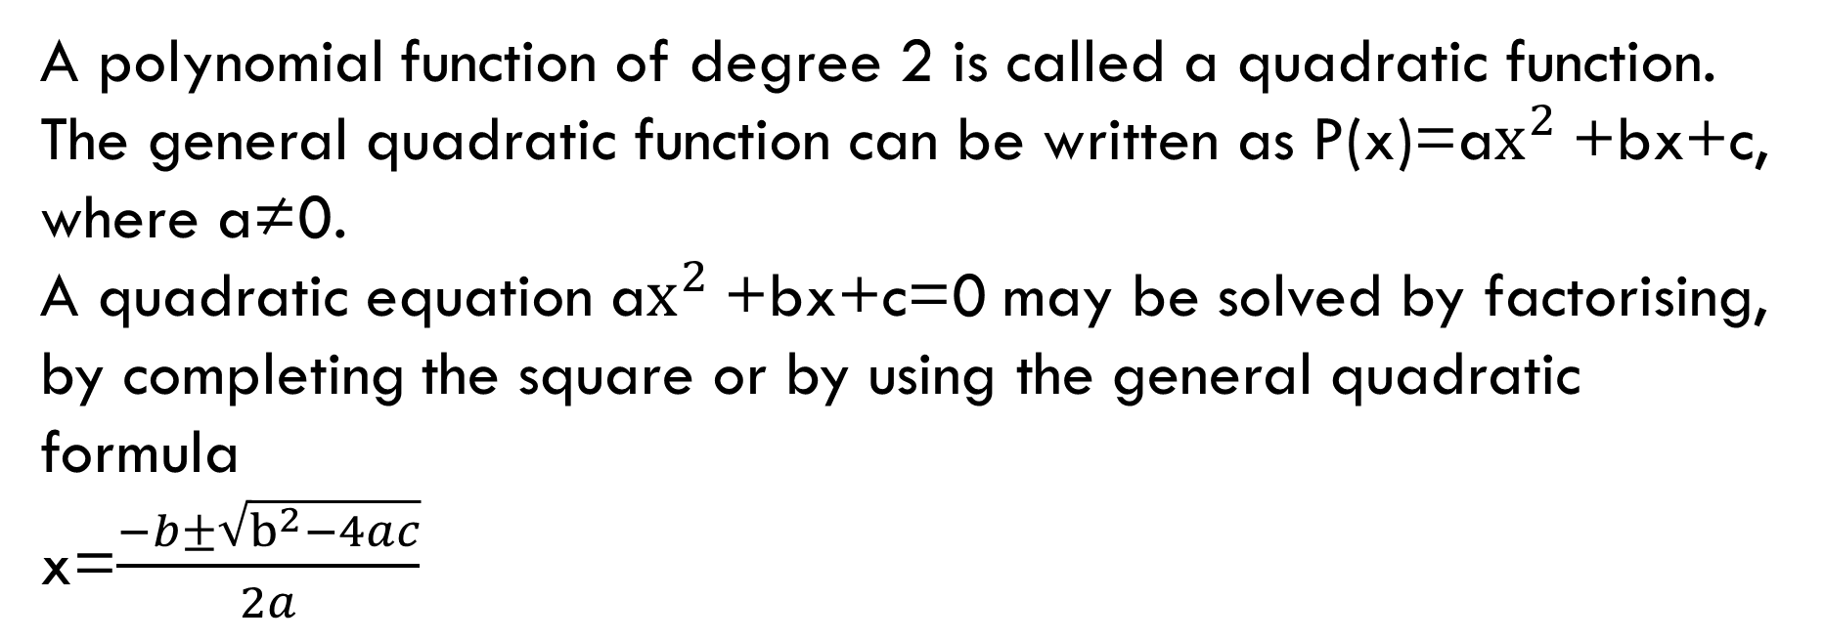
Quadratic functions
A polynomial function of degree 2 is called a quadratic function. The general quadratic function can be written as P(x)=a$x^{2}$+bx+c, where a≠0.
A quadratic equation a$x^{2}$+bx+c=0 may be solved by factorising, by completing the square or by using the general quadratic formula
x=$\frac{−b±\sqrt{b^{2}−4ac}}{2a}$

Slide 3
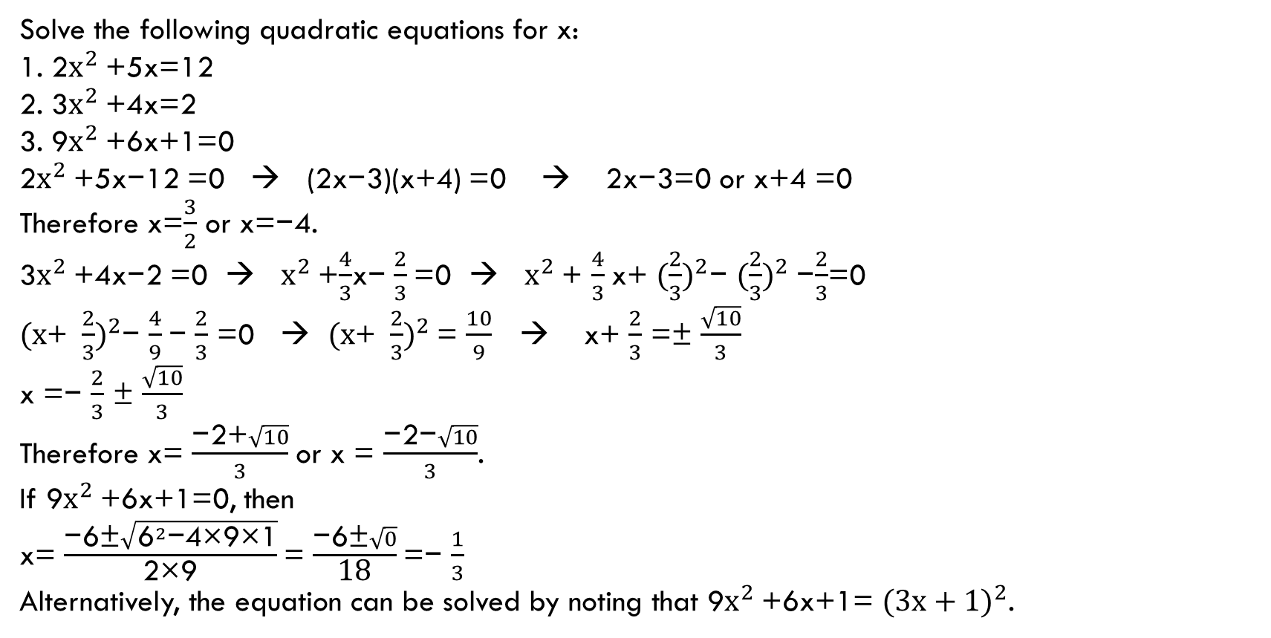
example
Solve the following quadratic equations for x:
1. 2$x^{2}$+5x=12
2. 3$x^{2}$+4x=2
3. 9$x^{2}$+6x+1=0
2$x^{2}$+5x−12 =0 → (2x−3)(x+4) =0 → 2x−3=0 or x+4 =0
Therefore x=$\frac{3}{2}$ or x=−4.
3$x^{2}$+4x−2 =0 → $x^{2}$+$\frac{4}{3}$x− $\frac{2}{3}$=0 → $x^{2}$+ $\frac{4}{3}$x+ ${(\frac{2}{3})}^{2}$− ${(\frac{2}{3})}^{2}$−$\frac{2}{3}$=0
${(x\text{+ }\frac{2}{3})}^{2}$− $\frac{4}{9}$− $\frac{2}{3}$ =0 → ${(x\text{+ }\frac{2}{3})}^{2}$= $\frac{10}{9}$→ x+ $\frac{2}{3}$ =± $\frac{\sqrt{10}}{3}$
x =− $\frac{2}{3}$ ± $\frac{\sqrt{10}}{3}$
Therefore x= $\frac{\text{−2+}\sqrt{10}}{3}$or x = $\frac{\text{−2−}\sqrt{10}}{3}$.
If 9$x^{2}$+6x+1=0, then
x= $\frac{\text{−}\text{6}\text{±}\sqrt{{\text{6}}^{2}\text{−4×9×1}}}{\text{2×9}}$= $\frac{\text{−6±}\sqrt{0}}{\text{18}}$=− $\frac{1}{3}$
Alternatively, the equation can be solved by noting that 9$x^{2}$+6x+1= ${(3x+1)}^{2}$.

Slide 4
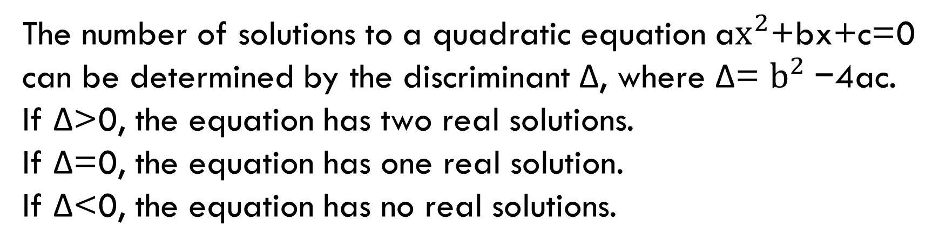
The discriminant: real solutions
The number of solutions to a quadratic equation a$x^{2}$+bx+c=0 can be determined by the discriminant Δ, where Δ= $b^{2}$−4ac.
If Δ>0, the equation has two real solutions.
If Δ=0, the equation has one real solution.
If Δ<0, the equation has no real solutions.

Slide 5
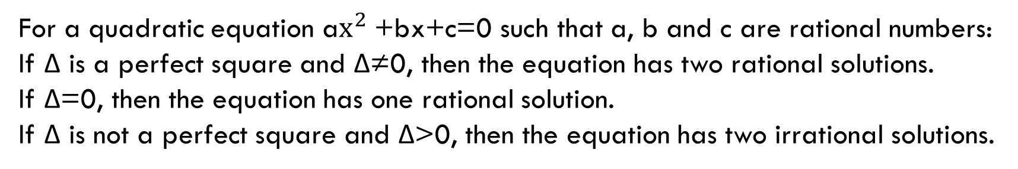
The discriminant: rational solutions
For a quadratic equation a$x^{2}$+bx+c=0 such that a, b and c are rational numbers:
If Δ is a perfect square and Δ≠0, then the equation has two rational solutions.
If Δ=0, then the equation has one rational solution.
If Δ is not a perfect square and Δ>0, then the equation has two irrational solutions.

Slide 6
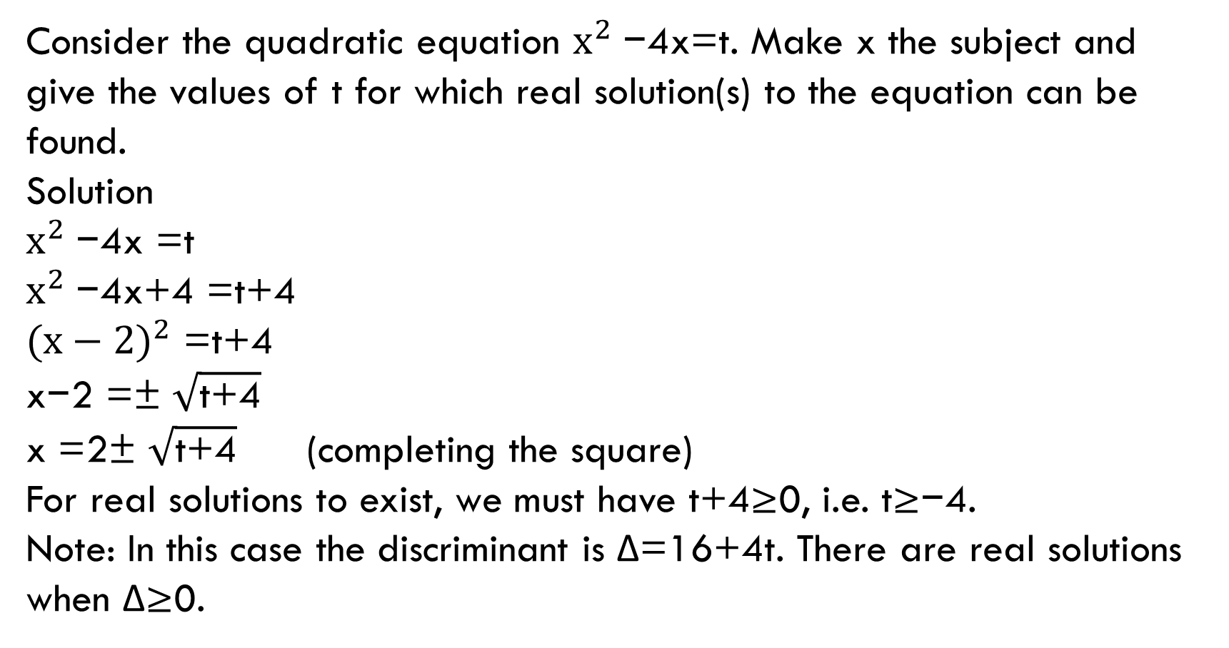
example
Consider the quadratic equation $x^{2}$−4x=t. Make x the subject and give the values of t for which real solution(s) to the equation can be found.
Solution
$x^{2}$−4x =t
$x^{2}$−4x+4 =t+4
${(x−2)}^{2}$ =t+4
x−2 =± $\sqrt{\text{t}\text{+4}}$
x =2± $\sqrt{\text{t}\text{+4}}$ (completing the square)
For real solutions to exist, we must have t+4≥0, i.e. t≥−4.
Note: In this case the discriminant is Δ=16+4t. There are real solutions when Δ≥0.

Slide 7

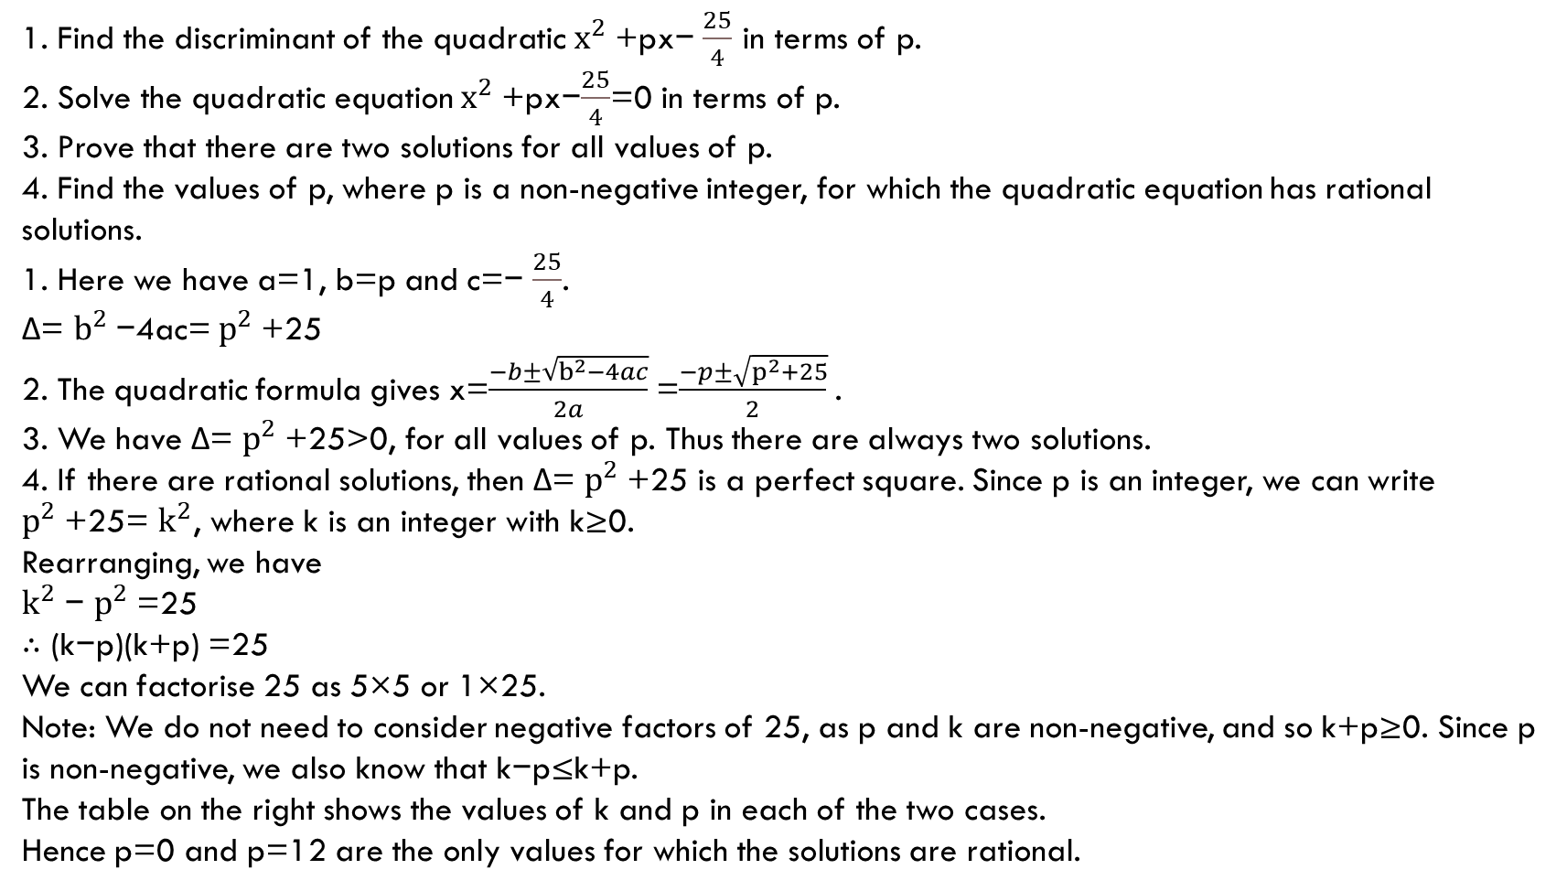
example
1. Find the discriminant of the quadratic $x^{2}$+px− $\frac{25}{4}$ in terms of p.
2. Solve the quadratic equation $x^{2}$+px−$\frac{25}{4}$=0 in terms of p.
3. Prove that there are two solutions for all values of p.
4. Find the values of p, where p is a non-negative integer, for which the quadratic equation has rational solutions.
1. Here we have a=1, b=p and c=− $\frac{25}{4}$.
Δ= $b^{2}$−4ac= $p^{2}$+25
2. The quadratic formula gives x=$\frac{−b±\sqrt{b^{2}−4ac}}{2a}$=$\frac{−p±\sqrt{p^{2}+25}}{2}$.
3. We have Δ= $p^{2}$+25>0, for all values of p. Thus there are always two solutions.
4. If there are rational solutions, then Δ= $p^{2}$+25 is a perfect square. Since p is an integer, we can write $p^{2}$+25= $k^{2}$, where k is an integer with k≥0.
Rearranging, we have
$k^{2}$− $p^{2}$=25
∴ (k−p)(k+p) =25
We can factorise 25 as 5×5 or 1×25.
Note: We do not need to consider negative factors of 25, as p and k are non-negative, and so k+p≥0. Since p is non-negative, we also know that k−p≤k+p.
The table on the right shows the values of k and p in each of the two cases.
Hence p=0 and p=12 are the only values for which the solutions are rational.

Slide 8
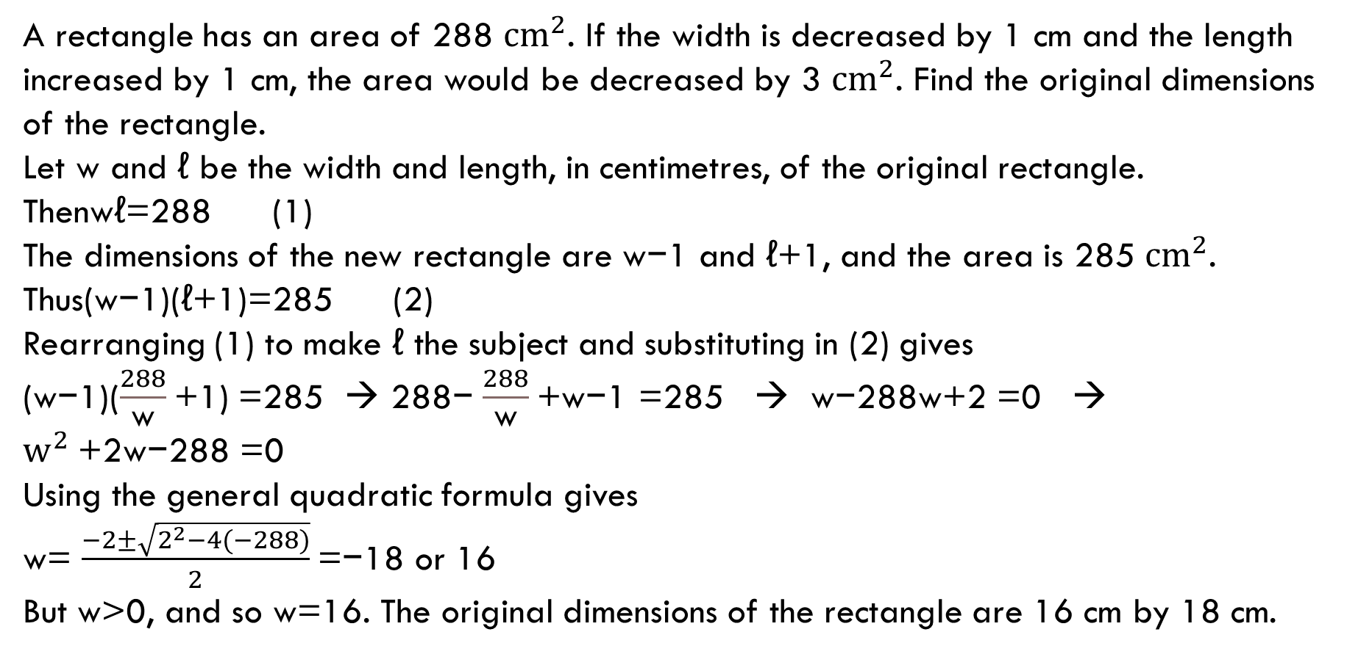
example
A rectangle has an area of 288 ${cm}^{2}$. If the width is decreased by 1 cm and the length increased by 1 cm, the area would be decreased by 3 ${cm}^{2}$. Find the original dimensions of the rectangle.
Let w and ℓ be the width and length, in centimetres, of the original rectangle.
Thenwℓ=288 (1)
The dimensions of the new rectangle are w−1 and ℓ+1, and the area is 285 ${cm}^{2}$.
Thus(w−1)(ℓ+1)=285 (2)
Rearranging (1) to make ℓ the subject and substituting in (2) gives
(w−1)($\frac{288}{\text{w}}$+1) =285 → 288− $\frac{288}{\text{w}}$+w−1 =285 → w−288w+2 =0 → $w^{2}$+2w−288 =0
Using the general quadratic formula gives
w= $\frac{−2±\sqrt{2^{2}−4(−288)}}{2}$=−18 or 16
But w>0, and so w=16. The original dimensions of the rectangle are 16 cm by 18 cm.

Slide 9
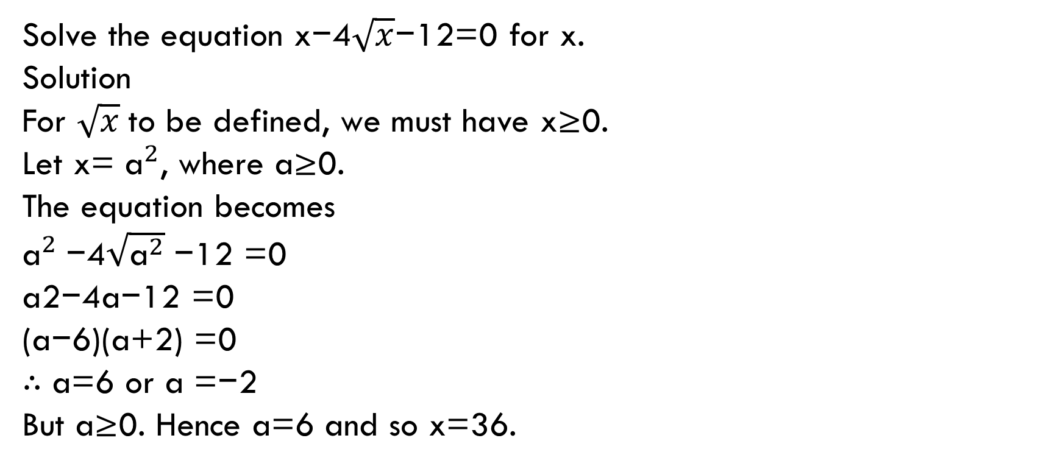
example
Solve the equation x−4$\sqrt{x}$−12=0 for x.
Solution
For $\sqrt{x}$to be defined, we must have x≥0.
Let x= ${\text{a}}^{2}$, where a≥0.
The equation becomes
${\text{a}}^{2}$−4$\sqrt{{\text{a}}^{2}}$−12 =0
a2−4a−12 =0
(a−6)(a+2) =0
∴ a=6 or a =−2
But a≥0. Hence a=6 and so x=36.

Slide 10
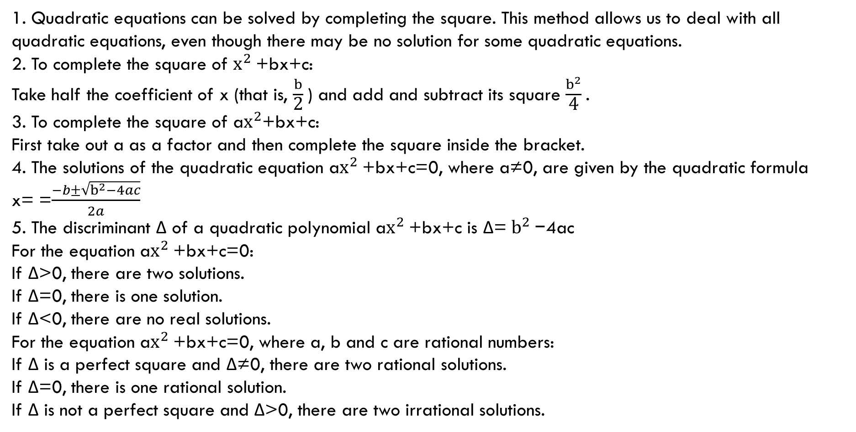
Section summary
1. Quadratic equations can be solved by completing the square. This method allows us to deal with all quadratic equations, even though there may be no solution for some quadratic equations.
2. To complete the square of $x^{2}$+bx+c:
Take half the coefficient of x (that is, $\frac{b}{\text{2}}$) and add and subtract its square $\frac{b^{2}}{\text{4}}$.
3. To complete the square of a$x^{2}$+bx+c:
First take out a as a factor and then complete the square inside the bracket.
4. The solutions of the quadratic equation a$x^{2}$+bx+c=0, where a≠0, are given by the quadratic formula
x= =$\frac{−b±\sqrt{b^{2}−4ac}}{2a}$
5. The discriminant Δ of a quadratic polynomial a$x^{2}$+bx+c is Δ= $b^{2}$−4ac
For the equation a$x^{2}$+bx+c=0:
If Δ>0, there are two solutions.
If Δ=0, there is one solution.
If Δ<0, there are no real solutions.
For the equation a$x^{2}$+bx+c=0, where a, b and c are rational numbers:
If Δ is a perfect square and Δ≠0, there are two rational solutions.
If Δ=0, there is one rational solution.
If Δ is not a perfect square and Δ>0, there are two irrational solutions.

