Slide 1
Simultaneous equations
5E

Slide 2
Simultaneous equations
We look at methods for finding the coordinates of the points of intersection of a linear graph with different non-linear graphs: parabolas, circles and rectangular hyperbolas. We also consider the intersections of two parabolas.

Slide 3
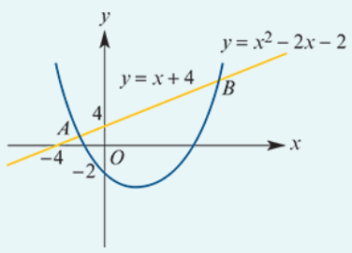
example
Find the coordinates of the points of intersection of the parabola with equation $y=x^{2}−2x−2$ and the straight line with equation $y=x+4$.
Equate the two expressions for $y$:
$x^{2}−2x−2$ = $x+4$
$x^{2}−3x−6$= 0
∴ $x$=$\frac{3±\sqrt{9−4×\left(−6\right)}}{2}$ = $\frac{3±\sqrt{33}}{2}$
The points of intersection are A($\frac{3−\sqrt{33}}{2}$, $\frac{11−\sqrt{33}}{2}$) and B($\frac{3+\sqrt{33}}{2}$, $\frac{11+\sqrt{33}}{2}$).

Slide 4
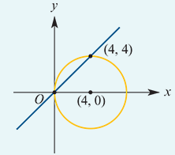
example
Find the points of intersection of the circle with equation ${\left(x−4\right)}^{2}+y^{2}$=16 and the line with equation $x$− $y$=0.
Rearrange $x$− $y$=0 to make y the subject.
Substitute y = x into the equation of the circle:
${\left(x−4\right)}^{2}+x^{2}$ =16
$x^{2}$ −8$x$+16+ $x^{2}$ =16
2$x^{2}$ −8$x$ =0
2$x$($x$−4) =0
∴ $x$=0 or $x$ =4
The points of intersection are (0,0) and (4,4).

Slide 5
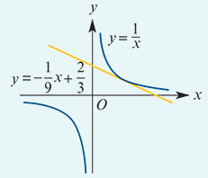
example
Find the point of contact of the straight line with equation $\frac{1}{9}$x+y= $\frac{2}{3}$ and the curve with equation xy=1.
Rewrite the equations as y=− $\frac{1}{9}$x+ $\frac{2}{3}$ and y= $\frac{1}{x}$.
Equate the expressions for y:
− $\frac{1}{9}$x+ $\frac{2}{3}$ = $\frac{1}{x}$
− $x^{2}$+6$x$ =9
$x^{2}$−6$x$+9 =0
($x$−3)2 =0
∴ $x$ =3
The point of intersection is (3,13).

Slide 6
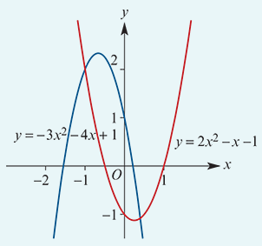
example
Find the coordinates of the points of intersection of the graphs of $y$=−3$x^{2}$−4$x$+1 and $y$=2$x^{2}$− $x$−1.
−3$x^{2}$−4$x$+1 =2$x^{2}$− $x$−1
−5$x^{2}$−3$x$+2 =0
5$x^{2}$+3$x$−2 =0
(5$x$−2)($x$+1) =0
∴ $x$=25 or $x$ =−1
Substitute in $y$=2$x^{2}$− $x$−1:
When $x$=−1, $y$=2.
When $x$= $\frac{2}{5}$, $y$=2 × $\frac{4}{25}$− $\frac{2}{5}$−1=− $\frac{27}{25}$.
The points of intersection are (−1,2) and ($\frac{2}{5}$,− $\frac{27}{25}$).

