Slide 1
Chapter 5 Algebra II
Revision

Slide 2
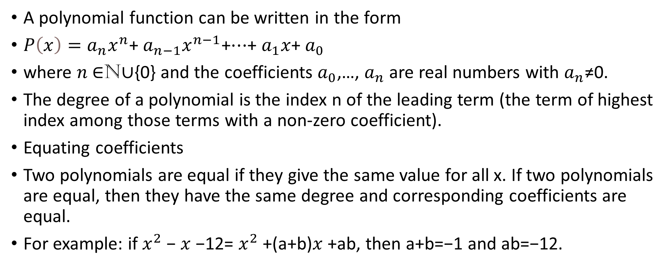
Polynomials
A polynomial function can be written in the form
$P\left(x\right)=a_{n}x^{n}$+ $a_{n−1}x^{n−1}\text{+⋯+}$ $a_{1}x$+ $a_{0}$
where $n$∈N∪{0} and the coefficients $a_{0}$,…, $a_{n}$ are real numbers with $a_{n}$≠0.
The degree of a polynomial is the index n of the leading term (the term of highest index among those terms with a non-zero coefficient).
Equating coefficients
Two polynomials are equal if they give the same value for all x. If two polynomials are equal, then they have the same degree and corresponding coefficients are equal.
For example: if $x^{2}$− $x$−12= $x^{2}$+(a+b)$x$+ab, then a+b=−1 and ab=−12.

Slide 3
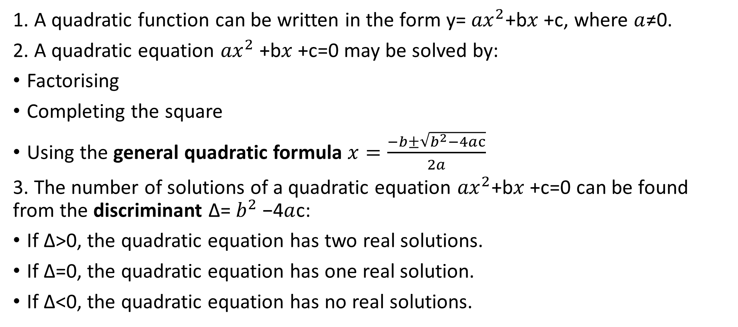
Quadratics
1. A quadratic function can be written in the form y= ${ax}^{2}$+b$x$+c, where $a$≠0.
2. A quadratic equation ${ax}^{2}$+b$x$+c=0 may be solved by:
Factorising
Completing the square
Using the general quadratic formula $x=\frac{−b±\sqrt{b^{2}−4ac}}{2a}$
3. The number of solutions of a quadratic equation ${ax}^{2}$+b$x$+c=0 can be found from the discriminant Δ= $b^{2}$−4$a$c:
If Δ>0, the quadratic equation has two real solutions.
If Δ=0, the quadratic equation has one real solution.
If Δ<0, the quadratic equation has no real solutions.

Slide 4
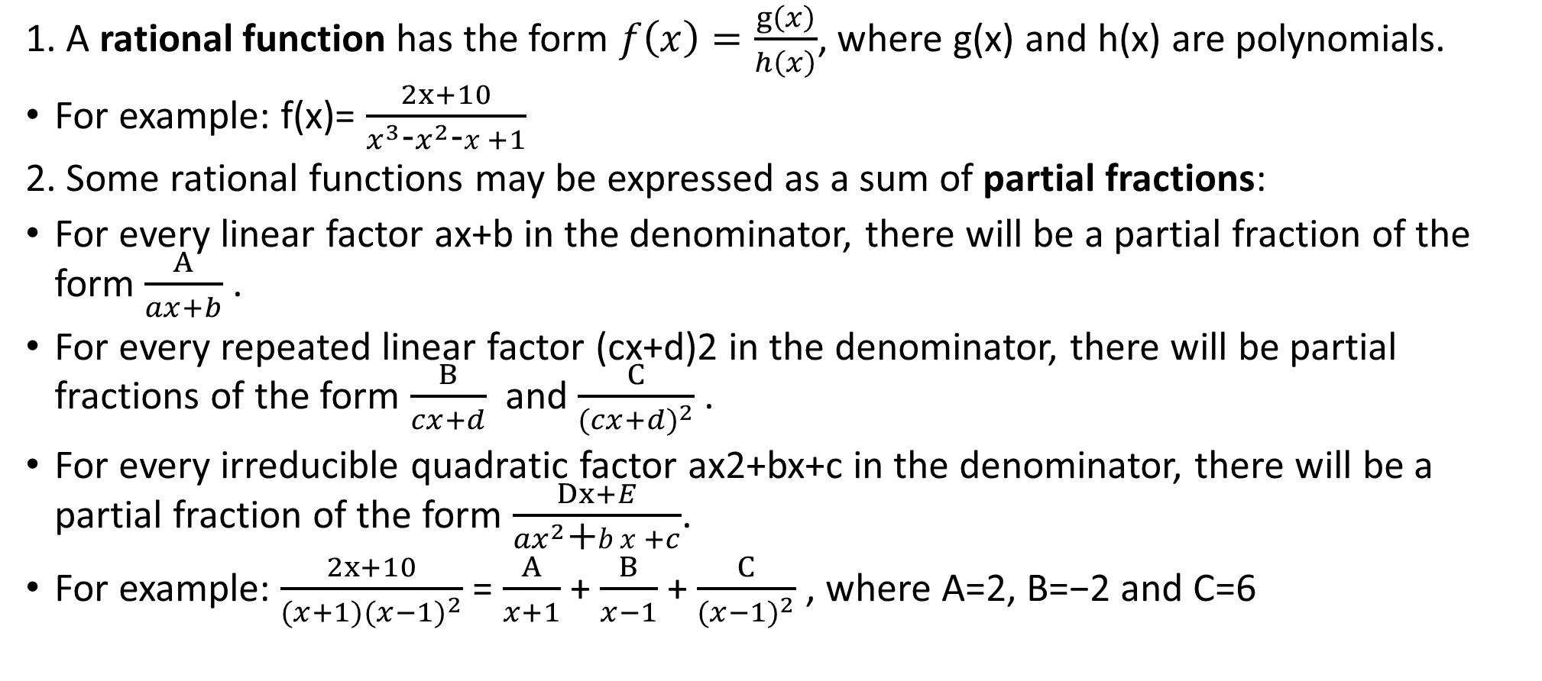
Partial fractions
1. A rational function has the form $f\left(x\right)=\frac{g\left(x\right)}{h\left(x\right)}$, where g(x) and h(x) are polynomials.
For example: f(x)= $\frac{2x+10}{x^{3}\text{−}x^{2}\text{−}x+1}$
2. Some rational functions may be expressed as a sum of partial fractions:
For every linear factor ax+b in the denominator, there will be a partial fraction of the form $\frac{A}{ax+b}$.
For every repeated linear factor (cx+d)2 in the denominator, there will be partial fractions of the form $\frac{B}{cx+d}$and $\frac{C}{{(cx+d)}^{2}}$.
For every irreducible quadratic factor ax2+bx+c in the denominator, there will be a partial fraction of the form $\frac{Dx+E}{{ax}^{2}\text{+}bx+c}$.
For example: $\frac{2x+10}{{(x+1)(x−1)}^{2}}$= $\frac{A}{x+1}$+ $\frac{B}{x−1}$+ $\frac{C}{{(x−1)}^{2}}$, where A=2, B=−2 and C=6

