Slide 1
Reviewing trigonometry
13A

Slide 2
Notes:
https://www.transum.org/Maths/Exercise/Trigonometry/Default.asp?Level=1
https://www.transum.org/Maths/Activity/Trig/Inverse.asp

Slide 3
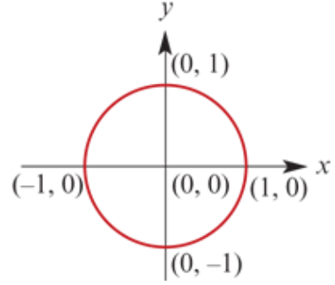
Defining sine and cosine
The unit circle is a circle of radius 1 with centre at the origin.
We can define the sine and cosine of any angle by using the unit circle.

Slide 4
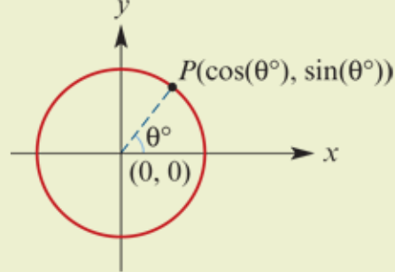
Unit-circle definition of sine and cosine
For each angle θ°, there is a point P on the unit circle as shown. The angle is measured anticlockwise from the positive direction of the x-axis.
cos(θ°) is defined as the x-coordinate of the point P
sin(θ°) is defined as the y-coordinate of the point P

Slide 5
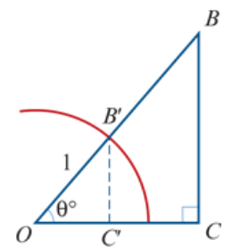
The trigonometric ratios
For acute angles, the unit-circle definition of sine and cosine given above is equivalent to the ratio definition.
For a right-angled triangle OBC, we can construct a similar triangle OB′C′ that lies in the unit circle. From the diagram:
B′C′=sin(θ°) and OC′=cos(θ°)
The similarity factor is the length OB, giving
BC =OBsin(θ°) and OC =OBcos(θ°)
∴ $\frac{BC}{OB}$ =sin(θ°) and $\frac{OC}{OB}$ =cos(θ°)

Slide 6
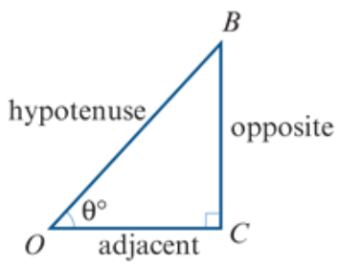
The trigonometric ratios
This gives the ratio definition of sine and cosine for a right-angled triangle. The naming of sides with respect to an angle θ° is as shown.
sin(θ°) = $\frac{\text{opposite}}{\text{hypotenuse}}$
cos(θ°) = $\frac{\text{adjacent}}{\text{hypotenuse}}$
tan(θ°) = $\frac{\text{opposite}}{\text{adjacent}}$

Slide 7
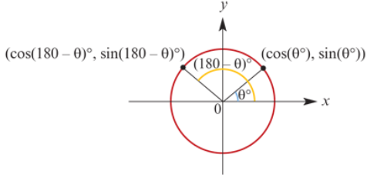
Obtuse angles
From the unit circle, we see that
sin(180−θ)° = sin(θ °)
cos(180−θ)°) = −cos(θ°)
For example:
sin135° = sin45°
cos135° = −cos45°
We will generally use the ratio definition of tangent for acute angles. But we can also find the tangent of an obtuse angle by defining
tanθ= $\frac{\text{sinθ}}{\text{cosθ}}$

Slide 8
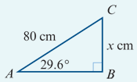
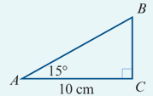
Solving right-angled triangles examples
1. Find the value of x correct to two decimal places.
2. Find the length of the hypotenuse correct to two decimal places.
$\frac{\text{x}}{\text{80}}$=sin29.6°
∴ x =80sin29.6°=39.5153…
Hence x=39.52, correct to two decimal places.
$\frac{\text{10}}{\text{AB}}$ =cos15°
10 =ABcos15°
∴ AB = $\frac{\text{10}}{\text{cos}\text{15°}}$ =10.3527…
The length of the hypotenuse is 10.35 cm, correct to two decimal places.

Slide 9
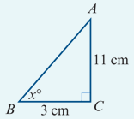
Solving right-angled triangles examples
Find the magnitude of ∠ABC.
tanx =$\frac{11}{3}$
∴x =$\tan^{−1}\left(\frac{11}{3}\right)$=(74.7448…)°
Hence x=74.74°, correct to two decimal places.

