Slide 1
The sine rule
13B

Slide 2
The sine rule
Considering non-right-angled triangles.
The sine rule is used to find unknown side lengths or angles of a triangle in the following two situations:
1. one side and two angles are given
2. two sides and a non-included angle are given (that is, the given angle is not ‘between’ the two given sides).
In the first case, the triangle is uniquely defined up to congruence. In the second case, there may be two triangles.

Slide 3
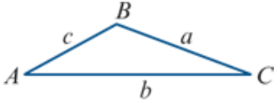
Labelling triangles
The following convention is used in the remainder of this chapter:
Interior angles are denoted by uppercase letters.
The length of the side opposite an angle is denoted by the corresponding lowercase letter.
For example, the magnitude of angle BAC is denoted by A, and the length of side BC is denoted by a.

Slide 4
Sine rule
For triangle ABC:
$\frac{a}{\sin{A}}$ = $\frac{b}{\sin{B}}$= $\frac{c}{\sin{C}}$

Slide 5
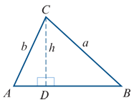
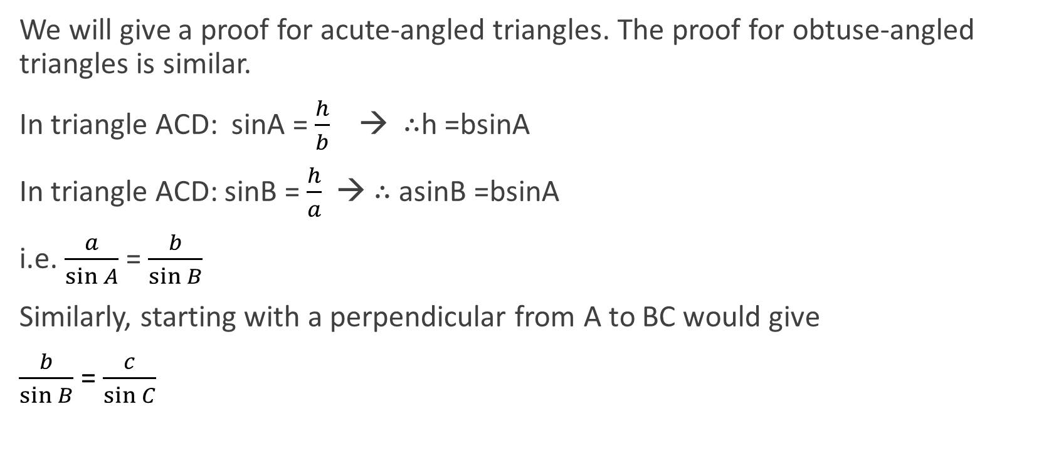
Sine rule Proof
We will give a proof for acute-angled triangles. The proof for obtuse-angled triangles is similar.
In triangle ACD: sinA = $\frac{h}{b}$ → ∴h =bsinA
In triangle ACD: sinB = $\frac{h}{a}$ → ∴ asinB =bsinA
i.e. $\frac{a}{\sin{A}}$ = $\frac{b}{\sin{B}}$
Similarly, starting with a perpendicular from A to BC would give
$\frac{b}{\sin{B}}$= $\frac{c}{\sin{C}}$

Slide 6
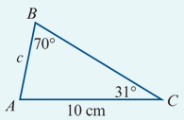
One side and two angles EXAMPLE
Use the sine rule to find the length of AB.
$\frac{\text{c}}{\text{sin}\text{31°}}$= $\frac{\text{10}}{\text{sin}\text{70}\text{°}}$
∴c = $\frac{\text{10}\text{sin}\text{31°}}{\text{sin}\text{70}\text{°}}$=5.4809…
The length of AB is 5.48 cm, correct to two decimal places.

Slide 7
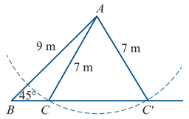
Two sides and a non-included angle
Suppose that we are given the two side lengths 7 m and 9 m and a non-included angle of 45\°. There are two triangles that satisfy these conditions, as shown in the diagram.
Warning
When you are given two sides and a non-included angle, you must consider the possibility that there are two such triangles.
An angle found using the sine rule is possible if the sum of the given angle and the found angle is less than 180°.
Note: If the given angle is obtuse or a right angle, then there is only one such triangle.

Slide 8
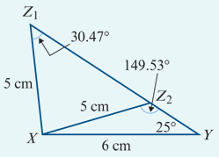
Example
Use the sine rule to find the magnitude of angle XZY in the triangle, given that Y=25°, y=5 cm and z=6 cm.
Solution
$\frac{\text{5}}{\text{sin}\text{25}\text{°}}$ = $\frac{\text{6}}{\text{sin}\text{Z}}$
$\frac{\text{sinZ}}{\text{6}}$ = $\frac{\text{sin}\text{25°}}{\text{5}}$
sinZ = $\frac{\text{6}\text{sin}\text{25°}}{\text{5}}$ =0.5071…
∴Z =(30.473…)° or Z=(180−30.473…)°
Hence Z=30.47° or Z=149.53°, correct to two decimal places.
Note: Remember that sin(180−θ)°=sin(θ°).

Slide 9
Section summary
Sine rule For triangle ABC:
$\frac{a}{\sin{A}}$ = $\frac{b}{\sin{B}}$= $\frac{c}{\sin{C}}$
When to use the sine rule:
1. one side and two angles are given (AAS)
2. two sides and a non-included angle are given.

