Slide 1
The area of a triangle
13D

Slide 2
Notes:
https://www.transum.org/Software/SW/Starter_of_the_day/Starter_April9.asp?init=44,45,46,

Slide 3
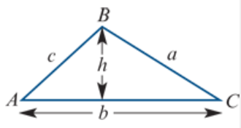
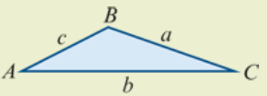
The area of a triangle
The area of a triangle is given by
Area=$\frac{1}{2}$×base length×height= $\frac{1}{2}$bh
By observing that h=c sinA, we obtain the following formula.
For triangle ABC:
Area= $\frac{1}{2}$bcsinA
That is, the area is half the product of the lengths of two sides and the sine of the angle included between them.

Slide 4
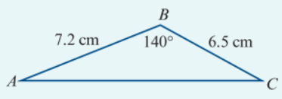
Example
Find the area of triangle ABC shown in the diagram.
Solution
Area= $\frac{1}{2}$×7.2×6.5sin140°=15.04 $cm^{2}$(correct to two decimal places)

Slide 5
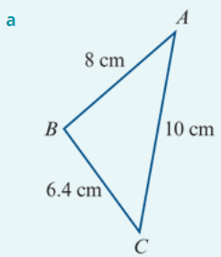
Example
Find the area of each of the following triangles, correct to three decimal places:
Solution
Using the cosine rule:
$8^{2}$ = ${6.4}^{2}$+ ${10}^{2}$−2×6.4×10cosC
64 =140.96−128cosC
cosC =0.60125
∴ C° =(53.0405…)° (store exact value on your calculator)
Area △ABC = $\frac{1}{2}$×6.4×10×sinC=25.570 $cm^{2}$ (correct to three decimal places)

Slide 6
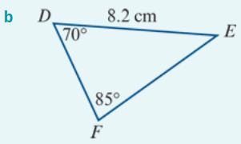
Example
Find the area of each of the following triangles, correct to three decimal places:
Solution
Note that E°=(180−(70+85))°=25°.
Using the sine rule:
DF =sin25°× $\frac{8.2}{sin85°}$ =3.4787… (store exact value on your calculator)
Area △DEF = $\frac{1}{2}$×8.2×DF×sin70°=13.403 $cm^{2}$ (correct to three decimal places)

Slide 7
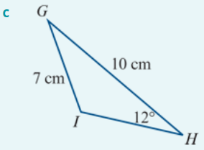
Example
Find the area of each of the following triangles, correct to three decimal places:
Solution
Using the sine rule:
sinI =10× $\frac{sin12°}{7}$ =0.2970…
∴ I° =(180−17.27…)° (since I is an obtuse angle)
=(162.72…)° (store exact value on your calculator)
∴ G° =(180−(12+I))° =(5.27…)° (store exact value on your calculator)
Area △GHI = $\frac{1}{2}$×10×7×sinG=3.220 $cm^{2}$ (correct to three decimal places)

Slide 8
Section summary
For triangle ABC:
Area= $\frac{1}{2}$bcsinA
That is, the area is half the product of the lengths of two sides and the sine of the angle included between them.

