Slide 1
Circle mensuration
13E

Slide 2
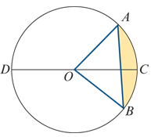
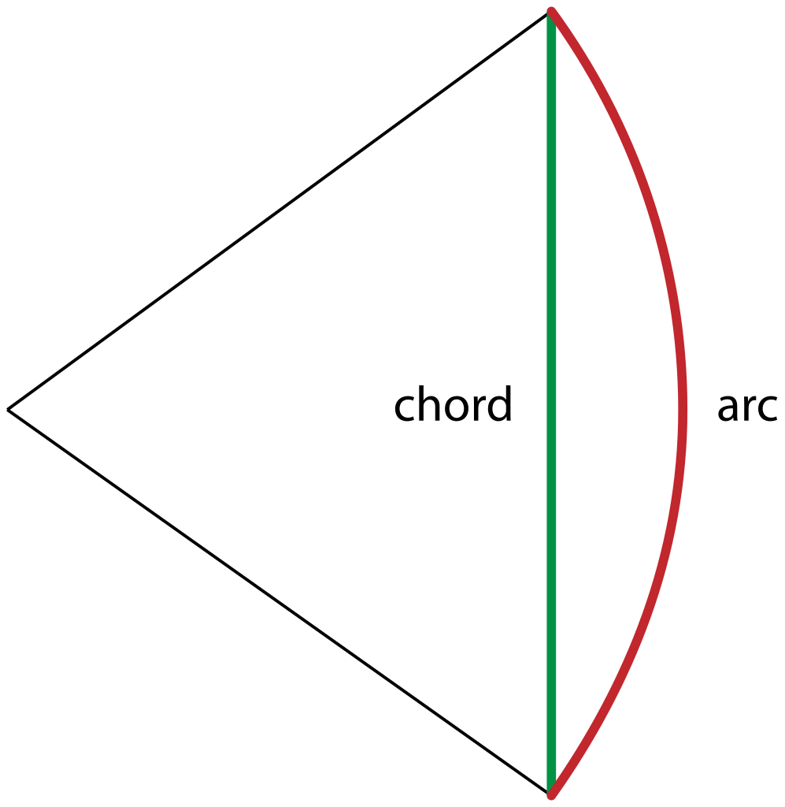
Terminology
In the diagram, the circle has centre O.
Chords A chord of a circle is a line segment with endpoints on the circle; e.g. line segment AB in the diagram. A chord passing through the centre of the circle is called a diameter; e.g. line segment CD in the diagram.
Arcs Any two points on a circle divide the circle into arcs. The shorter arc is called the minor arc and the longer is the major arc. In the diagram, arc ACB is a minor arc and arc ADB is a major arc. The arcs DAC and DBC are called semicircular arcs.

Slide 3
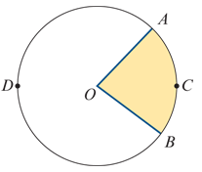
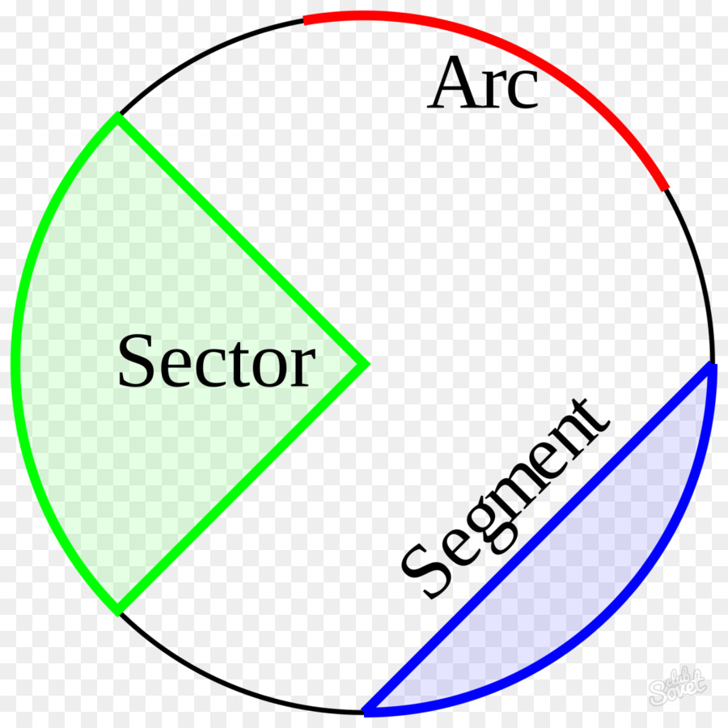
Terminology
Segments Every chord divides the interior of a circle into two regions called segments. The smaller is called the minor segment and the larger is the major segment. In the above diagram, the minor segment has been shaded.
Sectors Two radii and an arc define a region called a sector. In this diagram, with circle centre O, the shaded region is a minor sector and the unshaded region is a major sector.

Slide 4
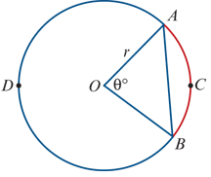
Arc length
The circle in the diagram has centre O and radius r. The arc ACB and the corresponding chord AB are said to subtend the angle ∠AOB at the centre of the circle.
The magnitude θ° of angle ∠AOB is a fraction of 360°. The length ℓ of arc ACB will be the same fraction of the circumference of the circle, 2πr.
Length of an arc using degrees
ℓ= $\frac{θ}{360}$×2πr= $\frac{πrθ}{180}$(where θ is measured in degrees)

Slide 5
Arc length
Radian measure of angles is introduced in Mathematical Methods Units 1 & 2.
We recall that, in the unit circle, an arc of length θ units subtends an angle of θ radians at the centre. A circle of radius r is similar to the unit circle, with similarity factor r, and therefore an arc of length rθ units subtends an angle of θ radians at the centre.
Length of an arc using radians
ℓ=rθ(where θ is measured in radians)
Note:As there are 2π radians in a circle, the arc length is ℓ= $\frac{θ}{2π}$×2πr=rθ.

Slide 6
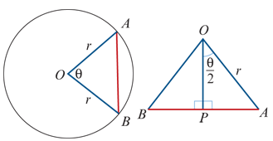
Chord length
In triangle OAP:
AP=rsin($\frac{θ}{2}$)
∴ AB=2rsin($\frac{θ}{2}$)

Slide 7
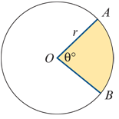
Area of a sector
The magnitude θ° of angle ∠AOB is a fraction of 360°. The area of the sector will be the same fraction of the area of the circle, πr2.
Using degrees: Area of sector= $\frac{πr^{2}θ}{360}$
Using radians: Area of sector= $\frac{1}{2} r^{2}$θ

Slide 8
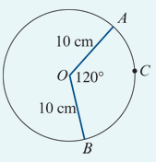
Example
The circle shown has centre O and radius length 10 cm. The angle subtended at O by arc ACB has magnitude 120°. Find:
1. the exact length of the chord AB
2. the exact length of the arc ACB
Solution
1. Chord length=2rsin($\frac{θ}{2}$)=20sin60° since r=10 and θ=120°
=20× $\frac{\sqrt{3}}{2}$ =10$\sqrt{3}$
Length of chord is 10$\sqrt{3}$ cm.
2. Arc length ℓ=rθ using radians
=10× $\frac{2π}{3}$ since r=10 and θ= $\frac{2π}{3}$
= $\frac{20π}{3}$
Length of arc is $\frac{20π}{3}$ cm.
Check:
Verify that length of arc is greater than length of chord.

Slide 9
Example
The circle shown has centre O and radius length 10 cm. The angle subtended at O by arc ACB has magnitude 120°. Find:
3. the exact area of the minor sector AOB
4. the magnitude of angle AOC, in degrees, if the minor arc AC has length 4 cm.
Solution
Area of sector= $\frac{1}{2}r^{2}$θ using radians
= $\frac{1}{2}$× ${10}^{2}$× $\frac{2π}{3}$ since r=10 and θ=2π3
= $\frac{100π}{3}$ Area of minor sector AOB is $\frac{100π}{3}$ ${cm}^{2}$.
Using radians: ℓ =rθ → 4 =10θ → ∴θ = $\frac{4}{10}$
Convert to degrees: ∠AOC=0.4× $\frac{180}{π}$=(22.9183…)°=22.92°(correct to two decimal places)

Slide 10
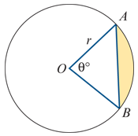
Area of a segment
The area of the shaded segment is found by subtracting the area of △AOB from the area of the minor sector OAB.
Using degrees: Area of segment= $\frac{πr^{2}θ}{360}$− $\frac{1}{2}r^{2}$sinθ
Using radians: Area of segment= $\frac{1}{2}r^{2}$θ− $\frac{1}{2}r^{2}$sinθ

Slide 11
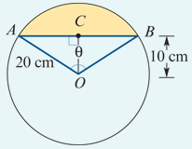
Example
A circle, with centre O and radius length 20 cm, has a chord AB that is 10cm from the centre of the circle. Calculate the area of the minor segment formed by this chord.
Solution
The area of the segment is $\frac{1}{2}r^{2}$(θ−sinθ). We know r=20, but we need to find θ.
In △OCB: cos($\frac{θ}{2}$) = $\frac{10}{20}$ → $\frac{θ}{2}$ = $\frac{π}{3}$ → ∴ θ = $\frac{2π}{3}$
Area of segment = $\frac{1}{2}$× ${20}^{2}$($\frac{2π}{3}$ −sin($\frac{2π}{3}$ ))=200($\frac{2π}{3}$ − $\frac{\sqrt{3}}{3}$ )=200($\frac{4π−3\sqrt{3}}{6}$ )= $\frac{100(4π−3\sqrt{3})}{3}$ ${cm}^{2}$

Slide 12
Section summary
Circle mensuration formulas with θ in radians
Arc length=rθ
Chord length=2rsin($\frac{θ}{2}$)
Area of sector= $\frac{1}{2}r^{2}$θ
Area of segment= $\frac{1}{2}r^{2}$(θ−sinθ)
Circle mensuration formulas with θ in degrees
Arc length= $\frac{\text{π}\text{r}θ}{180}$
Chord length=2rsin($\frac{θ}{2}$)
Area of sector= $\frac{πr^{2}θ}{360}$
Area of segment= $\frac{πr^{2}θ}{360}$− $\frac{1}{2}r^{2}$sinθ

