Slide 1
Angles of elevation, angles of depression and bearings
13F

Slide 2
Notes:
https://www.transum.org/Software/SW/Starter_of_the_day/starter_January26.ASP

Slide 3
Notes:
https://www.transum.org/Software/MathsMenu/Starter.asp?ID_Starter=78

Slide 4
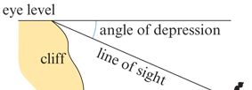
The angle of elevation & depression
The angle of elevation is the angle between the horizontal and a direction above the horizontal.
The angle of depression is the angle between the horizontal and a direction below the horizontal.

Slide 5
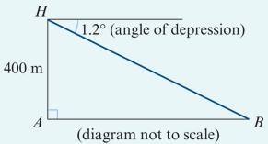
Example
The pilot of a helicopter flying at 400 m observes a small boat at an angle of depression of 1.2°. Calculate the horizontal distance of the boat to the helicopter.
Solution
$\frac{AH}{AB}$ =tan1.2° → $\frac{400}{AB}$ =tan1.2°
∴ AB = $\frac{400}{tan1.2°}$ =19095.800…
The horizontal distance is 19100 m, correct to the nearest 10 m.

Slide 6
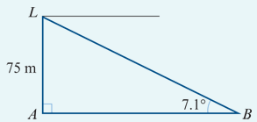
Example
The light on a cliff-top lighthouse, known to be 75 m above sea level, is observed from a boat at an angle of elevation of 7.1°. Calculate the distance of the boat from the lighthouse.
Solution
$\frac{75}{AB}$ =tan7.1°
∴AB = $\frac{75}{tan7.1°}$ =602.135…
The distance of the boat from the lighthouse is 602 m, correct to the nearest metre.

Slide 7
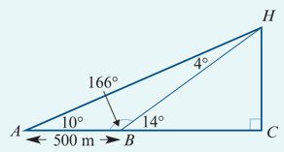
Example
From the point A, a man observes that the angle of elevation of the summit of a hill is 10°. He then walks towards the hill for 500 m along flat ground. The summit of the hill is now at an angle of elevation of 14°. Find the height of the hill above the level of A.
Magnitude of ∠HBA=(180−14)°=166°
Magnitude of ∠AHB=(180−(166+10))°=4°
Using the sine rule in triangle ABH:
$\frac{500}{sin4°}$= $\frac{HB}{sin10°}$
∴HB = $\frac{500sin10°}{sin4°}$=1244.67…
In triangle BCH: $\frac{HC}{HB}$ =sin14°
∴HC =HBsin14°=301.11…
The height of the hill is 301 m, correct to the nearest metre.

Slide 8
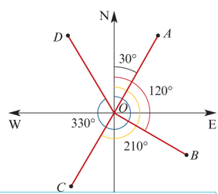
Bearings
The bearing (or compass bearing) is the direction measured from north clockwise.
For example:
The bearing of A from O is 030°.
The bearing of B from O is 120°.
The bearing of C from O is 210°.
The bearing of D from O is 330°.

Slide 9
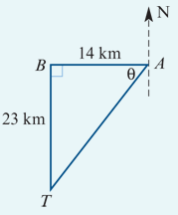
Example
The road from town A runs due west for 14 km to town B. A television mast is located due south of B at a distance of 23 km. Calculate the distance and bearing of the mast from the centre of town A.
tanθ = $\frac{23}{14}$ → ∴θ =58.67°(to two decimal places)
Thus the bearing is
180°+(90−58.67)°=211.33°
To find the distance, use Pythagoras’ theorem:
$AT^{2}$ = $AB^{2}$+ $BT^{2}$ = ${14}^{2}$+ ${23}^{2}$ =725
∴ AT =26.925…
The mast is 27 km from the centre of town A (to the nearest kilometre) and on a bearing of 211.33°.

Slide 10
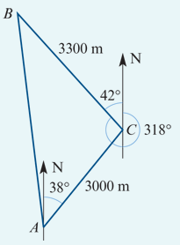
Example
A yacht starts from a point A and sails on a bearing of 038° for 3000 m. It then alters its course to a bearing of 318° and after sailing for a further 3300 m reaches a point B. Find:
1. the distance AB
The magnitude of angle ACB needs to be found so that the cosine rule can be applied in triangle ABC:
∠ACB =(180−(38+42))°= 100°
In triangle ABC: $AB^{2}$ = ${3000}^{2}$+ ${3300}^{2}$−2×3000×3300cos100° =23 328 233.917…
∴AB =4829.931…
The distance of B from A is 4830 m (to the nearest metre).

Slide 11
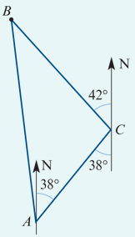
Example
A yacht starts from a point A and sails on a bearing of 038° for 3000 m. It then alters its course to a bearing of 318° and after sailing for a further 3300 m reaches a point B. Find:
2. the bearing of B from A.
To find the bearing of B from A, the magnitude of angle BAC must first be found. Using the sine rule:
$\frac{3300}{sinA}$= $\frac{AB}{sin100°}$ → ∴sinA = $\frac{3300sin100°}{AB}$=0.6728…
∴ A =(42.288…)°
The bearing of B from A =360°−(42.29°−38°)=355.71°
The bearing of B from A is 356° to the nearest degree.

