Slide 1
Problems in three dimensions
13G

Slide 2
Notes:
https://www.transum.org/software/SW/Starter_of_the_day/Students/Pairs.asp?Topic=9

Slide 3
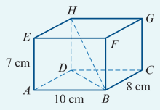
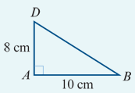
Example 1
ABCDEFGH is a cuboid. Find:
the distance DB
Solution
$DB^{2}$= $8^{2}$+ ${10}^{2}$=164
∴ DB =$\sqrt{164}$ =12.81 cm(correct to two decimal places)

Slide 4
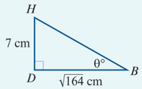
Example 1
ABCDEFGH is a cuboid. Find:
the distance HB
Solution
$HB^{2}$ = ${HD}^{2}$+ $DB^{2}$=72+164=213
∴ HB = $\sqrt{213}$=14.59 cm(correct to two decimal places)

Slide 5
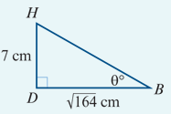
Example 1
ABCDEFGH is a cuboid. Find:
the magnitude of angle HBD
Solution
Tanθ =$\frac{HD}{BD}$= $\frac{7}{\sqrt{164}}$
∴ θ =28.66°(correct to two decimal places)

Slide 6
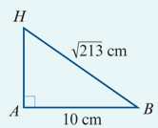
Example 1
ABCDEFGH is a cuboid. Find:
the magnitude of angle HBA.
Solution
From triangle HBA:
cosB = $\frac{10}{\sqrt{213}}$
∴B =46.75°(correct to two decimal places)

Slide 7
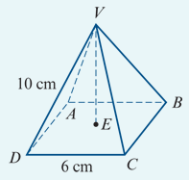
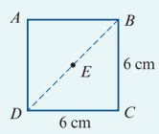
Example 2
The figure shows a pyramid with a square base. The base has sides 6 cm long and the edges VA, VB, VC and VD are each 10 cm long.
Find the length of DB.
Find the length of BE.
Solution
$DB^{2}$ = $6^{2}$+ $6^{2}$=72
∴ DB =6$\sqrt{2}$=8.4852…
The length of DB is 8.49 cm, correct to two decimal places.
BE=$\frac{1}{2}$DB=3$\sqrt{2}$=4.2426…
The length of BE is 4.24 cm, correct to two decimal places.

Slide 8
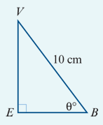
Example 2
The figure shows a pyramid with a square base. The base has sides 6 cm long and the edges VA, VB, VC and VD are each 10 cm long.
Find the length of VE.
Find the magnitude of angle VBE.
Solution
${VE}^{2}$ = ${VB}^{2}$ − ${BE}^{2}$ = ${10}^{2}$− ${(3\sqrt{2})}^{2}$=100−18=82
∴ VE = $\sqrt{82}$=9.0553…
The length of VE is 9.06 cm, correct to two decimal places.
Sinθ = $\frac{VE}{VB}$= $\frac{\sqrt{82}}{10}$=0.9055…
∴ θ =(64.8959…)°
The magnitude of ∠VBE is 64.90°, correct to two decimal places.

Slide 9
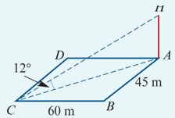
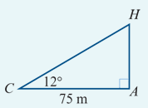
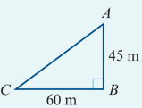
Example 3
A communications mast is erected at corner A of a rectangular courtyard ABCD with side lengths 60 m and 45 m as shown. If the angle of elevation of the top of the mast from C is 12°, find:
the height of the mast
Solution
${AC}^{2}$ = ${45}^{2}$ + ${60}^{2}$ =5625
∴AC =75
$\frac{HA}{75}$ =tan12°
∴HA =75tan12°=15.941…
The height of the mast is 15.94 m, correct to two decimal places.

Slide 10
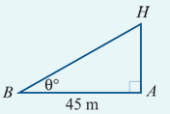
Example 3
A communications mast is erected at corner A of a rectangular courtyard ABCD with side lengths 60 m and 45 m as shown. If the angle of elevation of the top of the mast from C is 12°, find:
the angle of elevation of the top of the mast from B.
Solution
Tanθ = $\frac{HA}{45}$=0.3542…
∴ θ =(19.507…)°
The angle of elevation of the top of the mast, H, from B is 19.51°, correct to two decimal places.

