Slide 1
Angles between planes and more difficult 3D problems
13H

Slide 2
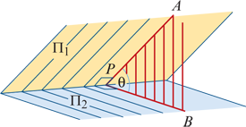
Angles between planes
Consider any point P on the common line of two planes Π1 and Π2. If lines PA and PB are drawn at right angles to the common line so that PA is in Π1 and PB is in Π2, then ∠APB is the angle between planes Π1 and Π2.

Slide 3
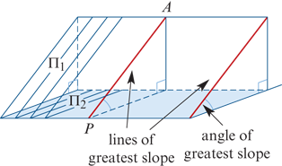
Angles between planes
Note: If the plane Π2 is horizontal, then PA is called a line of greatest slope in the plane Π1.

Slide 4
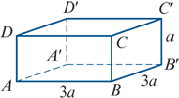
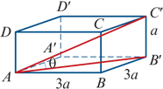
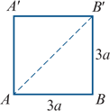
Example 1
For the cuboid shown in the diagram, find:
the angle between AC′ and the plane ABB′A′
To find the angle θ between AC′ and the plane ABB′A′, we need the projection of AC′ in the plane.
We drop a perpendicular from C′ to the plane (line C′B′), and join the foot of the perpendicular to A (line B′A).
The required angle, θ, lies between C′A and B′A.
Draw separate diagrams showing the base and the section through A, C′ and B′. Then we see that
AB′ =$\sqrt{{(3a)}^{2}+(3a^{)2}}$=3a $\sqrt{2}$
And tanθ =$\frac{a}{3a\sqrt{2}}$= $\frac{1}{3\sqrt{2}}$
Hence the required angle, θ, is 13.26°.

Slide 5
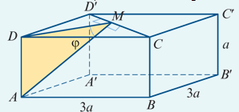
Example 1
For the cuboid shown in the diagram, find:
the angle between the planes ACD′ and DCD′.
The line common to the planes ACD′ and DCD′ is CD′. Let M be the midpoint of the line segment CD′.
Then MD is perpendicular to CD′ in the plane DCD′, and MA is perpendicular to CD′ in the plane ACD′.
Thus ϕ is the angle between the planes DCD′ and ACD′. We have
DM= $\frac{1}{2}$DC′= $\frac{1}{2}$(3a$\sqrt{2}$)
∴ tanϕ= =a÷($\frac{\text{3}\text{a}\sqrt{2}}{2}$)= $\frac{\sqrt{2}}{3}$
Hence the required angle is ϕ=25.24°.

Slide 6
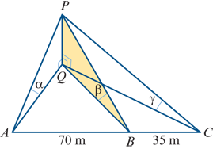
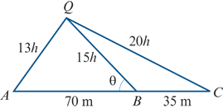
Example 2
Three points A, B and C are on a horizontal line such that AB=70 m and BC=35 m. The angles of elevation of the top of a tower are α, β and γ, where tanα= $\frac{1}{13}$,tanβ= $\frac{1}{15}$,tanγ= $\frac{1}{20}$ as shown in the diagram.
The base of the tower is at the same level as A, B and C. Find the height of the tower.
Let the height of the tower, PQ, be h m. Then h=QAtanα=QBtanβ=QCtanγ
which implies that QA=13h,QB=15h,QC=20h
Now consider the base triangle ACQ.
Using the cosine rule in △AQB: cosθ= $\frac{{(70)}^{2}+{(15h)}^{2}−{(13h)}^{2}}{2(70)(15h) }$
Using the cosine rule in △CQB: −cosθ=cos(180−θ)= $\frac{{(35)}^{2}+{(15h)}^{2}−{(20h)}^{2}}{2(35)(15h) }$
Hence $\frac{{(70)}^{2}+{(15h)}^{2}−{(13h)}^{2}}{2(70)(15h) }$ = $\frac{{(20h)}^{2}−{(30)}^{2}−{(15h)}^{2}}{2(35)(15h) }$
4900+ ${56h}^{2}$=2(175$h^{2}$−1225) → 7350 =294$h^{2}$
∴h= 5 The height of the tower is 5 m.

Slide 7
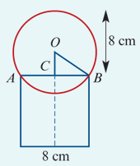
Example 3
A sphere rests on the top of a vertical cylinder which is open at the top. The inside diameter of the cylinder is 8 cm. The sphere projects 8 cm above the top of the cylinder. Find the radius length of the sphere.
This 3D problem can be represented by a 2D diagram without loss of information.
Let the radius length of the sphere be r cm. Then, in △OBC, we have
OC=(8−r) cm, BC=4 cm, OB=r cm
Using Pythagoras’ theorem:
${(8−r)}^{2}$ + $4^{2}$ = $r^{2}$
64−16r+ $r^{2}$ +16 = $r^{2}$
−16r+80 =0
∴r =5
The radius length of the sphere is 5 cm.

Slide 8
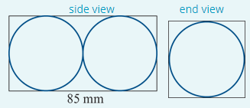
Example 4
A box contains two standard golf balls that fit snugly inside. The box is 85 mm long. What percentage of the space inside the box is air?
Two 2D diagrams may be used to represent the 3D situation.
Let r mm be the radius length of a golf ball.
Length of box =85 mm=4r mm
Thus r= $\frac{85}{4}$, i.e. r=21.25
So the box has dimensions 85 mm by 42.5 mm by 42.5 mm.
Now
volume of box= ${42.5}^{2}$×85 using V=Ah
volume of two golf balls=2× $\frac{4}{3}$× π × ${21.25}^{3}\text{=}\frac{8}{3}\text{π}\text{×}{21.25}^{3}$ using V= $\frac{4}{3}$π $r^{3}$
Hence percentage air= $\frac{100({42.5}^{2}×85−\frac{8}{3}\text{π}\text{×}{21.25}^{3})}{{42.5}^{2}×85}$=47.6% to one decimal place

