Slide 1
Trigonometric ratios and applications
Chapter 13

Slide 2
Notes:
https://www.transum.org/Software/MathsMenu/Starter.asp?ID_Starter=108

Slide 3
Notes:
https://www.transum.org/Software/MathsMenu/Starter.asp?ID_Starter=122

Slide 4
Triangles Labelling triangle
Interior angles are denoted by uppercase letters.
The length of the side opposite an angle is denoted by the corresponding lowercase letter.
For example, the magnitude of angle BAC is denoted by A, and the length of side BC by a.

Slide 5
Sine rule
For triangle ABC:
$\frac{a}{ sinA}$ = $\frac{b}{ sinB}$ = $\frac{c}{ sinC}$
The sine rule is used to find unknown quantities in a triangle in the following cases:
one side and two angles are given
two sides and a non-included angle are given.
In the first case, the triangle is uniquely defined. But in the second case, there may be two triangles.

Slide 6
Cosine rule
For triangle ABC:
$a^{2}$ = $b^{2}$+ $c^{2}$−2bccosA
cosA =$\frac{b^{2}+c^{2}−a^{2}}{2bc}$
The symmetrical results also hold:
$b^{2}$ = $a^{2}$+ $c^{2}$−2accosB
$c^{2}$= $a^{2}$+ $b^{2}$−2abcosC
The cosine rule is used to find unknown quantities in a triangle in the following cases:
two sides and the included angle are given
three sides are given.

Slide 7
Area of a triangle
Area =$\frac{1}{2}$bh
Area = $\frac{1}{2}$bcsinA
That is, the area of a triangle is half the product of the lengths of two sides and the sine of the angle included between them.

Slide 8
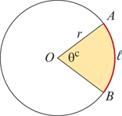
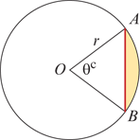
Circles
Length of minor arc AB (red curve) is given by
ℓ=rθ
Area of sector AOB (shaded) is given by
Area= $\frac{1}{2}r^{2}$θ
Length of chord AB (red line) is given by
ℓ=2rsin($\frac{θ}{2}$)
Area of segment (shaded) is given by
Area= $\frac{1}{2}$ $r^{2}$(θ−sinθ)

Slide 9
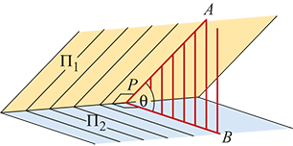
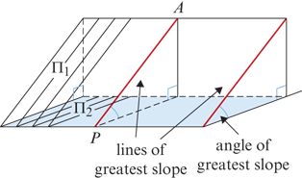
Angle between planes
Consider any point P on the common line of two planes ${\text{Π}}_{1}$ and ${\text{Π}}_{2}$ . If lines PA and PB are drawn at right angles to the common line so that PA is in ${\text{Π}}_{1}$ and PB is in ${\text{Π}}_{2}$ , then ∠APB is the angle between ${\text{Π}}_{1}$ and ${\text{Π}}_{2}$ .
If plane ${\text{Π}}_{2}$ is horizontal, then PA is called a line of greatest slope in plane ${\text{Π}}_{1}$ .

