Slide 1
Argand diagrams
16C

Slide 2
Notes:
https://www.transum.org/Software/SW/Starter_of_the_day/starter_October1.ASP

Slide 3
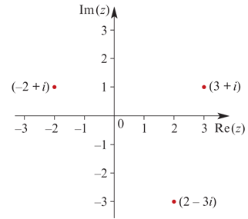
An Argand diagram
An Argand diagram is a geometric representation of the set of complex numbers. A complex number has two dimensions: the real part and the imaginary part. Therefore a plane is required to represent C.
An Argand diagram is drawn with two perpendicular axes. The horizontal axis represents Re(z), for z∈C, and the vertical axis represents Im(z), for z∈C.
Each point on an Argand diagram represents a complex number. The complex number a+bi is situated at the point (a,b) on the equivalent Cartesian axes, as shown by the examples in this figure.
A complex number written as a+bi is said to be in Cartesian form.

Slide 4
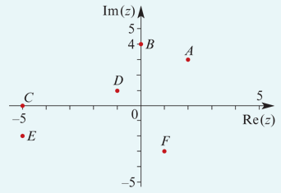
Example
Write down the complex number represented by each of the points shown on this Argand diagram.
A. 2+3i
B. 4i
C. −5
D. −1+i
E. −5−2i
F. 1−3i

Slide 5
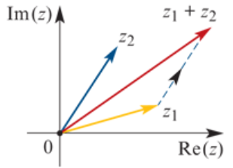
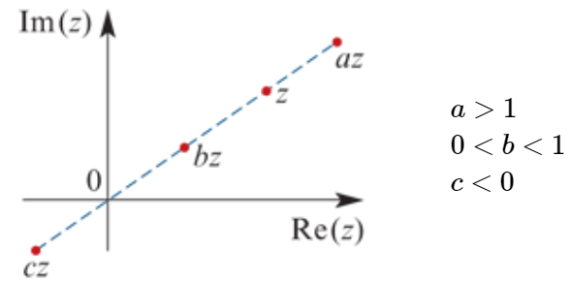
Geometric representation of the basic operations on complex numbers
In an Argand diagram, the sum of two complex numbers $z_{1}$ and $z_{2}$ can be found geometrically by placing the ‘tail’ of $z_{2}$ on the ‘tip’ of $z_{1}.$
When a complex number is multiplied by a real constant, it maintains the same ‘direction’, but its distance from the origin is scaled.
The difference $z_{1}$ − $z_{2}$ is represented by the sum $z_{1}$ +(− $z_{2}$ ).

Slide 6
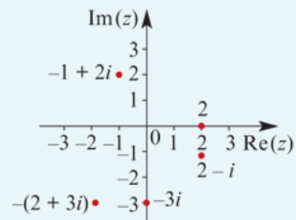
Example
Represent the following complex numbers as points on an Argand diagram:
2
−3i
2−i
−(2+3i)
−1+2i

Slide 7
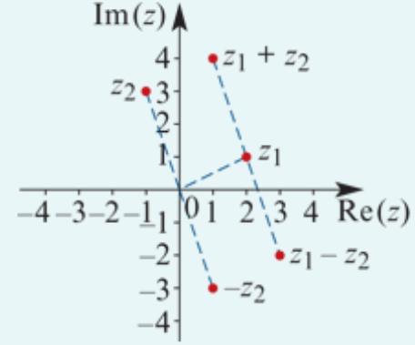
Example
Let $z_{1}$=2+i and $z_{2}$=−1+3i.
Represent the complex numbers $z_{1}$, $z_{2}$, $z_{1}$+ $z_{2}$ and $z_{1}$− $z_{2}$ on an Argand diagram and show the geometric interpretation of the sum and difference.
$z_{1}$+ $z_{2}$ =(2+i)+(−1+3i)=1+4i
$z_{1}$− $z_{2}$ =(2+i)−(−1+3i)=3−2i

Slide 8
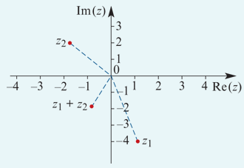
Example
Let $z_{1}$=1−4i and $z_{2}$=−2+2i. Find $z_{1}$+ $z_{2}$ algebraically and illustrate $z_{1}$+ $z_{2}$ on an Argand diagram.
Solution
$z_{1}$+ $z_{2}$=(1−4i)+(−2+2i)=−1−2i

Slide 9
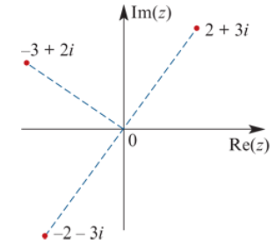
Rotation about the origin
When the complex number 2+3i is multiplied by −1, the result is −2−3i. This is achieved through a rotation of 180° about the origin.
When the complex number 2+3i is multiplied by i, we obtain
i(2+3i)=2i+3i2=2i−3=−3+2i
The result is achieved through a rotation of 90° anticlockwise about the origin.
If −3+2i is multiplied by i, the result is −2−3i. This is again achieved through a rotation of 90° anticlockwise about the origin.

Slide 10
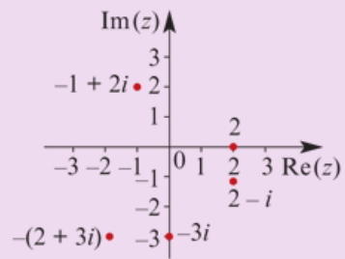
Section summary
An Argand diagram is a geometric representation of the set of complex numbers.
The horizontal axis represents Re(z) and the vertical axis represents Im(z), for z∈C.
The operations of addition, subtraction and multiplication by a real constant all have geometric interpretations on an Argand diagram.
Multiplication of a complex number by i corresponds to a rotation of 90° anticlockwise about the origin.
https://kahoot.it/challenge/04234830?challenge-id=866b7e2c-3a48-4847-852c-88711d5afe08_1633469255125

