Slide 1
Polar form of a complex number
16E

Slide 2
Cartesian → Polar Coordinates
Until now, we have described each point in the plane by a pair of numbers (x,y). These are called Cartesian coordinates, and take their name from the French intellectual René Descartes (1596–1650) who introduced them. However, they are not the only way to describe points in the plane. In fact, for many situations it is more convenient to use polar coordinates.

Slide 3
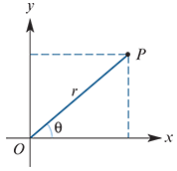
Polar coordinates
Using polar coordinates, every point P in the plane is described by a pair of numbers (r,θ).
The number r is the distance from the origin O to P.
The number θ measures the angle between the positive direction of the x-axis and the ray OP, as shown.

Slide 4
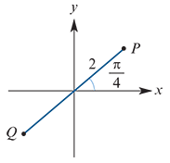
Polar coordinates
For example, the diagram on the right shows the point P with polar coordinates (2,$\frac{π}{4}$).
We can even make sense of polar coordinates such as Q(−2, $\frac{π}{4}$):
go to the direction $\frac{π}{4}$and then move a distance of 2 in the opposite direction.
Converting between the two coordinate systems requires little more than basic trigonometry.

Slide 5
Cartesian ←→ Polar Coordinates Converting
If a point P has polar coordinates (r,θ), then its Cartesian coordinates (x,y) satisfy
x=rcosθ and y=rsinθ
If a point P has Cartesian coordinates (x,y), then its polar coordinates (r,θ) satisfy
$r^{2}$= $x^{2}$+ $y^{2}$ and tanθ=$\frac{y}{x}$ (if x≠0)

Slide 6
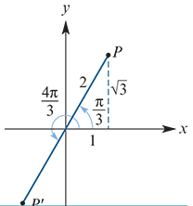
Non-uniqueness of polar coordinates
Polar coordinates differ from Cartesian coordinates in that each point in the plane has more than one representation in polar coordinates.
For example, the following polar coordinates all represent the same point:
(2, $\frac{π}{3}$),(−2, $\frac{4π}{3}$)and(2, $\frac{7π}{3}$)
The point P(r,θ) can be described in infinitely many ways:
(r, θ+2nπ) and (−r, θ+(2n+1)π) for all n∈Z

Slide 7
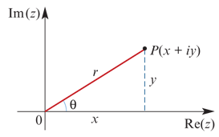
Polar form of the complex numbers
The diagram shows the point P corresponding to the complex number z=x+yi. We see that x=rcosθ and y=rsinθ, and so we can write
z=x+yi=rcosθ+(rsinθ)i=r(cosθ+isinθ)
This is called the polar form of the complex number. The polar form is abbreviated to
z=r cis θ

Slide 8
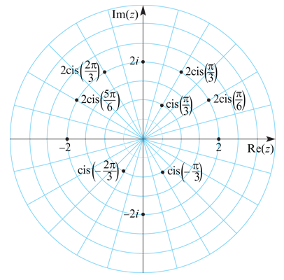
Polar form of the complex numbers
The distance r=$\sqrt{x^{2}+y^{2}}$ is called the modulus of z and is denoted by |z|.
The angle θ, measured anticlockwise from the horizontal axis, is called the argument of z.
Polar form for complex numbers is also called modulus–argument form.
This Argand diagram uses a polar grid with rays at intervals of $\frac{π}{12}$=15°.

Slide 9
Non-uniqueness of polar form
Each complex number has more than one representation in polar form.
Since cosθ=cos(θ+2nπ) and sinθ=sin(θ+2nπ), for all n∈Z, we can write
z=rcis θ=rcis (θ+2nπ)for all n∈Z
The convention is to use the angle θ such that −π<θ≤π. This value of θ is called the principal value of the argument of z and is denoted by Arg z. That is,
−π<Arg z≤π

Slide 10
Example
Express each of the following complex numbers in polar form:
z=1+$\sqrt{3}$i
We have x=1 and y= $\sqrt{3}$, giving
r=$\sqrt{x^{2}+y^{2}}$= $\sqrt{1+3}$=2
The point z=1+ $\sqrt{3}$i is in the 1st quadrant, and so 0<θ< $\frac{π}{2}$.
Cosθ = $\frac{x}{r}$ = $\frac{1}{2}$ And Sinθ = $\frac{y}{r}$ = $\frac{\sqrt{3}}{2}$
Hence θ= $\frac{π}{3}$ and therefore
z=1+$\sqrt{3}$i=2cis ($\frac{π}{3}$)
Express each of the following complex numbers in polar form:
z=2−2i
We have x=2 and y=−2, giving
r=$\sqrt{x^{2}+y^{2}}$= $\sqrt{4+4}$=2$\sqrt{2}$
The point z=2−2i is in the 4th quadrant, and so − $\frac{π}{2}$<θ<0.
Cosθ = $\frac{x}{r}$ = $\frac{1}{\sqrt{2}}$ And Sinθ = $\frac{y}{r}$ = – $\frac{1}{\sqrt{2}}$
Hence θ=− $\frac{π}{4}$ and therefore
z=2−2i=2 $\sqrt{2}$cis (− $\frac{π}{4}$ )

Slide 11
Example
Express z=2cis (− $\frac{2π}{3}$ ) in Cartesian form.
Solution
x=rcosθ=2cos(− $\frac{2π}{3}$ )=2×(− $\frac{1}{2}$ )=−1
y=rsinθ=2sin(− $\frac{2π}{3}$ )=2×(− $\frac{\sqrt{3}}{2}$ )=− $\sqrt{3}$
Hence z=2cis (− $\frac{2π}{3}$ )=−1− $\sqrt{3}$i.

Slide 12
Multiplication and division in polar form
We can give a simple geometric interpretation of multiplication and division of complex numbers in polar form.
If $z_{1}$= $r_{1}$cis $θ_{1}$ and $z_{2}$= $r_{2}$cis $θ_{2}$, then
$z_{1}z_{2}$= $r_{1}r_{2}$cis ($θ_{1}$ + $θ_{2}$) (multiply the moduli and add the angles)
$\frac{z_{1}}{z_{2}}$ = $\frac{r_{1}}{r_{2}}$ cis ($θ_{1}$ − $θ_{2}$) (divide the moduli and subtract the angles)
These two results can be proved using the addition formulas for sine and cosine established in Chapter 14.

Slide 13
Addition formulas
Addition formulas for sine
sin(u+v)=sinucosv+cosusinv
sin(u−v)=sinucosv−cosusinv
Addition formulas for cosine
cos(u+v)=cosucosv−sinusinv
cos(u−v)=cosucosv+sinusinv

Slide 14
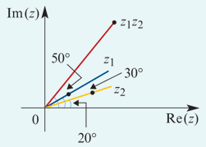
Example
Let $z_{1}$=2cis 30° and $z_{2}$=4cis 20°. Find the product $z_{1} z_{2}$ and represent it on an Argand diagram.
Solution
$z_{1} z_{2}$= $r_{1} r_{2}$cis ($θ_{1}$ + $θ_{2}$ )
=2×4cis (30°+20°)=8cis 50°

Slide 15
Example
Let $z_{1}$=3cis ($\frac{\text{π}}{2}$) and $z_{2}$=2cis ($\frac{\text{5}\text{π}}{6}$). Find the product $z_{1} z_{2}$.
Solution
$z_{1} z_{2}$= $r_{1} r_{2}$cis ($θ_{1}$ + $θ_{2}$ )=6cis ($\frac{\text{π}}{2}$+ $\frac{\text{5}\text{π}}{6}$)=6cis ($\frac{\text{4}\text{π}}{3}$)
∴ $z_{1} z_{2}$ =6cis (− $\frac{\text{2}\text{π}}{3}$) since −π<Arg z≤π

Slide 16
Example
If $z_{1}$=−$\sqrt{3}$+i and $z_{2}$=2 $\sqrt{3}$+2i, find the quotient $\frac{z_{1}}{z_{2}}$and express in Cartesian form.
First express $z_{1}$ and $z_{1}$ in polar form:
| $z_{1}$|= $\sqrt{3+1}$=2
Let $θ_{1}$ =Arg $z_{1}$. Then cos $θ_{1}$ =− $\frac{\sqrt{3}}{2}$ and sin $θ_{1}$ = $\frac{1}{2}$, giving $θ_{1}$ =$\frac{5π}{6}$.
| $z_{2}$|= $\sqrt{12+4}$=4
Let $θ_{2}$ =Arg $z_{2}$. Then cos $θ_{2}$ = $\frac{\sqrt{3}}{2}$ and sin $θ_{2}$ = $\frac{1}{2}$, giving $θ_{2}$ = $\frac{π}{6}$.
Hence $z_{1}$=2cis ($\frac{5π}{6}$) and $z_{2}$=4cis ($\frac{π}{6}$). Therefore
$\frac{z_{1}}{z_{2}}$ = $\frac{r_{1}}{r_{2}}$ cis ($θ_{1}$ − $θ_{2}$) = $\frac{2}{4}$cis ($\frac{5π}{6}$− $\frac{π}{6}$)= $\frac{1}{2}$cis ($\frac{2π}{3}$)
In Cartesian form:
$\frac{z_{1}}{z_{2}}$= $\frac{1}{2}$cos($\frac{2π}{3}$)+ $\frac{1}{2}$sin($\frac{2π}{3}$)i = $\frac{1}{2}$(− $\frac{1}{2}$)+ $\frac{1}{2}$($\frac{\sqrt{3}}{2}$)i = − $\frac{1}{4}$(1− $\sqrt{3}$i)

Slide 17
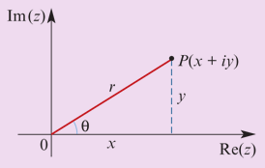
Section summary
Polar form
A complex number in Cartesian form
z=x+yi
can be written in polar form as
z=r(cosθ+isinθ)=rcis θ
The distance r= $\sqrt{x^{2}+y^{2}}$is called the modulus of z and is denoted by |z|.
The angle θ, measured anticlockwise from the horizontal axis, is called the argument of z.
The polar form of a complex number is not unique. The argument θ of z such that −π<θ≤π is called the principal value of the argument of z and is denoted by Arg z.
Multiplication and division in polar form
If $z_{1}$= $r_{1}$cis $θ_{1}$ and $z_{2}$= $r_{2}$cis $θ_{2}$, then
$z_{1}z_{2}$= $r_{1}r_{2}$cis ($θ_{1}$ + $θ_{2}$) and $\frac{z_{1}}{z_{2}}$ = $\frac{r_{1}}{r_{2}}$ cis ($θ_{1}$ − $θ_{2}$)

