Slide 1
Introduction to vectors
20A

Slide 2
vector quantity
Suppose that you are asked: ‘Where is your school in relation to your house?’
It is not enough to give an answer such as ‘four kilometres’. You need to specify a direction as well as a distance. You could give the answer ‘four kilometres north-east’.
Position is an example of a vector quantity.

Slide 3
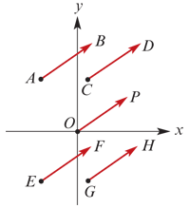
Directed line segments
A quantity that has a direction as well as a magnitude can be represented by an arrow:
the arrow points in the direction of the action
the length of the arrow gives the magnitude of the quantity in terms of a suitably chosen unit.
Arrows with the same length and direction are regarded as equivalent. These arrows are directed line segments and the sets of equivalent segments are called vectors.
The five directed line segments shown all have the same length and direction, and so they are equivalent.
A directed line segment from a point A to a point B is denoted by $\vec{AB}$.
For simplicity of language, this is also called vector $\vec{AB}$. That is, the set of equivalent segments can be named through one member of the set.
Note: The five directed line segments in the diagram all name the same vector: $\vec{AB}$= $\vec{CD}$= $\vec{OP}$= $\vec{EF}$= $\vec{GH}$.

Slide 4
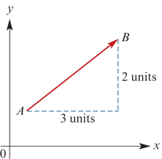
Column vectors
Vectors in the context of translations of the plane can be used. We represented each translation by a column of numbers, which was called a vector.
This is consistent with the approach here, as the column of numbers corresponds to a set of equivalent directed line segments.
For example, the column $\left[\begin{matrix}3 \\ 2\end{matrix}\right]$ corresponds to the directed line segments which go 3 across and 2 up.

Slide 5
Vector notation
A vector is often denoted by a single bold lowercase letter. The vector from A to B can be denoted by $\vec{AB}$or by a single letter $v$.That is, $v$= $\vec{AB}$.
When a vector is handwritten, the notation is .

Slide 6
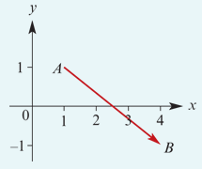
example
Draw a directed line segment corresponding to $\left[\begin{matrix}3 \\ −2\end{matrix}\right]$.
The vector $\left[\begin{matrix}3 \\ −2\end{matrix}\right]$ is ‘3across to the right and 2down’.
Note: Here the segment starts at (1,1) and goes to (4,−1). It can start at any point.

Slide 7
example
The vector u is defined by the directed line segment from (2,6) to (3,1).
If u= $\left[\begin{matrix}\begin{aligned}a \\ b\end{aligned} \\ \end{matrix}\right]$, find a and b.
The vector is
u= $\left[\begin{matrix}\begin{aligned}3−2 \\ 1−6\end{aligned} \\ \end{matrix}\right]$= $\left[\begin{matrix}\begin{aligned}1 \\ −5\end{aligned} \\ \end{matrix}\right]$
Hence a=1 and b=−5.

Slide 8
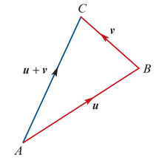
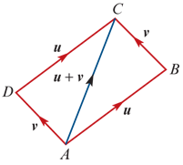
Addition of vectors Adding vectors geometrically
Two vectors u and v can be added geometrically by drawing a line segment representing u from A to B and then a line segment representing v from B to C.
The sum u+v is the vector from A to C. That is,
u+v= $\vec{AC}$
The same result is achieved if the order is reversed. This is represented in the diagram on the right:
u+v= $\vec{AC}$=v+u

Slide 9
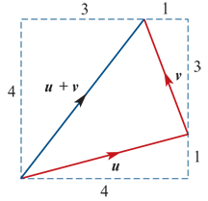
Addition of vectors Adding column vectors
Two vectors can be added using column-vector notation.
For example, if u= $\left[\begin{aligned}4 \\ 1\end{aligned}\right]$ and v= $\left[\begin{matrix}−1 \\ 3\end{matrix}\right]$, then
u+v= $\left[\begin{aligned}4 \\ 1\end{aligned}\right]$+ $\left[\begin{matrix}−1 \\ 3\end{matrix}\right]$= $\left[\begin{matrix}3 \\ 4\end{matrix}\right]$

Slide 10
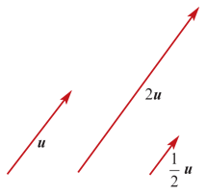
Scalar multiplication
Multiplication by a real number (scalar) changes the length of the vector. For example:
2u is twice the length of u
$\frac{1}{2}$u is half the length of u
We have 2u=u+u and $\frac{1}{2}$u+ $\frac{1}{2}$u=u.
In general, for k∈$R^{+}$, the vector ku has the same direction as u, but its length is multiplied by a factor of k.

Slide 11
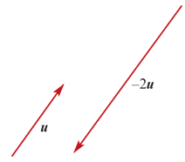
Scalar multiplication
When a vector is multiplied by −2, the vector’s direction is reversed and the length is doubled.
When a vector is multiplied by −1, the vector’s direction is reversed and the length remains the same.
If u= $\left[\begin{aligned}3 \\ 2\end{aligned}\right]$, then −u= $\left[\begin{aligned}−3 \\ −2\end{aligned}\right]$, 2u= $\left[\begin{aligned}6 \\ 4\end{aligned}\right]$ and −2u= $\left[\begin{aligned}−6 \\ −4\end{aligned}\right]$.
If u= $\vec{AB}$, then
−u=− $\vec{AB}$= $\vec{BA}$
The directed line segment − $\vec{AB}$ goes from B to A.

Slide 12
Zero vector Subtraction of vectors
Zero vector
The zero vector is denoted by 0 and represents a line segment of zero length. The zero vector has no direction.
Subtraction of vectors
To find u−v, we add −v to u.

Slide 13
example
For the vectors u= $\left[\begin{aligned}3 \\ −1\end{aligned}\right]$ and v= $\left[\begin{aligned}−2 \\ 2\end{aligned}\right]$, find 2u+3v.
Solution
2u+3v=2 $\left[\begin{aligned}3 \\ −1\end{aligned}\right]$+3 $\left[\begin{aligned}−2 \\ 2\end{aligned}\right]$= $\left[\begin{aligned}6 \\ −2\end{aligned}\right]$+ $\left[\begin{aligned}−6 \\ 6\end{aligned}\right]$= $\left[\begin{aligned}0 \\ 4\end{aligned}\right]$

Slide 14
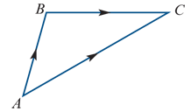
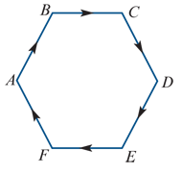
Polygons of vectors
For two vectors $\vec{AB}$and $\vec{BC}$, we have
$\vec{AB}$+ $\vec{BC}$= $\vec{AC}$
For a polygon ABCDEF, we have
$\vec{AB}$+ $\vec{BC}$+ $\vec{CD}$+ $\vec{DE}$+ $\vec{EF}$+ $\vec{FA}$=0

Slide 15
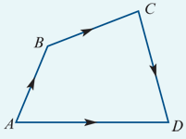
example
Illustrate the vector sum $\vec{AB}$+ $\vec{BC}$+ $\vec{CD}$, where A, B, C and D are points in the plane.
$\vec{AB}$+ $\vec{BC}$+ $\vec{CD}$= $\vec{AD}$

Slide 16
Parallel vectors
Two parallel vectors have the same direction or opposite directions.
Two non-zero vectors u and v are parallel if there is some k∈R∖{0} such that u=kv.
For example, if u= $\left[\begin{aligned}−2 \\ 3\end{aligned}\right]$ and v= $\left[\begin{aligned}−6 \\ 9\end{aligned}\right]$, then the vectors u and v are parallel as v=3u.

Slide 17
Position vectors
We can use a point O, the origin, as a starting point for a vector to indicate the position of a point A in space relative to O.
For most of this chapter, we study vectors in two dimensions and the point O is the origin of the Cartesian plane.
For a point A, the position vector is $\vec{OA}$.

Slide 18
Linear combinations of non-parallel vectors
If two non-zero vectors a and b are not parallel, then
ma+nb=pa+qb implies m=p and n=q
Proof
Assume that ma+nb=pa+qb. Then
ma−pa =qb−nb
∴(m−p)a =(q−n)b
If m≠p or n≠q, we could therefore write
a=$\frac{q−n}{m−p}$b or b= $\frac{m−p}{q−n}$a
But this is not possible, as a and b are non-zero vectors that are not parallel. Therefore m=p and n=q.

Slide 19
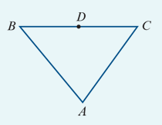
example
Let A, B and C be the vertices of a triangle, and let D be the midpoint of BC. Let a= $\vec{AB}$ and b= $\vec{BC}$.
Find each of the following in terms of a and b:
$\vec{BD}$
$\vec{DC}$
$\vec{AC}$
$\vec{AD}$
$\vec{CA}$
Solution Explanation
$\vec{BD}$=$\frac{1}{2}$ $\vec{BC}$= $\frac{1}{2}$ b same direction and half the length
$\vec{DC}$= $\vec{BD}$= $\frac{1}{2}$ b equivalent vectors
$\vec{AC}$= $\vec{AB}$+ $\vec{BC}$=a+b
$\vec{AD}$= $\vec{AB}$+ $\vec{BD}$=a+ $\frac{1}{2}$ b
$\vec{CA}$= − $\vec{AC}$=−(a+b) since $\vec{CA}$+ $\vec{AC}$=0

Slide 20
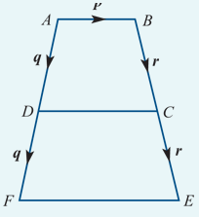
example
In the figure, $\vec{DC}$=kp where k∈R∖{0}.
1. Express p in terms of k, q and r.
2. Express $\vec{FE}$ in terms of k and p to show that FE is parallel to DC.
3. If $\vec{FE}$=4$\vec{AB}$, find the value of k.
Solution
p= $\vec{AB}$= $\vec{AD}$+ $\vec{DC}$+ $\vec{CB}$=q+kp−r Therefore (1−k)p=q−r
$\vec{FE}$=−2q+p+2r=2(r−q)+p From part 1, we have r−q=kp−p=(k−1)p
Therefore $\vec{FE}$=2(k−1)p+p=2kp−2p+p=(2k−1)p
$\vec{FE}$ =4 $\vec{AB}$ (2k−1)p =4p 2k−1 =4 ∴k =52

Slide 21
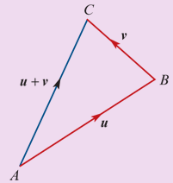
Section summary
A vector is a set of equivalent directed line segments.
Addition of vectors
If u= $\vec{AB}$and v= $\vec{BC}$, then u+v= $\vec{AB}$+ $\vec{BC}$= $\vec{AC}$.
Scalar multiplication
For k∈$R^{+}$, the vector ku has the same direction as u, but its length is multiplied by a factor of k.
If u= $\vec{AB}$, then −u=− $\vec{AB}$= $\vec{BA}$.
Zero vector
The zero vector, denoted by 0, has zero length and has no direction.
Subtraction of vectors
u−v=u+(−v)
Parallel vectors
Two non-zero vectors u and v are parallel if there is some k∈R∖{0} such that u=kv.

