Slide 1
Vectors in three dimensions
20F

Slide 2
Notes:
https://www.transum.org/Maths/Puzzles/Vectors/Parallel.asp

Slide 3
Notes:
https://www.transum.org/software/SW/Starter_of_the_day/Students/Vectors.asp

Slide 4
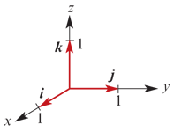
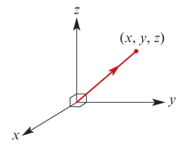
Vectors in 3D
Points in three dimensions are represented using three perpendicular axes as shown.
Vectors in three dimensions are of the form
a=$\left[\begin{matrix}x \\ y \\ z\end{matrix}\right]$=xi+yj+zk
Where i= $\left[\begin{matrix}1 \\ 0 \\ 0\end{matrix}\right]$, j= $\left[\begin{matrix}0 \\ 1 \\ 0\end{matrix}\right]$ and k= $\left[\begin{matrix}0 \\ 0 \\ 1\end{matrix}\right]$
The vectors i, j and k are the standard unit vectors for three dimensions.

Slide 5
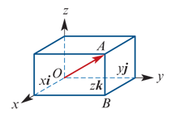
Vectors in 3D
The position vector for point A(x,y,z) is
$\vec{OA}$=xi+yj+zk
Using Pythagoras’ theorem twice:
${OA}^{2}$= ${OB}^{2}$+ ${BA}^{2}$= ${OB}^{2}$+ $z^{2}$= $x^{2}$+ $y^{2}$+ $z^{2}$
∴| $\vec{OA}$| =$\sqrt{x^{2} \text{+ }y^{2} \text{+ }z^{2}}$

Slide 6
Example
Let a=i+j−k and b=i+7k. Find:
1. a+b
2. b−3a
3. |a|
Solution
1. a+b=i+j−k+i+7k=2i+j+6k
2. b−3a=i+7k−3(i+j−k)=−2i−3j+10k
3. |a|= $\sqrt{1^{2} \text{+ }1^{2} \text{+ }{(−1)}^{2}}$= $\sqrt{3}$

Slide 7
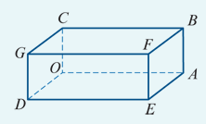
Example
OABCDEFG is a cuboid such that $\vec{OA}$=3j, $\vec{OC}$=k and $\vec{OD}$=i.
1. Express each of the following in terms of i, j and k:
$\vec{OE}$
$\vec{OF}$
$\vec{GF}$
$\vec{GB}$
2. Let M and N be the midpoints of OD and GF respectively. Find MN.
Solution
$\vec{OE}$= $\vec{OA}$+ $\vec{AE}$=3j+i (as $\vec{AE}$= $\vec{OD}$)
$\vec{OF}$= $\vec{OE}$+ $\vec{EF}$=3j+i+k (as $\vec{EF}$= $\vec{OC}$)
$\vec{GF}$= $\vec{OA}$=3j
$\vec{GB}$= $\vec{DA}$= $\vec{DO}$+ $\vec{OA}$= −i+3j
$\vec{MN}$ = $\vec{MD}$+ $\vec{DG}$+ $\vec{GN}$=$\frac{1}{2}$ $\vec{OD}$+ $\vec{OC}$+ $\frac{1}{2}$ $\vec{OA}$= $\frac{1}{2}$i+k+ $\frac{3}{2}$j
| $\vec{MN}$| =$\sqrt{\frac{1}{4}+1+\frac{9}{4}}=\frac{\sqrt{14}}{2}$

Slide 8
Example
If a=3i+2j+2k, find $\hat{a}$.
Solution
|a| = $\sqrt{9\text{+ }4\text{+ }4}$= $\sqrt{17}$
∴ $\hat{a}$ = $\frac{1}{\text{|}\text{a}\text{|}}$a =$\frac{1}{\sqrt{17}}$(3i+2j+2k)

Slide 9
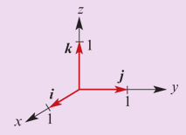
Section summary
In three dimensions:
The standard unit vectors are i, j and k.
Each vector can be written in the form u=xi+yj+zk.
If u=xi+yj+zk, then |u|= $\sqrt{x^{2} \text{+ }y^{2} \text{+ }z^{2}}$.

