Slide 1
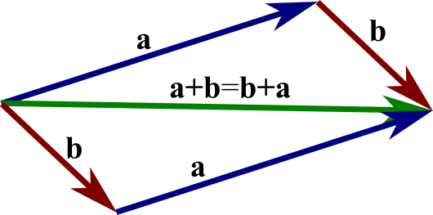
Chapter 20 Vectors Summary
Vectors

Slide 2
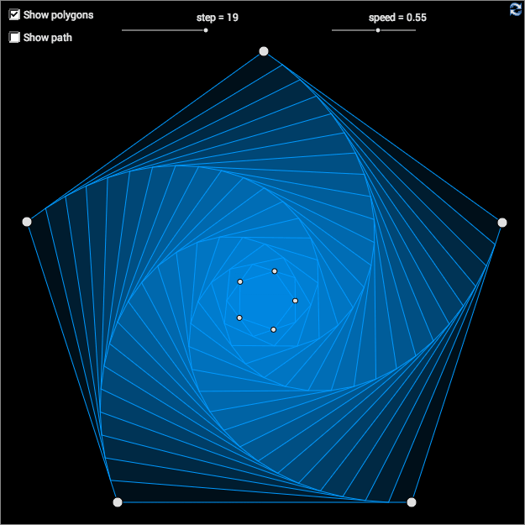
Definitions
A vector is a set of equivalent directed line segments.
A directed line segment from a point A to a point B is denoted by $\vec{AB}$.
The position vector of a point A is the vector $\vec{OA}$, where O is the origin.
A vector can be written as a column of numbers. The vector $\left[\begin{matrix} \\ 2 \\ 3\end{matrix}\right]$is ‘2across and 3up’.

Slide 3
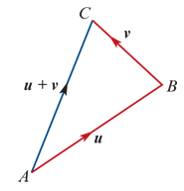
Basic operations on vectors
Addition
If u=$\left[\begin{matrix}a \\ b\end{matrix}\right]$ and v= $\left[\begin{matrix}c \\ d\end{matrix}\right]$, then u+v= $\left[\begin{matrix}a+c \\ b+d\end{matrix}\right]$.
The sum u+v can also be obtained geometrically as shown.
Scalar multiplication
For k∈R+, the vector ku has the same direction as u, but its length is multiplied by a factor of k.
The vector −v has the same length as v, but the opposite direction.
Two non-zero vectors u and v are parallel if there exists k∈R∖{0} such that u=kv.
Subtraction u−v=u+(−v)

Slide 4
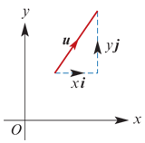
Component form
In two dimensions, each vector u can be written in the form u=xi+yj, where
i is the unit vector in the positive direction of the x-axis
j is the unit vector in the positive direction of the y-axis.
The magnitude of vector u=xi+yj is given by |u|=$\sqrt{x^{2}+y^{2}}$.
The unit vector in the direction of vector a is given by $\hat{a}$=$\frac{1}{\left|a\right|}a$.

Slide 5
Scalar product and vector projections
The scalar product of vectors a=$a_{1}$i+ $a_{2}$j and b= $b_{1}$i+ $b_{2}$j is given by a⋅b= $a_{1}b_{1}$+ $a_{2}b_{2}$
The scalar product is described geometrically by a⋅b=|a||b|cosθ, where θ is the angle between a and b.
Therefore a⋅a=${\text{|}\text{a}\text{|}}^{2}$.
Two non-zero vectors a and b are perpendicular if and only if a⋅b=0.
Resolving a vector a into rectangular components is expressing the vector a as a sum of two vectors, one parallel to a given vector b and the other perpendicular to b.
The vector resolute of a in the direction of b is $\frac{a⋅b}{b⋅b}$b.
The scalar resolute of a in the direction of b is $\frac{a⋅b}{\text{|}\text{b}\text{|}}$.

Slide 6
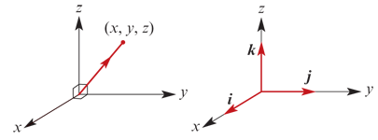
Vectors in three dimensions
In three dimensions, each vector u can be written in the form u=xi+yj+zk, where i, j and k are unit vectors as shown.
If u=xi+yj+zk, then |u|= $\sqrt{x^{2}+y^{2}+z^{2}}$.

