Slide 1
Points, lines and angles
9A

Slide 2
Points, lines and planes
Point In geometry, a point is used to indicate position.
Line In the physical world, we may illustrate the idea of a line as a tightly stretched wire or a fold in a piece of paper. A line has no width and is infinite in length.
Plane A plane has no thickness and it extends infinitely in all directions.
We make the following assumptions about points and lines:
Given a point and a line, the point may or may not lie on the line.
Two distinct points are contained in exactly one line.
Two distinct lines do not have more than one point in common.

Slide 3
Notes:
https://www.transum.org/Software/MathsMenu/Starter.asp?ID_Starter=52

Slide 4
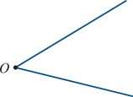
Angles
A ray is a portion of a line consisting of a point O and all the points on one side of O.
An angle is the figure formed by two distinct rays which have a common endpoint O. The common endpoint is called the vertex of the angle.
If the two rays are part of one straight line, the angle is called a straight angle and measures 180°.
A right angle is an angle of 90°.
An acute angle is an angle which is less than 90°.
An obtuse angle is an angle which is greater than 90° and less than 180°.
Supplementary angles are two angles whose sum is 180°.
Complementary angles are two angles whose sum is 90°.

Slide 5
Naming angles
The convention for naming an angle is to fully describe the rays of the angle and the endpoint where the rays meet.
The marked angle is denoted by ∠ABC.
When there is no chance of ambiguity, it can be written as ∠B.
Sometimes an angle can simply be numbered as shown, and in a proof we refer to the angle as ∠1.
The important thing is that the writing of your argument must be clear and unambiguous. With complicated diagrams, the ∠ABC notation is safest.

Slide 6
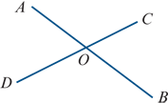
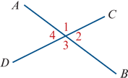
Theorem
If two straight lines intersect, then the opposite angles are equal in pairs.
Such angles are said to be vertically opposite.
Proof using angle names
∠AOC and ∠COB are supplementary.
That is, ∠AOC+∠COB=180°.
Also, ∠COB and ∠BOD are supplementary.
That is, ∠COB+∠BOD=180°.
Hence ∠AOC=∠BOD.
The proof can also be presented with the labelling technique.
Proof using number labels
∠1+∠2 =180° (supplementary angles)
∠2+∠3 =180° (supplementary angles)
∴ ∠1 =∠3

Slide 7
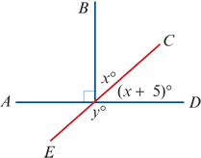
Example
Find the values of x and y in the diagram.
Solution
x+(x+5) =90 (complementary angles)
2x =85
∴ x =42.5
y+(x+5) =180 (supplementary angles)
y+47.5 =180
∴ y =132.5

Slide 8
Parallel lines
Given two distinct lines ℓ1 and ℓ2 in the plane, either the lines intersect in a single point or the lines have no point in common. In the latter case, the lines are said to be parallel. We can write this as ℓ1∥ℓ2.
Here is another important assumption.

Slide 9
Playfair’s axiom
Given any point P not on a line ℓ, there is only one line through P parallel to ℓ.
From this we have the following results for three distinct lines ℓ1, ℓ2 and ℓ3 in the plane:
If ℓ1∥ℓ2 and ℓ2∥ℓ3, then ℓ1∥ℓ3.
If ℓ1∥ℓ2 and ℓ3 intersects ℓ1, then ℓ3 also intersects ℓ2.
We prove the first of these and leave the other as an exercise. The proof is by contradiction.
Proof
Let ℓ1, ℓ2 and ℓ3 be three distinct lines in the plane such that ℓ1∥ℓ2 and ℓ2∥ℓ3. Now suppose that ℓ1 is not parallel to ℓ3. Then ℓ1 and ℓ3 meet at a point P. But by Playfair’s axiom, there is only one line parallel to ℓ2 passing through P. Therefore ℓ1=ℓ3. But this gives a contradiction, as ℓ1 and ℓ3 are distinct by assumption.

Slide 10
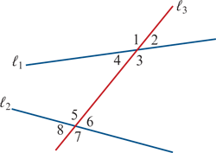
Corresponding, alternate and co-interior angles
The following types of pairs of angles play an important role in considering parallel lines.
In the diagram, the lines ℓ1 and ℓ2 are crossed by a transversal ℓ3.
Corresponding angles:
Angles 1 and 5
Angles 2 and 6
Angles 3 and 7
Angles 4 and 8
Alternate angles:
Angles 3 and 5
Angles 4 and 6
Co-interior angles:
Angles 3 and 6
Angles 4 and 5

Slide 11
Theorem
When two lines are crossed by a transversal, any one of the following three conditions implies the other two:
a pair of alternate angles are equal
a pair of corresponding angles are equal
a pair of co-interior angles are supplementary.

Slide 12
Theorem
If two parallel lines are crossed by a transversal, then alternate angles are equal.
Conversely, if two lines crossed by a transversal form an equal pair of alternate angles, then the two lines are parallel.

Slide 13
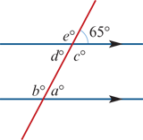
Example
Find the values of the pronumerals.
Note: The arrows indicate that the two lines are parallel.
Solution
a =65 (corresponding)
d =65 (alternate with a)
b =115 (co-interior with d)
e =115 (corresponding with b)
c =115 (vertically opposite e)

Slide 14
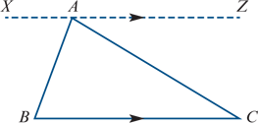
Example
For ΔABC shown in the diagram, the line XAZ is drawn through vertex A parallel to BC.
Use this construction to prove that the sum of the interior angles of a triangle is a straight angle (180°).
Solution
∠ABC=∠XAB (alternate angles)
∠ACB=∠ZAC (alternate angles)
∠XAB+∠ZAC+∠BAC is a straight angle.
Therefore ∠ABC+∠ACB+∠BAC=180°.

Slide 15
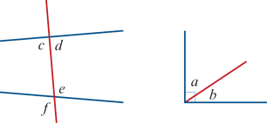
Section summary
Pairs of angles
complementary (a and b)
supplementary (c and d)
vertically opposite (e and f)
alternate (c and e)
corresponding (c and f)
co-interior (d and e)
Parallel lines
If two parallel lines are crossed by a transversal, then:
alternate angles are equal
corresponding angles are equal
co-interior angles are supplementary.
If two lines crossed by a transversal form an equal pair of alternate angles, then the two lines are parallel.

