Slide 1
Triangles and polygons
9B

Slide 2
Types of polygons
A simple polygon is a polygon such that no two sides have a point in common except a vertex.
A convex polygon A non-convex polygon
A convex polygon is a polygon that contains each line segment connecting any pair of points on its boundary.
For example, the left-hand figure is convex, while the right-hand figure is not.
Note: In this chapter we will always assume that the polygons being considered are convex.
A regular polygon is a polygon in which all the angles are equal and all the sides are equal.

Slide 3
Names of polygons
triangle (3 sides)
quadrilateral (4 sides)
pentagon (5 sides)
hexagon (6 sides)
heptagon (7 sides)
octagon (8 sides)
nonagon (9 sides)
decagon (10 sides)
dodecagon (12 sides)

Slide 4
Triangles
A triangle is a figure formed by three line segments determined by a set of three points not on one line. If the three points are A, B and C, then the figure is called triangle ABC and commonly written ΔABC. The points A, B and C are called the vertices of the triangle.

Slide 5
Triangle inequality
An important property of a triangle is that any side is shorter than the sum of the other two.
In ΔABC: a<b+c, b<c+a and c<a+b.
Note: For ΔABC labelled as shown, we have c<b<a if and only if ∠C<∠B<∠A.

Slide 6
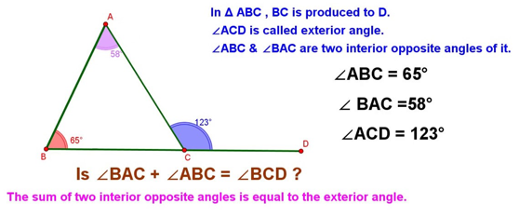
Angles of a triangle
The sum of the three interior angles of a triangle is 180°.
The sum of two interior angles of a triangle is equal to the opposite exterior angle.

Slide 7
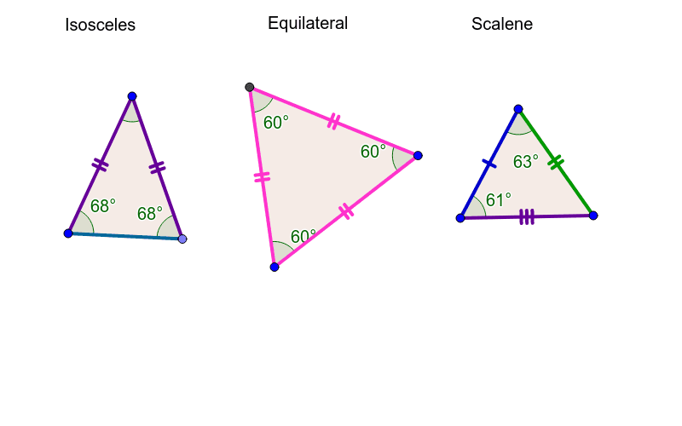
Classification of triangles
Equilateral triangle a triangle in which all three sides are equal
Isosceles triangle a triangle in which two sides are equal
Scalene triangle a triangle in which all three sides are unequal

Slide 8
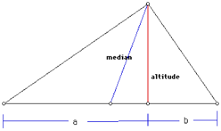
Important lines in a triangle
Median A median of a triangle is a line segment from a vertex to the midpoint of the opposite side.
Altitude An altitude of a triangle is a line segment from a vertex to the opposite side (possibly extended) which forms a right angle where it meets the opposite side.

Slide 9
Example
The sides of a triangle are 6−x, 4x+1 and 2x+3. Find the value of x for which the triangle is isosceles, and show that if it is isosceles, then it is equilateral.
Solution
We want to show that if any two side lengths are equal, then the third length is the same.
6−x =4x+1 ⇒ 5x =5 ⇒ x =1
When x=1, we have 6−x=5, 4x+1=5 and 2x+3=5. Hence the triangle is equilateral with each side of length 5 units.

Slide 10
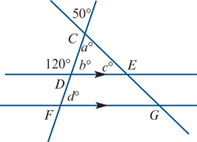
Example
Find the values of a, b, c and d, giving reasons.
Solution
a =50 (vertically oposite angles)
b =60 (supplementary angles)
c =180−(50+60)=70 (angle sum of a triangle)
d =60 (corresponding angles DE∥FG)

Slide 11
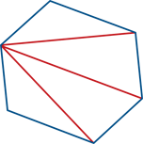
Angle sum of a polygon
If a polygon has n sides, then we can draw n−3 diagonals from a vertex. In this way, we can divide the polygon into n−2 triangles, each with an angle sum of 180°.
We have drawn a hexagon to illustrate this, but we could have used any polygon.

Slide 12
Angle sum of a polygon
The sum of the interior angles of an n-sided polygon is (n−2)180°.
Each interior angle of a regular n-sided polygon has size $\frac{\left(n−2\right)}{n}$180°.

Slide 13
Example
A regular dodecagon is shown to the right.
a. Find the sum of the interior angles of a dodecagon.
b. Find the size of each interior angle of a regular dodecagon.
a. The angle sum of a polygon with n sides is (n−2)180°.
Therefore the angle sum of a dodecagon is 1800°.
b. Each of the interior angles is $\frac{1800}{12}$=150°.

Slide 14
Section summary
Polygons
The sum of the interior angles of an n-sided polygon is (n−2)180°.
In a regular polygon, all the angles are equal and all the sides are equal.
Each interior angle of a regular n-sided polygon has size $\frac{\left(n−2\right)}{n}$180°.
Triangles
An equilateral triangle is a triangle in which all three sides are equal.
An isosceles triangle is a triangle in which two sides are equal.
A scalene triangle is a triangle in which all three sides are unequal.
The sum of the three interior angles of a triangle is 180°.
The sum of two interior angles of a triangle is equal to the opposite exterior angle.
In ΔABC:
a<b+c, b<c+a and c<a+b
c<b<a if and only if ∠C<∠B<∠A

