Slide 1
Congruence and proofs
9C

Slide 2
Notes:
https://www.transum.org/Software/SW/Starter_of_the_day/starter_June4.ASP

Slide 3
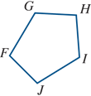
Congruent
Two plane figures are called congruent if one figure can be moved on top of the other figure, by a sequence of translations, rotations and reflections, so that they coincide exactly.
Congruent figures have exactly the same shape and size. For example, the two figures shown are congruent. We can write:
pentagon ABCDE ≡ pentagon FGHIJ

Slide 4
Congruent
When two figures are congruent, we can find a transformation that pairs up every part of one figure with the corresponding part of the other, so that:
paired angles have the same size
paired intervals have the same length
paired regions have the same area.

Slide 5
Congruent triangles
The SSS congruence test
If the three sides of one triangle are respectively equal to the three sides of another triangle, then the two triangles are congruent.
ΔABC ≡ ΔPQR

Slide 6
Congruent triangles
The SAS congruence test
If two sides and the included angle of one triangle are respectively equal to two sides and the included angle of another triangle, then the two triangles are congruent.
ΔABC≡ΔPQR

Slide 7
Congruent triangles
The AAS congruence test
If two angles and one side of one triangle are respectively equal to two angles and the matching side of another triangle, then the two triangles are congruent.
ΔABC≡ΔPQR

Slide 8
Congruent triangles
The RHS congruence test
If the hypotenuse and one side of one right-angled triangle are respectively equal to the hypotenuse and one side of another right-angled triangle, then the two triangles are congruent.
ΔABC≡ΔPQR

Slide 9
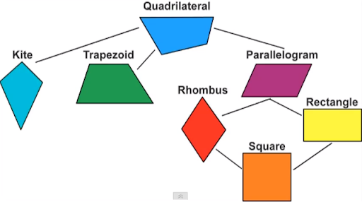
Classification of quadrilaterals
Trapezium a quadrilateral with at least one pair of opposite sides parallel
Parallelogram a quadrilateral with both pairs of opposite sides parallel
Rhombus a parallelogram with a pair of adjacent sides equal
Rectangle a quadrilateral in which all angles are right angles
Square a quadrilateral that is both a rectangle and a rhombus

Slide 10
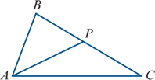
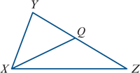
Example
Let ΔABC and ΔXYZ be such that ∠BAC=∠YXZ, AB=XY and AC=XZ.
If P and Q are the midpoints of BC and YZ respectively, prove that AP=XQ.
Solution
From the given conditions, we have ΔABC≡ΔXYZ (SAS).
Therefore ∠ABP=∠XYQ and BC=YZ.
Thus BP=YQ, as P and Q are the midpoints of BC and YZ respectively.
Hence ΔABP≡ΔXYQ (SAS) and so AP=XQ.

Slide 11
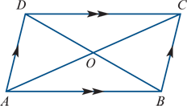
Example
Prove that, in a parallelogram, the diagonals bisect each other.
Solution
Note that opposite sides of a parallelogram are equal.
In triangles DOC and BOA:
∠ODC =∠OBA (alternate angles CD∥AB)
∠OCD =∠OAB (alternate angles CD∥AB)
∠AOB =∠DOC (vertically opposite)
AB =CD (opposite sides of parallelogram are equal)
ΔDOC ≡ΔBOA (AAS)
Hence AO=OC and DO=OB.

Slide 12
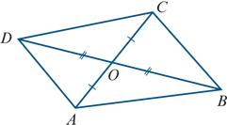
Example
Prove that if the diagonals of a quadrilateral bisect each other, then the quadrilateral is a parallelogram.
Solution
OD =OB (diagonals bisect each other)
OA =OC (diagonals bisect each other)
∠AOB =∠DOC (vertically opposite)
∠DOA =∠COB (vertically opposite)
ΔDOC ≡ΔBOA (SAS)
ΔDOA ≡ΔBOC (SAS)
Therefore ∠ODC=∠OBA and so CD∥AB, since alternate angles are equal.
Similarly, we have AD∥BC. Hence ABCD is a parallelogram.

Slide 13
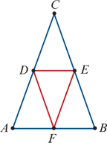
Example
Prove that the triangle formed by joining the midpoints of the three sides of an isosceles triangle (with the midpoints as the vertices of the new triangle) is also isosceles.
Solution
Assume ΔABC is isosceles with CA=CB and ∠CAB=∠CBA.
Then we have DA=EB, where D and E are the midpoints of CA and CB respectively.
We also have AF=BF, where F is the midpoint of AB.
Therefore ΔDAF≡ΔEBF (SAS).
Hence DF=EF and so ΔDEF is isosceles.

Slide 14
Section summary
Congruent figures have exactly the same shape and size.
If triangle ABC is congruent to triangle XYZ, this can be written as ΔABC≡ΔXYZ.
Two triangles are congruent provided any one of the following four conditions holds:
SSS the three sides of one triangle are equal to the three sides of the other triangle
SAS two sides and the included angle of one triangle are equal to two sides and the included angle of the other triangle
AAS two angles and one side of one triangle are equal to two angles and the matching side of the other triangle
RHS the hypotenuse and one side of a right-angled triangle are equal to the hypotenuse and one side of another right-angled triangle.

