Slide 1
Pythagoras' theorem
9D

Slide 2
Pythagoras’ theorem
Let ABC be a triangle with side lengths a, b and c.
If ∠C is a right angle, then
$a^{2}+b^{2}=c^{2}$

Slide 3
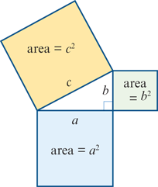
Pythagoras’ theorem
Pythagoras’ theorem can be illustrated by the diagram shown here. The sum of the areas of the two smaller squares is equal to the area of the square on the longest side (hypotenuse).

Slide 4
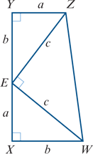
Proof
The proof is based on the diagram shown on the right.
Area of trapezium XYZW=$\frac{1}{2}$(a+b)(a+b)
Area of ΔEWX+area of ΔEYZ+area of ΔEWZ
= $\frac{1}{2}$ab+ $\frac{1}{2}$ab+12$c^{2}$ =ab+ $\frac{1}{2} c^{2}$
Thus $\frac{1}{2}$(a+b)(a+b) =ab+ $\frac{1}{2} c^{2}$
$a^{2}$+2ab+ $b^{2}$ =2ab+ $c^{2}$
Hence $a^{2}+b^{2}=c^{2}$

Slide 5
Converse of Pythagoras’ theorem
Let ABC be a triangle with side lengths a, b and c.
If $a^{2}+b^{2}=c^{2}$, then ∠C is a right angle.

Slide 6
Proof
Assume ΔABC has side lengths a=BC, b=CA and c=AB such that $a^{2}+b^{2}=c^{2}$.
Construct a second triangle ΔXYZ with YZ=a and ZX=b such that ∠XZY is a right angle.
By Pythagoras’ theorem, the length of the hypotenuse of ΔXYZ is
$\sqrt{a^{2}+b^{2}}=\sqrt{c^{2}}=c$
Therefore ΔABC≡ΔXYZ (SSS).
Hence ∠C is a right angle.

Slide 7
Example
The diagonal of a soccer field is 130 m and the length of the long side of the field is 100 m. Find the length of the short side, correct to the nearest centimetre.
Solution
Let x be the length of the short side. Then
$x^{2}+{100}^{2}={130}^{2}$
$x^{2}$ = ${130}^{2}$− ${100}^{2}$
∴ x = $\sqrt{6900}$
Correct to the nearest centimetre, the length of the short side is 83.07 m.

Slide 8
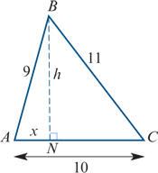
Example
Consider ΔABC with AB=9 cm, BC=11 cm and AC=10 cm. Find the length of the altitude of ΔABC on AC.
Let BN be the altitude on AC as shown, with BN=h cm.
Let AN=x cm. Then CN=(10−x) cm.
In ΔABN: $x^{2}+h^{2}$ =81 (1)
In ΔCBN: ${(100−x)}^{2}$+ $h^{2}$ =121 (2)
Expanding in equation (2) gives
100−20x+ $x^{2}$+ $h^{2}$ =121
Substituting for $x^{2}$+ $h^{2}$ from (1) gives 100−20x+81 =121 ∴ x =3
Substituting in (1), we have
9+ $h^{2}$ =81 $h^{2}$ =72 ∴ h =6 $\sqrt{2}$
The length of altitude BN is 6 $\sqrt{2}$ cm.

Slide 9
Section summary
Pythagoras’ theorem and its converse
Let ABC be a triangle with side lengths a, b and c.
If ∠C is a right angle, then $a^{2}+b^{2}=c^{2}$.
If $a^{2}+b^{2}=c^{2}$, then ∠C is a right angle.

