Slide 1
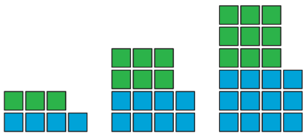
Ratios
9E

Slide 2

Example
Divide 300 in the ratio 3:2.
Solution
one part =300÷5=60
∴ two parts =60×2=120
∴ three parts =60×3=180

Slide 3
Example
Divide 3000 in the ratio 3:2:1.
Solution
one part =3000÷6=500
∴ two parts =500×2=1000
∴ three parts =500×3=1500

