Slide 1
An introduction to similarity
9F

Slide 2
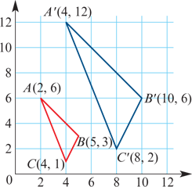
Similarity
The two triangles ABC and A′B′C′ shown in the diagram are similar.
Note: OA′=2OA, OB′=2OB, OC′=2OC
Triangle A′B′C′ can be considered as the image of triangle ABC under a mapping of the plane in which the coordinates are multiplied by 2.
This mapping is called an expansion from the origin of factor 2. From now on we will call this factor the similarity factor.
The rule for this mapping can be written in transformation notation as (x,y)→(2x,2y).
There is also a mapping from ΔA′B′C′ to ΔABC, which is an expansion from the origin of factor $\frac{1}{2}$. The rule for this is (x,y)→($\frac{1}{2}$x, $\frac{1}{2}$y).

Slide 3
Similarity
Two figures are called similar if we can enlarge one figure so that its enlargement is congruent to the other figure.
Matching lengths of similar figures are in the same ratio.
Matching angles of similar figures are equal.

Slide 4
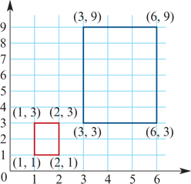
Similar images
For example, the rectangle with side lengths 1 and 2 is similar to the rectangle with side lengths 3 and 6.
Here the similarity factor is 3 and the rule for the mapping is (x,y)→(3x,3y).
Notes:
Any two circles are similar.
Any two squares are similar.
Any two equilateral triangles are similar.

Slide 5
Similar triangles
If triangle ABC is similar to triangle A′B′C′, we can write this as
ΔABC∼ΔA′B′C′
The triangles are named so that angles of equal magnitude hold the same position. That is, A matches to A′, B matches to B′ and C matches to C′. So we have
$\frac{A^{′}B^{′}}{AB}$ = $\frac{B^{′}C^{′}}{BC}$= $\frac{C^{′}A^{′}}{CA}$=k
where k is the similarity factor.

Slide 6
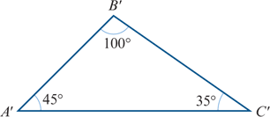
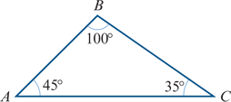
There are four standard tests for two triangles to be similar
The AAA similarity test
If two angles of one triangle are respectively equal to two angles of another triangle, then the two triangles are similar.

Slide 7
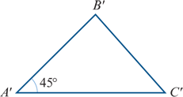
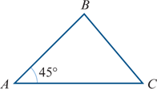
There are four standard tests for two triangles to be similar
The SAS similarity test
If the ratios of two pairs of matching sides are equal and the included angles are equal, then the two triangles are similar.
$\frac{A^{′}B^{′}}{AB}$ = $\frac{A^{′}C^{′}}{AC}$

Slide 8
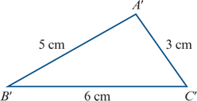
There are four standard tests for two triangles to be similar
The SSS similarity test
If the sides of one triangle can be matched up with the sides of another triangle so that the ratio of matching lengths is constant, then the two triangles are similar.
$\frac{A^{′}B^{′}}{AB}$ = $\frac{B^{′}C^{′}}{BC}$= $\frac{C^{′}A^{′}}{CA}$

Slide 9
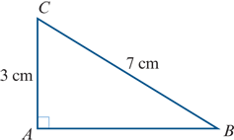
There are four standard tests for two triangles to be similar
The RHS similarity test
If the ratio of the hypotenuses of two right-angled triangles equals the ratio of another pair of sides, then the two triangles are similar.

Slide 10
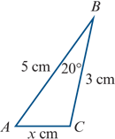
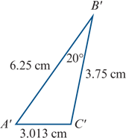
Example
Give the reason for triangle ABC being similar to triangle A′B′C′.
Find the value of x.
Solution
Triangle ABC is similar to triangle A′B′C′ by SAS, since
$\frac{5}{6.25}$ =0.8= $\frac{3}{3.75}$
and ∠ABC =20°=∠A′B′C
$\frac{x}{3.013}$ = $\frac{5}{6.25}$
∴ x = $\frac{5}{6.25}$×3.013=2.4104

Slide 11
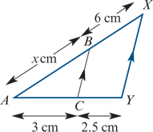
Example
Give the reason for triangle ABC being similar to triangle AXY.
Find the value of x.
Corresponding angles are of equal magnitude (AAA).
$\frac{AB}{AX}$ = $\frac{AC}{AY}$
$\frac{x}{x+6}$ = $\frac{3}{5.5}$
5.5x =3(x+6)
2.5x =18
∴ x =7.2

Slide 12
Section summary
Two figures are similar if we can enlarge one figure so that its enlargement is congruent to the other figure.
Matching lengths of similar figures are in the same ratio.
Matching angles of similar figures are equal.
Two triangles are similar provided any one of the following four conditions holds:
AAA two angles of one triangle are equal to two angles of the other triangle
SAS the ratios of two pairs of matching sides are equal and the included angles are equal
SSS the sides of one triangle can be matched up with the sides of the other triangle so that the ratio of matching lengths is constant
RHS the ratio of the hypotenuses of two right-angled triangles equals the ratio of another pair of sides.

