Slide 1
Proofs involving similarity
9G

Slide 2
Notes:
https://www.transum.org/Maths/Activity/Similar/

Slide 3
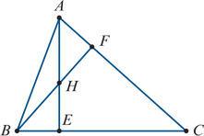
Example
The altitudes AE and BF of ΔABC intersect at H. Prove that
$\frac{AE}{BF}$= $\frac{AC}{BC}$
Solution
∠CEA =∠CFB (AE and BF are altitudes)
∠ACE =∠BCF (common)
∴ ΔCAE ∼ΔCBF (AAA)
∴ $\frac{AE}{BF}$= $\frac{AC}{BC}$

Slide 4
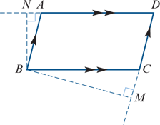
Example
ABCD is a parallelogram with ∠ABC acute. BM is perpendicular to DC extended, and BN is perpendicular to DA extended. Prove that
DC×CM=DA×AN
Solution
∠BCM =∠ABC (alternate angles AB∥CD)
∠BAN =∠ABC (alternate angles BC∥AD)
∴ ∠BCM =∠BAN
∠BNA =∠BMC=90°(given)
∴ ΔBCM ∼ΔBAN
Hence $\frac{CM}{AN}$= $\frac{BC}{AB}$
But AB=CD and BC=AD, giving $\frac{CM}{AN}$= $\frac{AD}{CD}$
Hence DC×CM=DA×AN.

Slide 5
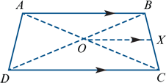
Example
ABCD is a trapezium with diagonals intersecting at O. A line through O, parallel to the base CD, meets BC at X. Prove that BX×DC=XC×AB.
Solution
ΔABC ∼ΔOXC (AAA)
ΔDCB ∼ΔOXB (AAA)
Thus $\frac{BX}{BC}$ = $\frac{OX}{DC}$ (1)
and $\frac{XC}{BC}$ = $\frac{OX}{AB}$ (2)
Divide (1) by (2): $\frac{BX}{XC}$= $\frac{AB}{DC}$
∴ BX×DC=XC×AB

