Slide 1
Areas, volumes and similarity
9H

Slide 2
Similarity and area
If two shapes are similar and the similarity factor is k (that is, if for any length AB of one shape, the corresponding length A′B′ of the similar shape is kAB), then
area of similar shape=$k^{2}$×area of original shape

Slide 3
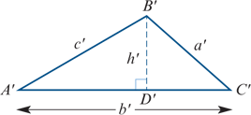
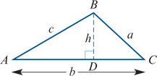
Similarity and area
For example, if triangles ABC and A′B′C′ are similar with A′B′=kAB, then
area of ΔA′B′C′= $k^{2}$×area of ΔABC
This can be shown by observing that, since ΔABC∼ΔA′B′C′, we have
area of ΔA′B′C′=$\frac{1}{2}$b′h′= $\frac{1}{2}$(kb)(kh)= $k^{2}$($\frac{1}{2}$bh)= $k^{2}$×area of ΔABC

Slide 4
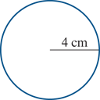
Similar circles
Similarity factor= $\frac{4}{3}$
Ratio of areas= $\frac{16π}{9π}$=${\left(\frac{4}{3}\right)}^{2}$
Area =9π ${cm}^{2}$ Area =16π ${cm}^{2}$

Slide 5
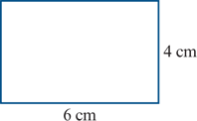
Similar rectangles
Similarity factor=2
Ratio of areas= $\frac{24}{6}$=4= $2^{2}$
Area =6 ${cm}^{2}$ Area =24 ${cm}^{2}$

Slide 6
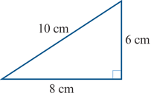
Similar triangles
Similarity factor=2
Ratio of areas= $\frac{24}{6}$=4= $2^{2}$
Area =6 ${cm}^{2}$ Area =24 ${cm}^{2}$

Slide 7
Example
The two rectangles shown below are similar. The area of rectangle ABCD is 20 ${cm}^{2}$. Find the area of rectangle A′B′C′D′.
Solution
The ratio of their side lengths is $\frac{\text{A}\text{′}\text{B}\text{′}}{\text{AB}}$= $\frac{5}{3}$ .
The ratio of their areas is $\frac{\text{Area} \text{of} \text{A}\text{′}\text{B}\text{′}\text{C}\text{′}\text{D}\text{′}}{\text{Area} \text{of} \text{ABCD}}$= ${\left(\frac{5}{3}\right)}^{2}$= $\frac{25}{9}$.
∴ Area of A′B′C′D′= $\frac{25}{9}$×20=55 $\frac{5}{9} {cm}^{2}$

Slide 8
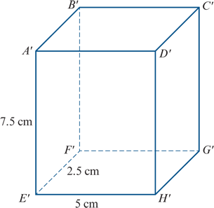
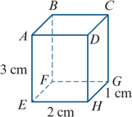
Similarity and volume
Two solids are considered to be similar if they have the same shape and the ratios of their corresponding linear dimensions are equal.
For example, the two cuboids ABCDEFGH and A′B′C′D′E′F′G′H′ shown are similar, with similarity factor 2.5.

Slide 9
Similarity and volume
If two solids are similar and the similarity factor is k, then
volume of similar solid= $k^{3}$×volume of original solid
For example, for the two cuboids shown, we have
∴ Volume of ABCDEFGH=2×1×3=6 ${cm}^{3}$
Volume of A′B′C′D′E′F′G′H′=5×2.5×7.5=93.75 ${cm}^{3}$
Ratio of volumes= $\frac{93.75}{6}$ =15.625= ${2.5}^{3}$

Slide 10
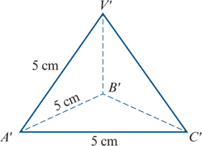
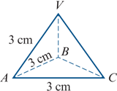
Similarity and volume
Here is another example:
Similarity factor= $\frac{5}{3}$
Ratio of volumes= ${\left(\frac{5}{3}\right)}^{3}$

Slide 11
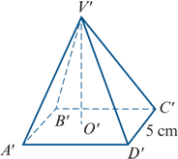
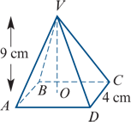
Example
The two square pyramids are similar and VO=9 cm.
a. Find the ratio of the lengths of their bases, and hence find the height V′O′ of pyramid V′A′B′C′D′.
b. The volume of VABCD is 48 ${cm}^{3}$. Find the ratio of their volumes, and hence find the volume of V′A′B′C′D′.
Solution
a. The ratio of the length of their bases is
$\frac{\text{C}\text{′}\text{D}\text{′}}{\text{CD}}$= $\frac{5}{4}$
∴ V′O′ = $\frac{5}{4}$×9=11.25 cm
b. The ratio of their volumes is
$\frac{\text{Volume} \text{of} \text{V}\text{′}\text{A}\text{′}\text{B}\text{′}\text{C}\text{′}\text{D}\text{′}}{\text{Volume} \text{of} \text{VABCD} }$
∴ Volume of V′A′B′C′D′= ${\left(\frac{5}{4}\right)}^{3}$= $\frac{125}{64}$= $\frac{125}{64}$×48=93.75 ${cm}^{3}$

Slide 12
Section summary
If two shapes are similar and the similarity factor is k (that is, if for any length AB of one shape, the corresponding length A′B′ of the similar shape is kAB), then
area of similar shape= $k^{2}$×area of original shape
If two solids are similar and the similarity factor is k, then
volume of similar solid= $k^{3}$×volume of original solid

