Slide 1
Angle properties of the circle
10A

Slide 2
Notes:
https://www.transum.org/Software/SW/Starter_of_the_day/Starter_April9.asp?init=11,16,17,

Slide 3
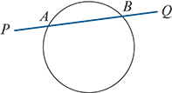
Chord and Secant
A line segment joining two points on a circle is called a chord. A line that cuts a circle at two distinct points is called a secant.
For example, in the diagram, the line PQ is a secant and the line segment AB is a chord.

Slide 4
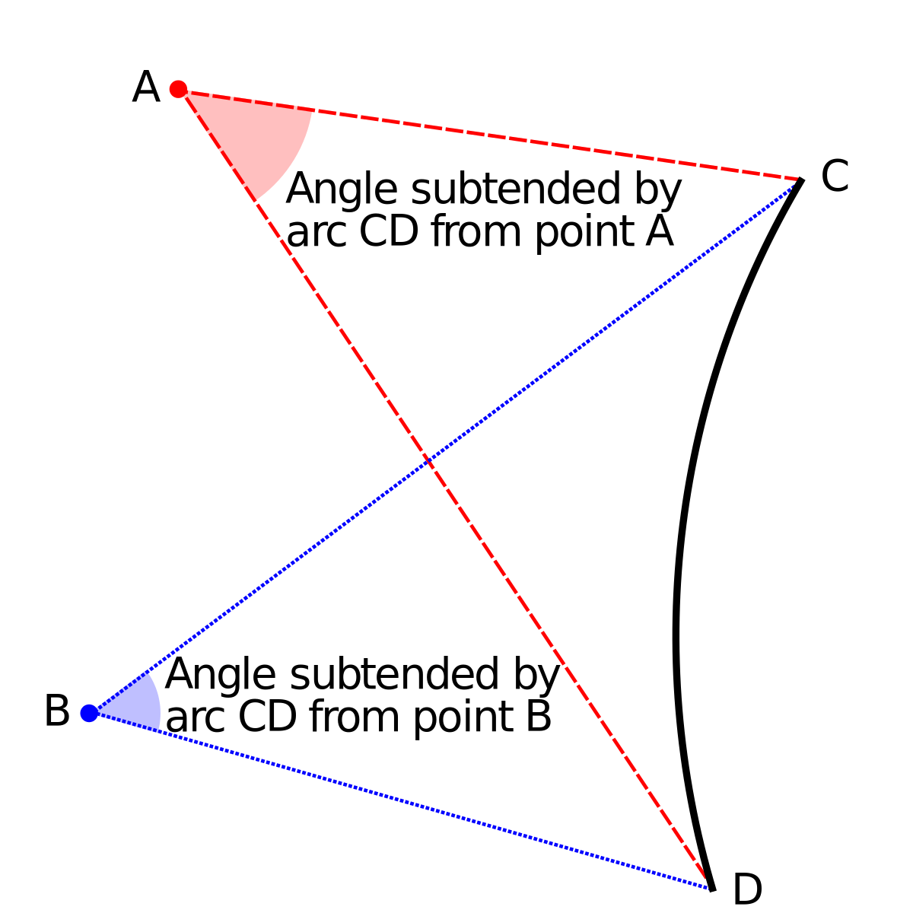
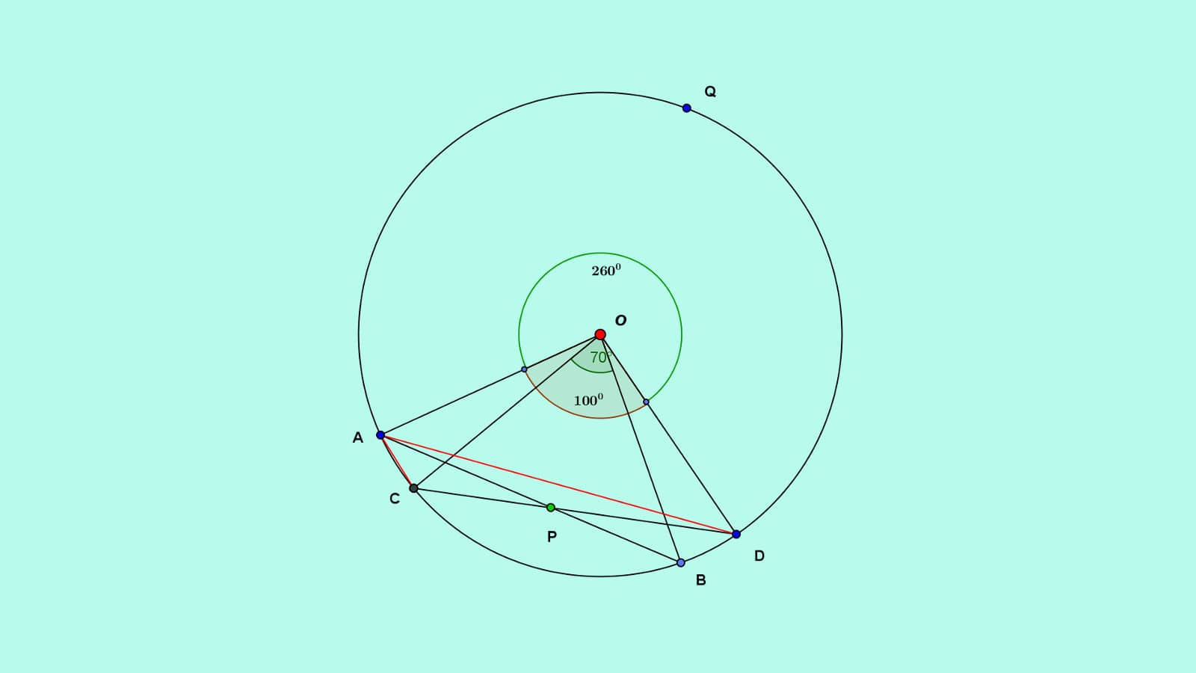
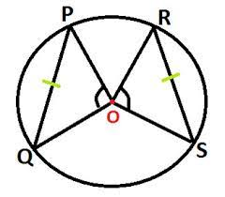
Subtended angles
You should prove the following two results. The first proof uses the SSS congruence test and the second uses the SAS congruence test.
Equal chords of a circle subtend equal angles at the centre.
If two chords subtend equal angles at the centre, then the chords are equal.

Slide 5
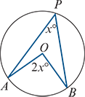
Theorem 1
The angle at the centre of a circle is twice the angle at the circumference subtended by the same arc.

Slide 6
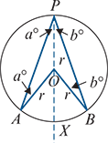
Proof
Join points P and O and extend the line through O, as shown in the diagram on the right.
Note that AO=BO=PO=r, the radius of the circle. Therefore triangles PAO and PBO are isosceles.
Let ∠APO=∠PAO=a° and ∠BPO=∠PBO=b°.
Then angle AOX is 2a° (exterior angle of a triangle) and angle BOX is 2b° (exterior angle of a triangle).
Hence ∠AOB=2a°+2b°=2(a+b)°=2∠APB.
Note: In this proof, the centre O and point P are on the same side of chord AB. Slight variations of this proof can be used for other cases. The result is always true.

Slide 7
Converse of Theorem 1
Let A and B be points on a circle, centre O, and let P be a point on the same side of AB as O. If the angle APB is half the angle AOB, then P lies on the circle.

Slide 8
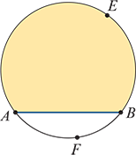
Segments
A segment of a circle is the part of the plane bounded by an arc and its chord. For example, in the diagram:
Arc AEB and chord AB define a major segment (shaded).
Arc AFB and chord AB define a minor segment (unshaded).

Slide 9
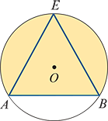
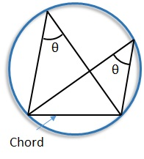
Angles in a segment
∠AEB is said to be an angle in segment AEB.
Theorem 2: Angles in the same segment
Angles in the same segment of a circle are equal.

Slide 10
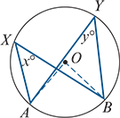
Proof
Let ∠AXB=x° and ∠AYB=y°.
Then, by Theorem 1, ∠AOB=2x°=2y°.
Therefore x=y.

Slide 11
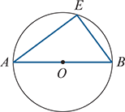
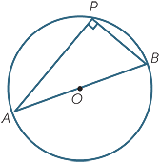
Theorem 3: Angle subtended by a diameter
The angle subtended by a diameter at the circumference is equal to a right angle (90°).
Proof
The angle subtended at the centre is 180°, and so the result follows from Theorem 1.
We can give a straightforward proof of a converse of this result.

Slide 12
Converse of Theorem 3
The circle whose diameter is the hypotenuse of a right-angled triangle passes through all three vertices of the triangle.
Proof
In the diagram, triangle ABC has a right angle at B. Let M be the midpoint of the hypotenuse AC.
We need to prove that MA=MB=MC.
Complete the rectangle ABCD.
Hence AC=BD and M is also the midpoint of BD. It follows that MA=MB=MC.

Slide 13
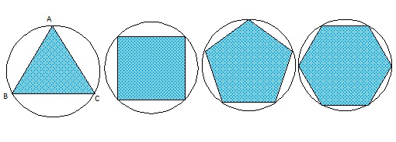
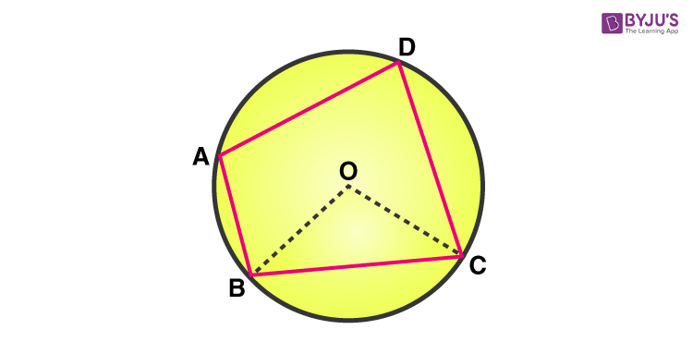
Cyclic polygons
A set of points is said to be concyclic if they all lie on a common circle.
A polygon is said to be inscribed in a circle if all its vertices lie on the circle. This implies that no part of the polygon lies outside the circle.
A quadrilateral that can be inscribed in a circle is called a cyclic quadrilateral.

Slide 14
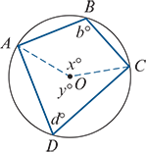
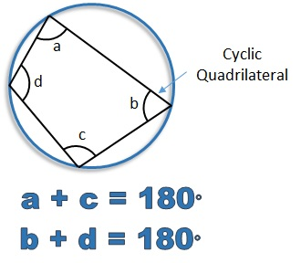
Theorem 4
The opposite angles of a quadrilateral inscribed in a circle sum to 180°.
That is, the opposite angles of a cyclic quadrilateral are supplementary.

Slide 15
Proof
In the diagram, the quadrilateral ABCD is inscribed in a circle with centre O.
By Theorem 1, we have x=2d and y=2b.
Now x+y =360
and so 2b+2d =360
Hence b+d =180

Slide 16
Converse of Theorem 4
If opposite angles of a quadrilateral are supplementary, then the quadrilateral is cyclic.

Slide 17
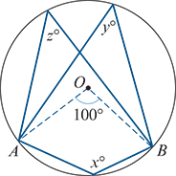
Example
Find the value of each of the pronumerals in the diagram, where O is the centre of the circle and ∠AOB=100°.
Solution
Theorem 1 gives y=z=50.
The value of x can be found by observing either of the following:
Reflex angle AOB is 260°.
Therefore x=130 (by Theorem 1).
We have x+y=180 (by Theorem 4).
Therefore x=180−50=130.

Slide 18
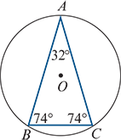
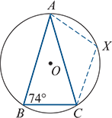
Example
An isosceles triangle is inscribed in a circle as shown. Find the angles in the three minor segments of the circle cut off by the sides of this triangle.
Solution
To find ∠AXC, form the cyclic quadrilateral AXCB. Then ∠AXC and ∠ABC are supplementary. Therefore ∠AXC=106°, and so all angles in the minor segment formed by AC have magnitude 106°.
Similarly, it can be shown that all angles in the minor segment formed by AB have magnitude 106°, and that all angles in the minor segment formed by BC have magnitude 148°.

Slide 19
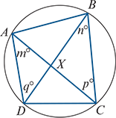
Example
A , B, C and D are points on a circle. The diagonals of quadrilateral ABCD meet at X. Prove that triangles ADX and BCX are similar.
Solution
∠DAC and ∠DBC are in the same segment. Therefore m=n.
∠ADB and ∠ACB are in the same segment. Therefore q=p.
Hence triangles ADX and BCX are similar (AAA).

Slide 20
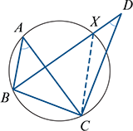
Converse of Theorem 2
If a line segment subtends equal angles at two points on the same side of the line segment, then the two points and the endpoints of the line segment are concyclic.
Proof
A circle is drawn through points A, B and C. (This can be done with any three non-collinear points.)
Assume that ∠BAC=∠BDC and that D lies outside the circle. (There is another case to consider when D is inside, but the proof is similar. If D lies on the circle, then we are finished.)
Let X be the point of intersection of line BD with the circle. Then, by Theorem 2, ∠BAC=∠BXC and so ∠BDC=∠BXC. But this is impossible. (You can use the equality of the angle sums of ΔBXC and ΔBDC to show this.)
Hence D lies on the same circle as A, B and C.

Slide 21
Section summary
Equal chords of a circle subtend equal angles at the centre.
If two chords subtend equal angles at the centre, then the chords are equal.
Theorem 1 The angle at the centre of a circle is twice the angle at the circumference subtended by the same arc.
Theorem 2 Angles in the same segment of a circle are equal.
Theorem 3 The angle subtended by a diameter at the circumference is 90°.
Theorem 4 Opposite angles of a cyclic quadrilateral sum to 180°.

