Slide 1
Tangents
10B

Slide 2
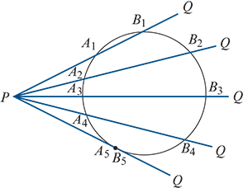
Tangent
Consider a point P outside a circle, as shown in the diagram. By rotating the secant PQ, with P as the pivot point, we obtain a sequence of pairs of points on the circle. As PQ moves towards the edge of the circle, the pairs of points become closer together, until they eventually coincide.
When PQ is in this final position (i.e. when the intersection points A and B coincide), it is called a tangent to the circle.
A tangent touches the circle at only one point, and this point is called the point of contact.
The length of a tangent from a point P outside the circle is the distance between P and the point of contact.

Slide 3
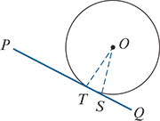
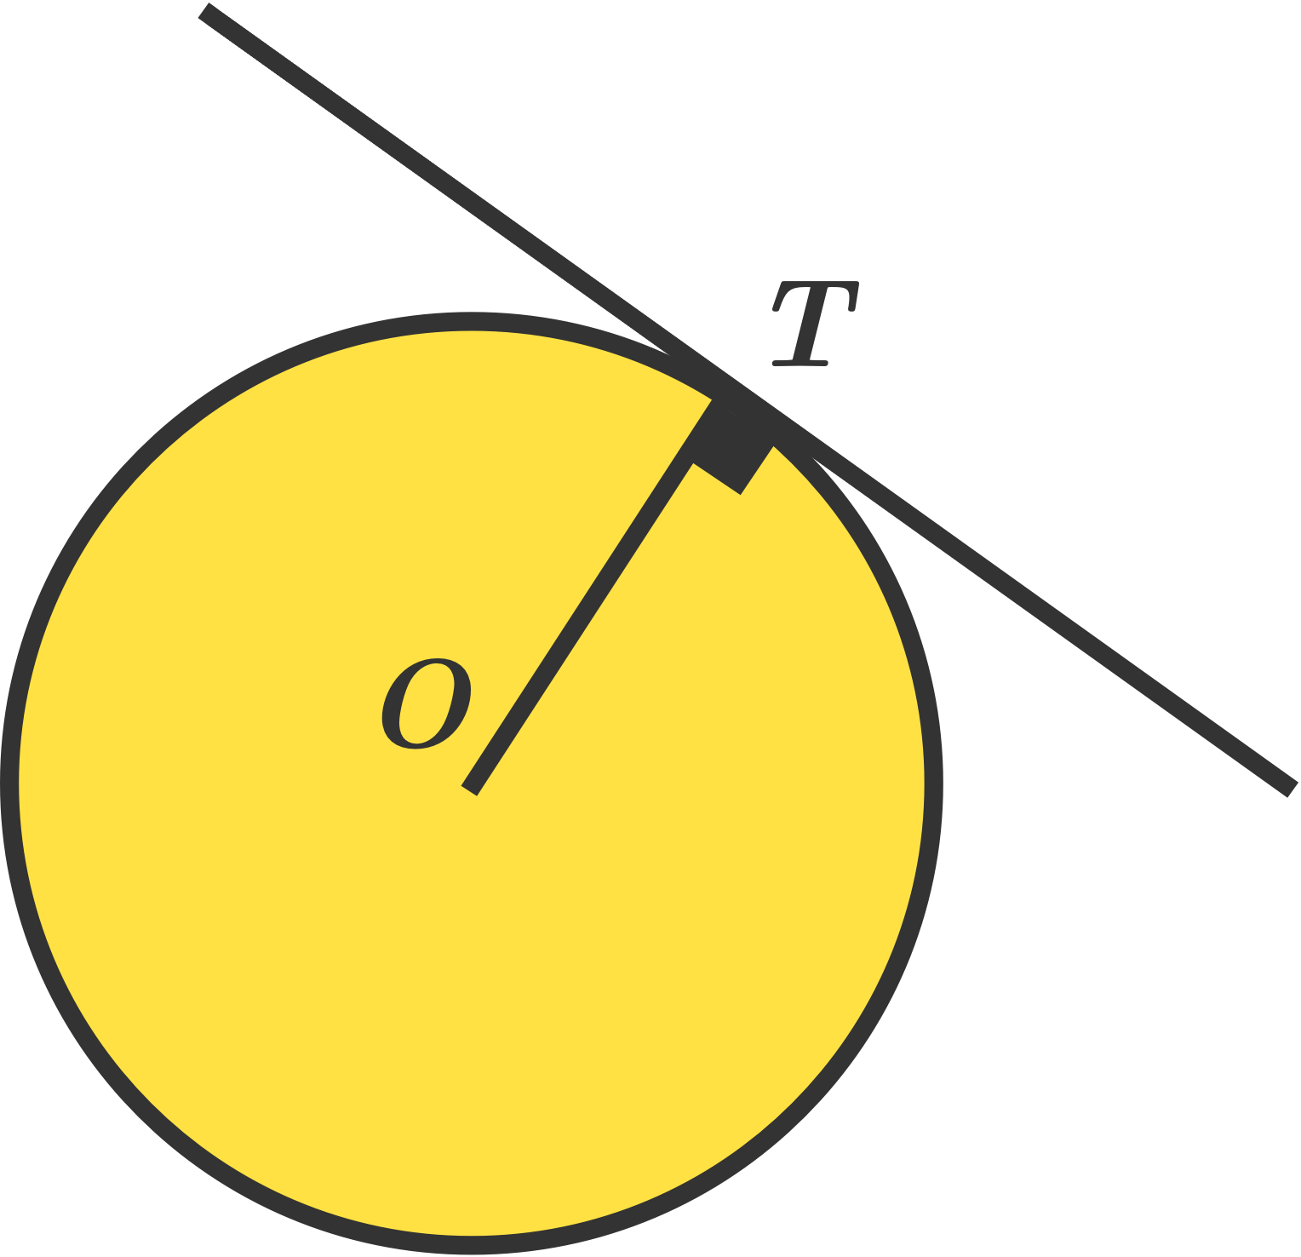
Theorem 5: Tangent is perpendicular to radius
A tangent to a circle is perpendicular to the radius drawn from the point of contact.
Proof
This will be a proof by contradiction.
Let T be the point of contact of tangent PQ and suppose that ∠OTP is not a right angle.
Let S be the point on PQ, not T, such that OSP is a right angle. Then triangle OST has a right angle at S.
Therefore OT>OS, as OT is the hypotenuse of triangle OST.
This implies that S is inside the circle, as OT is a radius.
Thus the line through T and S must cut the circle again. But PQ is a tangent, and so this is a contradiction. Hence we have shown that ∠OTP is a right angle.

Slide 4
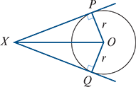
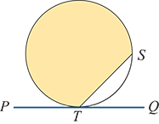
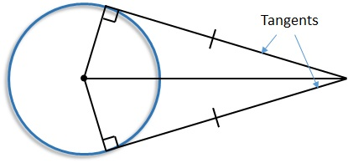
Theorem 6: Two tangents from the same point
The two tangents drawn from an external point to a circle are the same length.
Proof
We can see that ΔXPO is congruent to ΔXQO using the RHS test, as ∠XPO=∠XQO=90°, the side XO is common and OP=OQ (radii).
Therefore XP=XQ.
The alternate segment theorem
In the diagram:
The shaded segment is called the alternate segment in relation to ∠STQ.
The unshaded segment is alternate to ∠STP.

Slide 5
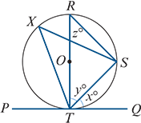
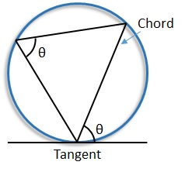
Theorem 7: Alternate segment theorem
The angle between a tangent and a chord drawn from the point of contact is equal to any angle in the alternate segment.
Proof
Let ∠STQ=x°, ∠RTS=y° and ∠TRS=z°, where RT is a diameter.
Then ∠RST=90° (Theorem 3, angle subtended by a diameter), and therefore y+z=90.
Also ∠RTQ=90° (Theorem 5, tangent is perpendicular to radius), and therefore x+y=90.
Thus x=z. But ∠TXS is in the same segment as ∠TRS and so ∠TXS=x°.

Slide 6
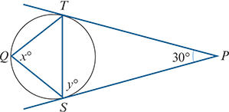
Example
Find the magnitudes of the angles x and y in the diagram.
Solution
Triangle PST is isosceles (Theorem 6, two tangents from the same point).
Therefore ∠PST=∠PTS and so y=75.
The alternate segment theorem gives x=y=75.

Slide 7
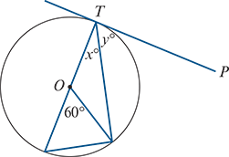
Example
Find the values of x and y, where PT is tangent to the circle centre O.
Solution
x=30 as the angle at the circumference is half the angle subtended at the centre, and so y=60 as ∠OTP is a right angle.

Slide 8
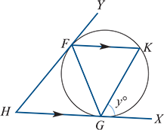
Example
The tangents to a circle at F and G meet at H. A chord FK is drawn parallel to HG. Prove that triangle FGK is isosceles.
Solution
Let ∠XGK=y°.
Then ∠GFK=y° (alternate segment theorem) and ∠GKF=y° (alternate angles).
Therefore triangle FGK is isosceles with FG=KG.

Slide 9
Section summary
A tangent to a circle is perpendicular to the radius drawn from the point of contact.
The two tangents drawn from an external point to a circle are the same length.
In the diagram, the alternate segment to ∠STQ is shaded, and the alternate segment to ∠STP is unshaded.
Alternate segment theorem The angle between a tangent and a chord drawn from the point of contact is equal to any angle in the alternate segment.

