Slide 1
Chords in circles
10C

Slide 2
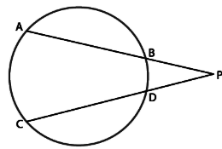
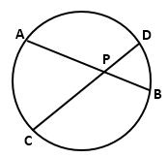
Theorem 8
If AB and CD are two chords of a circle that cut at a point P (which may be inside or outside the circle), then PA⋅PB=PC⋅PD.

Slide 3
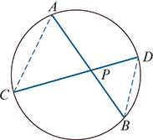
Proof
Case 1:
The intersection point P is inside the circle.
Consider triangles APC and DPB:
∠APC =∠DPB (vertically opposite)
∠CAB =∠BDC (angles in the same segment)
Thus triangle APC is similar to triangle DPB. This gives
$\frac{PA}{PD}$ = $\frac{PC}{PB}$
∴PA⋅PB =PC⋅PD

Slide 4
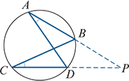
Proof
Case 2:
The intersection point P is outside the circle.
Show that triangle APD is similar to triangle CPB. This gives
$\frac{PA}{PC}$ = $\frac{PD}{PB}$
∴PA⋅PB =PC⋅PD
A converse of Theorem 8 is:
If line segments AB and CD intersect at a point M and AM⋅BM=CM⋅DM, then the points A, B, C and D are concyclic.

Slide 5
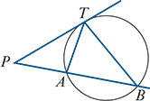
Theorem 9
If P is a point outside a circle and T, A, B are points on the circle such that PT is a tangent and PAB is a secant, then $PT^{2}$=PA⋅PB.
Proof
Consider triangles PAT and PTB:
∠ATP =∠TBA (alternate segment theorem)
∠PAT =∠PTB (angle sum of a triangle)
Therefore triangle PAT is similar to triangle PTB. This gives
$\frac{PA}{PT}$ = $\frac{PT}{PB}$
∴ $PT^{2}$ =PA⋅PB

Slide 6
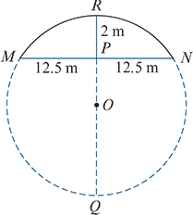
Example
The arch of a bridge is to be in the form of an arc of a circle. The span of the bridge is to be 25 m and the height in the middle 2 m. Find the radius of the circle.
Let r be the radius of the circle. Then PQ=2r−2.
Use Theorem 8 with the chords RQ and MN:
RP⋅PQ=MP⋅PN
Therefore
2PQ= ${12.5}^{2}$
PQ = $\frac{{12.5}^{2}}{2}$
2r−2 = $\frac{{12.5}^{2}}{2}$ as PQ=2r−2
∴r = $\frac{1}{2}$ ($\frac{{12.5}^{2}}{2}$ +2)= $\frac{641}{16}$ m

Slide 7
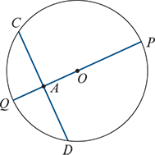
Example
Let A be any point inside a circle with radius r and centre O. Show that, if CD is a chord through A, then CA⋅AD= $r^{2}$− ${OA}^{2}$.
Solution
Let PQ be a diameter through A as shown.
By Theorem 8:
CA⋅AD=QA⋅AP
Since QA=r−OA and AP=r+OA, this gives
CA⋅AD=(r−OA)(r+OA)= $r^{2}$− ${OA}^{2}$

Slide 8
Section summary
Theorem 8 If AB and CD are two chords of a circle that cut at a point P (which may be inside or outside the circle), then PA⋅PB=PC⋅PD.
Theorem 9 If P is a point outside a circle and T, A, B are points on the circle such that PT is a tangent and PAB is a secant, then $PT^{2}$=PA⋅PB.

