Slide 1
Chapter 10 Circle geometry
Revision

Slide 2
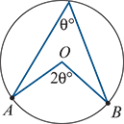
Theorem
The angle at the centre of a circle is twice the angle at the circumference subtended by the same arc.

Slide 3
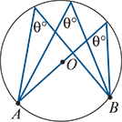
Theorem
Angles in the same segment of a circle are equal.

Slide 4
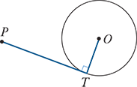
Theorem
A tangent to a circle is perpendicular to the radius drawn from the point of contact.

Slide 5
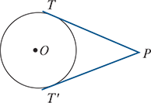
Theorem
The two tangents drawn from an external point are the same length, i.e. PT=PT′.

Slide 6
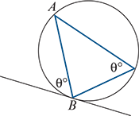
Theorem
The angle between a tangent and a chord drawn from the point of contact is equal to any angle in the alternate segment.

Slide 7
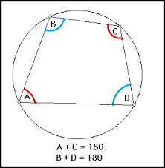
Theorem
A quadrilateral is cyclic if and only if the sum of each pair of opposite angles is 180°.

Slide 8
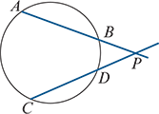
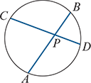
Theorem
If AB and CD are two chords of a circle that cut at a point P, then
PA⋅PB=PC⋅PD

