Slide 1
Symmetry properties
14A

Slide 2
Notes:
https://www.transum.org/Software/SW/Starter_of_the_day/starter_November25.ASP

Slide 3
Symmetry properties and exact values of sine and cosine

Slide 4
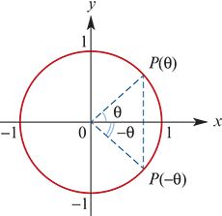
Negative angles
By symmetry:
cos(−θ) =cosθ
sin(−θ) =−sinθ
tan(−θ) =$\frac{−\sin{θ}}{\cos{θ}}$=−tanθ

Slide 5
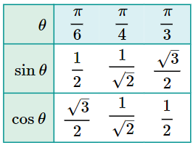
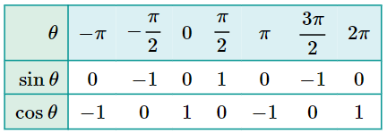
Exact values of sine and cosine
The values in this table can easily be determined from the graphs of sine and cosine or from the unit circle.
The values in this table can easily be determined by drawing:
an equilateral triangle of side length 2 and one median
a square of side length 1 and one diagonal.

Slide 6
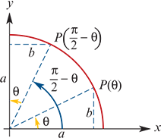
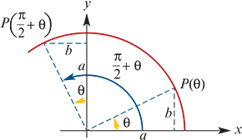
Complementary relationships
From the diagram to the right:
sin($\frac{π}{2}$−θ) =a=cosθ
cos($\frac{π}{2}$−θ) =b=sinθ
From the diagram to the right:
sin($\frac{π}{2}$+θ) =a=cosθ
cos($\frac{π}{2}$+θ) =−b=−sinθ

Slide 7
Example
If sinθ=0.4 and cosα=0.8, find the value of:
sin($\frac{π}{2}$−α)
cos($\frac{π}{2}$+θ)
sin(−θ)
Solution
sin($\frac{π}{2}$−α)=cosα=0.8
cos($\frac{π}{2}$+θ)=−sinθ=−0.4
sin(−θ)=−sinθ=−0.4

