Slide 1
The tangent function
14B

Slide 2
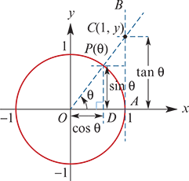
Tangent
Consider the unit circle. If we draw a tangent to the unit circle at A, then the y-coordinate of C, the point of intersection of the line OP and the tangent, is called Tangent θ (abbreviated to tanθ).

Slide 3
Tangent
By considering the similar triangles OPD and OCA:
$\frac{\tan{θ}}{1}$=$\frac{\sin{θ}}{\cos{θ}}$
∴ tanθ= $\frac{\sin{θ}}{\cos{θ}}$
Note that tanθ is undefined when cosθ=0.

Slide 4
Tangent
A table of values for y=tanx is given below.

Slide 5
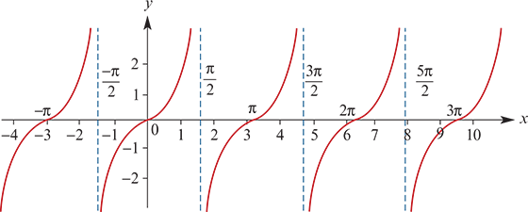
Tangent
The graph of y=tanx is given below.

Slide 6
Tangent
You must also know the following exact values:
tan($\frac{π}{6}$)= $\frac{1}{\sqrt{3}}$,
tan($\frac{π}{4}$)=1,
tan($\frac{π}{3}$)= $\sqrt{3}$

Slide 7
Properties of the tangent function
The graph repeats itself every π units, i.e. the period of tan is π.
The range of tan is R.
The vertical asymptotes have equations x= $\frac{(2k+1)π}{2}$ where k∈Z.
The axis intercepts are at x=kπ where k∈Z.

Slide 8
Symmetry
Using symmetry properties of sine and cosine, we have
tan(π−θ)= $\frac{\sin{(π−θ)}}{\cos{(π−θ)}}$= $\frac{\sin{θ}}{−cos{θ}}$=−tanθ
Similarly, we obtain:
tan(π+θ)=tanθ
tan(2π−θ)=−tanθ
tan(−θ)=−tanθ
tan($\frac{π}{2}$−θ)= $\frac{\cos{θ}}{\sin{θ}}$
tan($\frac{π}{2}$+θ)=− $\frac{\cos{θ}}{\sin{θ}}$
Note: We will see in Section 14E that $\frac{\cos{θ}}{\sin{θ}}$θ can be written as cotθ.

Slide 9
Example-Solution of equations involving the tangent function
Solve the equation 3tan(2x)=$\sqrt{3}$ for x∈(0,2π).
Solution
Since we want solutions for x in (0,2π), we find solutions for 2x in (0,4π).
Once we have found one solution for 2x, we can obtain all other solutions by adding and subtracting multiples of π.
3tan(2x) = $\sqrt{3}$
tan(2x) = $\frac{\sqrt{3}}{3}$ =$\frac{1}{\sqrt{3}}$
∴2x = $\frac{π}{6}$ or $\frac{7π}{6}$ or $\frac{13π}{6}$ or $\frac{19π}{6}$
x = $\frac{π}{12}$ or $\frac{7π}{12}$ or $\frac{13π}{12}$ or $\frac{19π}{12}$

Slide 10
Example-Solution of equations involving the tangent function
Solve the equation tan($\frac{1}{2}$(x− $\frac{π}{4}$))=−1 for x∈[−2π,2π].
Solution
Note that
x∈[−2π,2π]⇔x− $\frac{π}{4}$ ∈[− $\frac{9π}{4}$ , $\frac{7π}{4}$ ]⇔ $\frac{1}{2}$(x− $\frac{π}{4}$ )∈[− $\frac{9π}{8}$ , $\frac{7π}{8}$ ]
tan($\frac{1}{2}$(x− $\frac{π}{4}$)) =−1
Implies $\frac{1}{2}$(x− $\frac{π}{4}$) = − $\frac{π}{4}$ or $\frac{3π}{4}$
x− $\frac{π}{4}$ =− $\frac{π}{2}$ or $\frac{3π}{2}$
∴x =− $\frac{π}{4}$ or $\frac{7π}{4}$

Slide 11
Graphing the tangent function
When graphing a transformation of the tangent function:
Find the period.
Find the equations of the asymptotes.
Find the intercepts with the axes.

Slide 12
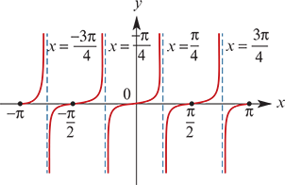
Example
Sketch the graph of each of the following for x∈[−π,π]:
y=3tan(2x)
Period= $\frac{π}{n}$= $\frac{π}{2}$
Asymptotes: x= $\frac{(2k+1)π}{4}$, k∈Z
Axis intercepts: x= $\frac{kπ}{2}$, k∈Z

Slide 13
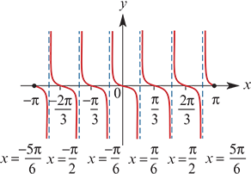
Example
Sketch the graph of each of the following for x∈[−π,π]:
y=−2tan(3x)
Solution
Period= $\frac{π}{n}$= $\frac{π}{3}$
Asymptotes: x= $\frac{(2k+1)π}{6}$, k∈Z
Axis intercepts: x= $\frac{kπ}{3}$, k∈Z

Slide 14
Section summary
The tangent function is given by tanθ= $\frac{\sin{θ}}{\cos{θ}}$ for cosθ≠0.
The graph of y=tanx:
The period is π.
The vertical asymptotes have equations x= $\frac{(2k+1)π}{2}$ where k∈Z.
The axis intercepts are at x=kπ where k∈Z.
Useful symmetry properties:
tan(π+θ)=tanθ
tan(−θ)=−tanθ

