Slide 1
Chapter 14 Further trigonometry
Revision

Slide 2
Complementary relationships
sin($\frac{π}{2}$−θ) =cosθ
sin($\frac{π}{2}$+θ) =cosθ
cos($\frac{π}{2}$−θ) =sinθ
cos($\frac{π}{2}$+θ) =−sinθ

Slide 3
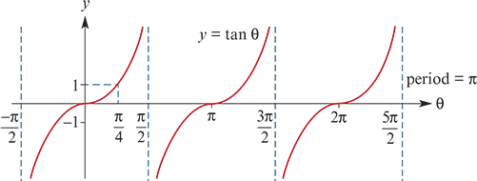
Graph of the tangent function

Slide 4
Reciprocal circular functions
Secθ = $\frac{1}{\cos{θ}}$
cosec θ = $\frac{1}{\sin{θ}}$
cotθ = $\frac{\cos{θ}}{\sin{θ}}$= $\frac{1}{\tan{θ}}$ (if cosθ≠0)

Slide 5
Pythagorean identity
$\cos^{2}{θ \text{+} \sin^{2}{θ}}$ =1
1+ $\tan^{2}{θ}$ = $\sec^{2}{θ}$
$\cot^{2}{θ}$+1 = ${cosec}^{2}{θ}$

Slide 6
Addition formulas
cos(u+v)=cosu cosv−sinu sinv
cos(u−v)=cosu cosv+sinu sinv
sin(u+v)=sinu cosv+cosu sinv
sin(u−v)=sinu cosv−cosu sinv
tan(u+v)= $\frac{tanu+tanv}{1−tanu tanv}$
tan(u−v)= $\frac{tanu−tanv}{1+tanu tanv}$

Slide 7
Double angle formulas
cos(2u)=$\cos^{2}{u}$ − $\sin^{2}{u}$=2$\cos^{2}{u}$−1 =1−2$\sin^{2}{u}$
sin(2u)=2sinu cosu
tan(2u)= $\frac{2tanu}{1−\tan^{2}{u}}$
acosx+bsinx=rcos(x−α) where r= $\sqrt{a^{2}+b^{2}}$, cosα= $\frac{a}{r}$, sinα= $\frac{b}{r}$
acosx+bsinx=rsin(x+β) where r= $\sqrt{a^{2}+b^{2}}$, sinβ= $\frac{a}{r}$, cosβ= $\frac{b}{r}$

