Slide 1
Reciprocal functions
15A
https://www.wolframalpha.com/calculators/equation-solver-calculator
https://kahoot.it/challenge/01508469?challenge-id=866b7e2c-3a48-4847-852c-88711d5afe08_1637103531658
https://kahoot.it/challenge/08315502?challenge-id=866b7e2c-3a48-4847-852c-88711d5afe08_1637103231308

Slide 2
Notes:
https://www.transum.org/Software/sw/Starter_of_the_day/Starter_August12.asp

Slide 3
Reciprocals of polynomials
You have learned in previous years that the reciprocal of a non-zero number a is $\frac{1}{a}$. Likewise, we have the following definition.
If y=f(x) is a polynomial function, then its reciprocal function is defined by the rule
y= $\frac{1}{f(x)}$
For example, the reciprocal of the function y=$x^{3}$ is y= $\frac{1}{x^{3}}$.

Slide 4
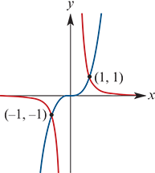
Example
Sketch the graphs of y= $x^{3}$ and y= $\frac{1}{x^{3}}$ on the same set of axes.
We first sketch the graph of y= $x^{3}$. This is shown in blue.
Horizontal asymptotes
If x→±$∞$, then $\frac{1}{x^{3}}$→0. Therefore the line y=0 is a horizontal asymptote of the reciprocal function.
Vertical asymptotes
Notice that $x^{3}$ =0 when x=0.
If x is a small positive number, then $\frac{1}{x^{3}}$ is a large positive number.
If x is a small negative number, then $\frac{1}{x^{3}}$ is a large negative number.
Therefore the line x=0 is a vertical asymptote of the reciprocal function.

Slide 5
Observations from the example
This example highlights behaviour typical of reciprocal functions:
If y=f(x) is a non-zero polynomial function, then the graph of y= $\frac{1}{f(x)}$ will have vertical asymptotes where f(x)=0.
The graphs of a function and its reciprocal are always on the same side of the x-axis.
If the graphs of a function and its reciprocal intersect, then it must be where f(x)=±1.
The following example is perhaps easier, because the reciprocal graph has no vertical asymptotes. This time we are interested in turning points.

Slide 6
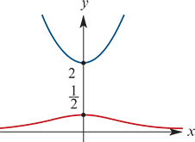
Example
Consider the function f(x)=$x^{2}$+2. Sketch the graphs of y=f(x) and y= $\frac{1}{f(x)}$ on the same set of axes.
We first sketch y= $x^{2}$+2. This is shown in blue.
Horizontal asymptotes
If x→± $∞$, then $\frac{1}{f(x)}$→0. Therefore the line y=0 is a horizontal asymptote of the reciprocal function.
Vertical asymptotes
There are no vertical asymptotes, as there is no solution to the equation f(x)=0.
Turning points
Notice that the graph of y= $x^{2}$+2 has a minimum at (0,2). The reciprocal function therefore has a maximum at (0, $\frac{1}{2}$).

Slide 7
Reciprocals of polynomials
If the graph of y=f(x) has a local minimum at x=a, then the graph of y= $\frac{1}{f(x)}$ will have a local maximum at x=a.
If the graph of y=f(x) has a local maximum at x=a, then the graph of y= $\frac{1}{f(x)}$ will have a local minimum at x=a.

Slide 8
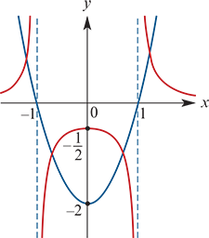
Example
Consider the function f(x)=2(x−1)(x+1). Sketch the graphs of y=f(x) and y= $\frac{1}{f(x)}$ on the same set of axes.
We first sketch y=2(x−1)(x+1). This is shown in blue.
Horizontal asymptotes
If x→± $∞$, then $\frac{1}{f(x)}$→0. Therefore the line y=0 is a horizontal asymptote of the reciprocal function.
Vertical asymptotes
We have f(x)=0 when x=−1 or x=1. Therefore the lines x=−1 and x=1 are vertical asymptotes of the reciprocal function.
Turning points
The graph of y=f(x) has a minimum at (0,−2). Therefore the reciprocal has a local maximum at (0,− $\frac{1}{2}$).

Slide 9
Reciprocals of circular functions
Secant
secx= $\frac{1}{cosx}$

Slide 10
Reciprocals of circular functions
Cosecant
cosecx= $\frac{1}{sinx}$
The first graph shows y=cosx and y=secx; the second shows y=sinx and y=cosecx.
Note: The x-axis intercepts become vertical asymptotes. Local maximums become local minimums, and vice versa.

Slide 11
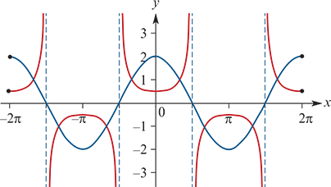
Example
Let f(x)=2cosx for −2π≤x≤2π.
Sketch the graphs of y=f(x) and y= $\frac{1}{f(x)}$ on the same set of axes.
We first sketch y=2cosx for x∈[−2π,2π]. This is shown in blue.
Vertical asymptotes
Vertical asymptotes of the reciprocal function will occur when f(x)=0.
These are given by x=± $\frac{π}{2}$,± $\frac{3π}{2}$.
Turning points
The points (0,2) and (±2π,2) are local maximums of y=f(x). Therefore the points (0, $\frac{1}{2}$) and (±2π, $\frac{1}{2}$) are local minimums of the reciprocal.
The points (±π,−2) are local minimums of y=f(x). Therefore the points (±π,− $\frac{1}{2}$) are local maximums of the reciprocal.

Slide 12
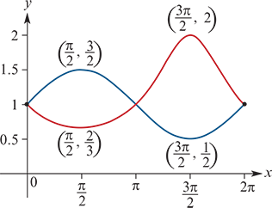
Example
Let f(x)=0.5sinx+1 for 0≤x≤2π.
Sketch the graphs of y=f(x) and y= $\frac{1}{f(x)}$ on the same set of axes.
We first sketch y=0.5sinx+1 for x∈[0,2π]. This is shown in blue.
Turning points
The point ($\frac{π}{2}$, $\frac{3}{2}$) is a local maximum of y=f(x). Therefore the point ($\frac{π}{2}$, $\frac{2}{3}$) is a local minimum of the reciprocal.
The point ($\frac{3π}{2}$, $\frac{1}{2}$) is a local minimum of y=f(x). Therefore the point ($\frac{3π}{2}$,2) is a local maximum of the reciprocal.

Slide 13
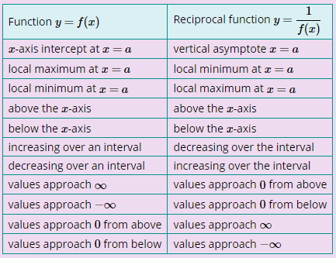
Section summary
Given the graph of a continuous function y=f(x), we can sketch the graph of y= $\frac{1}{f(x)}$ with the help of the following observations:

