Slide 1
Parabola
15C
https://create.kahoot.it/details/3cd2d141-50aa-4eba-a783-71e450eaa978
https://create.kahoot.it/details/34f59ea4-c165-493e-87d9-e1193637ed0d

Slide 2
Notes:
https://www.transum.org/Software/sw/Starter_of_the_day/Starter_January29.asp

Slide 3
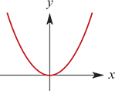
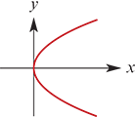
Parabola
The standard form of a parabola is $y=ax^{2}$.
Rotating the figure by 90° gives a parabola with equation $x=ay^{2}$.
The parabola can also be defined geometrically.
$y=ax^{2} x=ay^{2}$

Slide 4
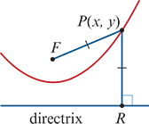
Locus definition of a parabola
A parabola is the locus of a point P that moves so that its distance from a fixed point F is equal to its perpendicular distance from a fixed line.
Note: The fixed point is called the focus and the fixed line is called the directrix.

Slide 5
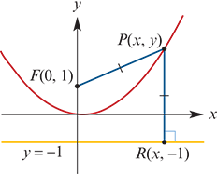
Example
Verify that the set of all points P(x,y) that are equidistant from the point F(0,1) and the line y=−1 is a parabola.
Solution
We know that the point P(x,y) satisfies
FP =RP
$\sqrt{x^{2}+{\left(y−1\right)}^{2}}$ = $\sqrt{{\left(y−(−1)\right)}^{2}}$
$x^{2}+{\left(y−1\right)}^{2}$= ${\left(y+1\right)}^{2}$
$x^{2}$+ $y^{2}$−2y+1 = $y^{2}$+2y+1
$x^{2}$−2y =2y
$x^{2}$ =4y
y = $\frac{{ x}^{2}}{4}$
Therefore the set of points is the parabola with equation y= $\frac{{ x}^{2}}{4}$.

Slide 6
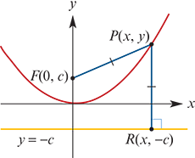
Example
a. Find the equation of the parabola with focus F(0,c) and directrix y=−c.
b. Hence find the focus of the parabola with equation y=2$x^{2}$.
Solution
a. A point P(x,y) on the parabola satisfies
FP =RP
$\sqrt{x^{2}+{\left(y−c\right)}^{2}}$ = $\sqrt{{\left(y−(−c)\right)}^{2}}$
$x^{2}+{\left(y−c\right)}^{2}$= ${\left(y+c\right)}^{2}$
$x^{2}$+ $y^{2}$−2cy+c2 = $y^{2}$+2cy+ $c^{2}$
$x^{2}$−2cy =2cy
$x^{2}$ =4cy
The parabola has equation 4cy= $x^{2}$.
b. Since $\frac{y}{2}$= $x^{2}$, we solve $\frac{1}{2}$=4c, giving c= $\frac{1}{8}$.
Hence the focus is F(0, $\frac{1}{8}$).
The parabola with focus F(0,c) and directrix y=−c has equation 4cy=x2.

Slide 7
A remarkable application
Parabolas have a remarkable property that makes them extremely useful. Light travelling parallel to the axis of symmetry of a reflective parabola is always reflected to its focus.
Parabolas can therefore be used to make reflective telescopes. Low intensity signals from outer space will reflect off the dish and converge at a receiver located at the focus.
To see how this works, we require a simple law of physics:
When light is reflected off a surface, the angle between the ray and the tangent to the surface is preserved after reflection.

Slide 8
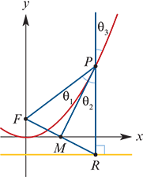
Reflective property of the parabola
Any ray of light parallel to the axis of symmetry of the parabola that reflects off the parabola at point P will pass through the focus at F.

Slide 9
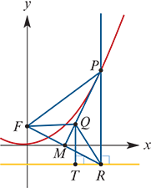
Proof
Since point P is on the parabola, the distance to the focus F is the same as the distance to the directrix. Therefore FP=RP, and so △FPR is isosceles.
Let M be the midpoint of FR. Then △FMP is congruent to △RMP (by SSS). Therefore MP is the perpendicular bisector of FR and
$θ_{1}$= $θ_{2}$ ( as △FMP≡△RMP)
= $θ_{3}$ (vertically opposite angles)
However, we also need to ensure that line MP is tangent to the parabola. To see this, we will show that point P is the only point common to the parabola and line MP.
Take any other point Q on line MP. Suppose that point T is the point on the directrix closest to Q. Then
FQ=RQ>TQ
and so point Q is not on the parabola.

Slide 10
Section summary
A parabola is the locus of a point P that moves so that its distance from a fixed point F is equal to its perpendicular distance from a fixed line.
The fixed point is called the focus and the fixed line is called the directrix.
The parabola with equation 4cy= $x^{2}$ has focus F(0,c) and directrix y=−c.

