Slide 1
Ellipses
15D

Slide 2
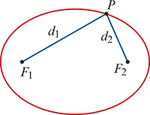
Locus definition of an ellipse
An ellipse is the locus of a point P that moves so that the sum of its distances from two fixed points $F_{1}$ and $F_{2}$ is a constant. That is,
$F_{1}$P+ $F_{2}$P=k
Note: Points $F_{1}$ and $F_{2}$ are called the foci of the ellipse.

Slide 3
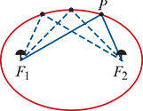
Drawing an ellipse
An ellipse can be drawn by pushing two pins into paper. These will be the foci. A string of length k is tied to each of the two pins and the tip of a pen is used to pull the string taut and form a triangle. The pen will trace an ellipse if it is moved around the pins while keeping the string taut.

Slide 4
Cartesian equations of ellipses
The standard form of the Cartesian equation of an ellipse centred at the origin is
$\frac{x^{2}}{a^{2}}$ + $\frac{y^{2}}{b^{2}}$=1

Slide 5
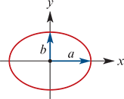
Cartesian equations of ellipses
This ellipse has x-axis intercepts ±a and y-axis intercepts ±b.
Applying the translation defined by (x,y)→(x+h,y+k), we can see the following result:
The graph of
$\frac{{(x−h)}^{2}}{a^{2}}$ + $\frac{{(y−k)}^{2}}{b^{2}}$=1
is an ellipse centred at the point (h,k).

Slide 6
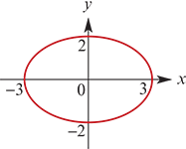
Example
For each of the following equations, sketch the graph of the corresponding ellipse. Give the coordinates of the centre and the axis intercepts.
a. $\frac{x^{2}}{9}$ + $\frac{y^{2}}{4}$=1
Solution
a. The equation can be written as
$\frac{x^{2}}{3^{2}}$ + $\frac{y^{2}}{2^{2}}$=1
This is an ellipse with centre (0,0) and axis intercepts at x=±3 and y=±2.

Slide 7
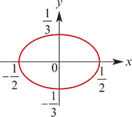
Example
For each of the following equations, sketch the graph of the corresponding ellipse. Give the coordinates of the centre and the axis intercepts.
b. 4$x^{2}$+9$y^{2}$=1
Solution
b. The equation can be written as
$\frac{x^{2}}{{(\frac{1}{2})}^{2}}$ + $\frac{y^{2}}{{(\frac{1}{3})}^{2}}$=1
This is an ellipse with centre (0,0) and axis intercepts at x=± $\frac{1}{2}$ and y=± $\frac{1}{3}$.

Slide 8
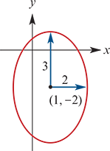
Example
For each of the following equations, sketch the graph of the corresponding ellipse. Give the coordinates of the centre and the axis intercepts.
c. $\frac{{(x−1)}^{2}}{4}$ + $\frac{{(y+2)}^{2}}{9}$=1
Solution
c. This is an ellipse with centre (1,−2).
To find the x-axis intercepts, let y=0. Then solving for x gives
x=$\frac{3±2\sqrt{5}}{3}$
Likewise, to find the y-axis intercepts, let x=0. This gives
y= $\frac{−4±3\sqrt{3}}{2}$

Slide 9
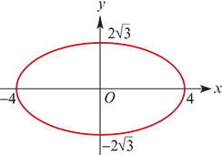
Example
Consider points A(−2,0) and B(2,0). Find the equation of the locus of points P satisfying AP+BP=8.
Let (x,y) be the coordinates of point P. If AP+BP=8, then
$\sqrt{{\left(x+2\right)}^{2}+y^{2}}$+ $\sqrt{{\left(x−2\right)}^{2}+y^{2}}$ =8
and so $\sqrt{{\left(x+2\right)}^{2}+y^{2}}$=8− $\sqrt{{\left(x−2\right)}^{2}+y^{2}}$
Square both sides, then expand and simplify:
${\left(x+2\right)}^{2}+y^{2}$=64−16 $\sqrt{{\left(x−2\right)}^{2}+y^{2}}$+(${\left(x−2\right)}^{2}+y^{2}$
$x^{2}$+4x+4+ $y^{2}$ =64−16 $\sqrt{{\left(x−2\right)}^{2}+y^{2}}$+ $x^{2}$−4x+4+ $y^{2}$
x−8 =−2 $\sqrt{{\left(x−2\right)}^{2}+y^{2}}$
Square both sides again:
$x^{2}$−16x+64=4($x^{2}$−4x+4+ $y^{2}$ )
Simplifying yields
3$x^{2}$+4$y^{2}$ =48
i.e. $\frac{x^{2}}{16}$ + $\frac{y^{2}}{12}$=1
This is an ellipse with centre the origin and axis intercepts at x=±4 and y=±2 $\sqrt{3}$.
Every point P on the ellipse satisfies AP+BP=8.

Slide 10
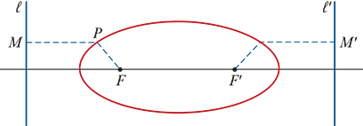
Example
Note: You might like to consider the general version of this example with A(−c,0), B(c,0) and AP+BP=2a, where a>c>0.
It can also be shown that an ellipse is the locus of points P(x,y) satisfying
FP=eMP
where F is a fixed point, 0<e<1 and MP is the perpendicular distance from P to a fixed line ℓ. From the symmetry of the ellipse, it is clear that there is a second point F′ and a second line ℓ′ such that F′P=eM′P defines the same locus, where M′P is the perpendicular distance from P to ℓ′.

Slide 11
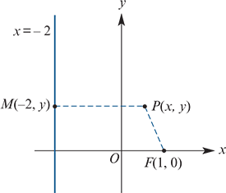
Example
Find the equation of the locus of points P(x,y) if the distance from P to the point F(1,0) is half the distance MP, the perpendicular distance from P to the line with equation x=−2. That is, FP= $\frac{1}{2}$MP.
Solution
Let (x,y) be the coordinates of point P.
If FP= $\frac{1}{2}$MP, then $\sqrt{{\left(x−1\right)}^{2}+y^{2}}$= $\frac{1}{2}$ $\sqrt{{\left(x+2\right)}^{2}}$
Square both sides: ${\left(x−1\right)}^{2}+y^{2}$= $\frac{1}{4}$ ${\left(x+2\right)}^{2}$
4($x^{2}$−2x+1)+4$y^{2}$ = $x^{2}$+4x+4 → 3$x^{2}$−12x+4$y^{2}$ =0
Complete the square: 3($x^{2}$−4x+4)+4$y^{2}$ =12
3 ${\left(x−2\right)}^{2}$+4$y^{2}$ 2 =12 or equivalently $\frac{{(x−2)}^{2}}{4}$ + $\frac{y^{2}}{3}$=1
This is an ellipse with centre (2,0).

Slide 12
Section summary
An ellipse is the locus of a point P that moves so that the sum of its distances $d_{1}$ and $d_{2}$ from two fixed points $F_{1}$ and $F_{2}$ F2 (called the foci) is equal to a fixed positive constant.
The graph of
$\frac{{(x−h)}^{2}}{a^{2}}$ + $\frac{{(y−k)}^{2}}{b^{2}}$=1
is an ellipse centred at the point (h,k).

