Slide 1
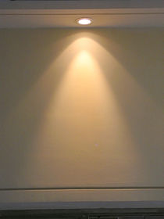
Hyperbolas
15E

Slide 2
Notes:
https://www.transum.org/Software/sw/Starter_of_the_day/Starter_December13.asp

Slide 3
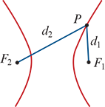
Locus definition of a hyperbola
A hyperbola is the locus of a point P that moves so that the difference between its distances from two fixed points $F_{1}$ and $F_{2}$ is a constant. That is,
∣ $F_{2}$P− $F_{1}$P∣=k
Note: Points $F_{1}$ and $F_{2}$ are called the foci of the hyperbola.

Slide 4
Locus definition of a hyperbola
The standard form of the Cartesian equation of a hyperbola centred at the origin is
$\frac{x^{2}}{a^{2}}−\frac{y^{2}}{b^{2}}=1$
Applying the translation defined by (x,y)→(x+h,y+k), we can see the following result:
The graph of
$\frac{{\left(x−h\right)}^{2}}{a^{2}}−\frac{{\left(y−k\right)}^{2}}{b^{2}}=1$
is a hyperbola centred at the point (h,k).
Note: Interchanging x and y in this equation produces another hyperbola (rotated by 90°).

Slide 5
Asymptotes of the hyperbola
We now investigate the behaviour of the hyperbola as x→±$∞$. We first show that the hyperbola with equation
$\frac{x^{2}}{a^{2}}−\frac{y^{2}}{b^{2}}=1$
has asymptotes
y= $\frac{b}{a}$x and y=− $\frac{b}{a}$x

Slide 6
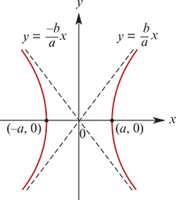
Asymptotes of the hyperbola
To see why this should be the case, we rearrange the equation of the hyperbola as follows:
$\frac{x^{2}}{a^{2}}−\frac{y^{2}}{b^{2}}=1$
$\frac{y^{2}}{b^{2}}$ = $\frac{x^{2}}{a^{2}}$−1
$y^{2}$ = $\frac{b^{2}x^{2}}{a^{2}}$− $b^{2}$= $\frac{b^{2}x^{2}}{a^{2}}$(1− $\frac{a^{2}}{x^{2}}$)
If x→±$∞$, then $\frac{a^{2}}{x^{2}}$→0. Therefore $y^{2}$ → $\frac{b^{2}x^{2}}{a^{2}}$ as x→± $∞$. That is,
y→± $\frac{bx}{a}$ as x→± $∞$
Applying the translation defined by (x,y)→(x+h,y+k), we obtain the following result:

Slide 7
Asymptotes of the hyperbola
The hyperbola with equation
$\frac{{\left(x−h\right)}^{2}}{a^{2}}−\frac{{\left(y−k\right)}^{2}}{b^{2}}=1$
has asymptotes given by
y−k=± $\frac{b}{a}$(x−h)

Slide 8
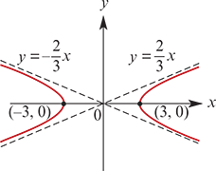
Example
For each of the following equations, sketch the graph of the corresponding hyperbola. Give the coordinates of the centre, the axis intercepts and the equations of the asymptotes.
a. $\frac{x^{2}}{9}−\frac{y^{2}}{4}=1$
Solution
Since $\frac{x^{2}}{9}−\frac{y^{2}}{4}=1$, we have
$y^{2}$= $\frac{{4x}^{2}}{9}$(1− $\frac{9}{x^{2}}$)
Thus the equations of the asymptotes are y=± $\frac{2}{3}$x.
If y=0, then $x^{2}$=9 and so x=±3. The x-axis intercepts are (3,0) and (−3,0). The centre is (0,0).

Slide 9
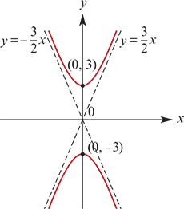
Example
For each of the following equations, sketch the graph of the corresponding hyperbola. Give the coordinates of the centre, the axis intercepts and the equations of the asymptotes.
b. $\frac{y^{2}}{9}−\frac{x^{2}}{4}=1$
Solution
Since $\frac{y^{2}}{9}−\frac{x^{2}}{4}=1$, we have
$y^{2}$= $\frac{{9x}^{2}}{4}$(1+ $\frac{4}{x^{2}}$)
Thus the equations of the asymptotes are y=± $\frac{3}{2}$x.
The y-axis intercepts are (0,3) and (0,−3). The centre is (0,0).

Slide 10
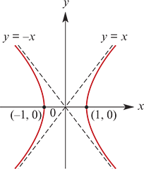
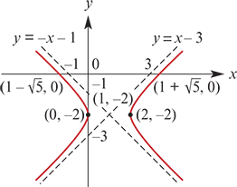
Example
For each of the following equations, sketch the graph of the corresponding hyperbola. Give the coordinates of the centre, the axis intercepts and the equations of the asymptotes.
c. ${(x−1)}^{2}$− ${(y+2)}^{2}$=1
First sketch the graph of $x^{2}$− $y^{2}$=1. The asymptotes are y=x and y=−x. The centre is (0,0) and the axis intercepts are (1,0) and (−1,0).
Note: This hyperbola is called a rectangular hyperbola, as its asymptotes are perpendicular.
Now to sketch the graph of
${(x−1)}^{2}$− ${(y+2)}^{2}$=1
we apply the translation (x,y)→(x+1,y−2).
The new centre is (1,−2) and the asymptotes have equations y+2=±(x−1). That is, y=x−3 and y=−x−1.
Axis intercepts
If x=0, then y=−2.
If y=0, then ${(x−1)}^{2}$=5 and so x=1±$\sqrt{5}$.
Therefore the axis intercepts are (0,−2) and (1± $\sqrt{5}$,0).

Slide 11
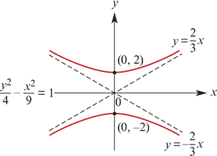
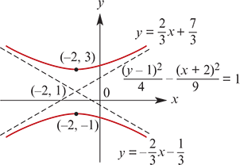
Example
For each of the following equations, sketch the graph of the corresponding hyperbola. Give the coordinates of the centre, the axis intercepts and the equations of the asymptotes.
d. $\frac{{\left(y−1\right)}^{2}}{4}−\frac{{\left(x+2\right)}^{2}}{9}=1$
Solution
The graph of $\frac{{\left(y−1\right)}^{2}}{4}−\frac{{\left(x+2\right)}^{2}}{9}=1$ is obtained from the hyperbola $\frac{y^{2}}{4}−\frac{x^{2}}{9}=1$ through the translation (x,y)→(x−2,y+1). Its centre will be (−2,1).

Slide 12
Example
Consider the points A(−2,0) and B(2,0). Find the equation of the locus of points P satisfying AP−BP=3.
Solution
Let (x,y) be the coordinates of point P.
If AP−BP=3, then
$\sqrt{{\left(x+2\right)}^{2}+y^{2}}$− $\sqrt{{\left(x−2\right)}^{2}+y^{2}}$ =3 and so $\sqrt{{\left(x+2\right)}^{2}+y^{2}}$=3+$\sqrt{{\left(x−2\right)}^{2}+y^{2}}$
Square both sides, then expand and simplify:
${\left(x+2\right)}^{2}+y^{2}$=9+6$\sqrt{{\left(x−2\right)}^{2}+y^{2}}$+${\left(x−2\right)}^{2}+y^{2}$
$x^{2}$+4x+4+ $y^{2}$=9+6 $\sqrt{{\left(x−2\right)}^{2}+y^{2}}$+ $x^{2}$−4x+4+ $y^{2}$
8x−9 =6 $\sqrt{{\left(x−2\right)}^{2}+y^{2}}$
Note that this only holds if x≥$\frac{9}{8}$. Squaring both sides again gives
64$x^{2}$−144x+81 =36($x^{2}$−4x+4+ $y^{2}$)
28$x^{2}$−36$y^{2}$ =63
$\frac{{4x}^{2}}{9}−\frac{{4y}^{2}}{7}=1$for x≥ $\frac{3}{2}$
This is the right branch of a hyperbola with centre the origin and x-axis intercept $\frac{3}{2}$.

Slide 13
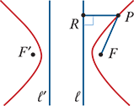
Hyperbola
It can also be shown that a hyperbola is the locus of points P(x,y) satisfying
FP=eRP
where F is a fixed point, e>1 and RP is the perpendicular distance from P to a fixed line ℓ.
From the symmetry of the hyperbola, it is clear that there is a second point F′ and a second line ℓ′ such that F′P=eR′P defines the same locus, where R′P is the perpendicular distance from P to ℓ′.

Slide 14
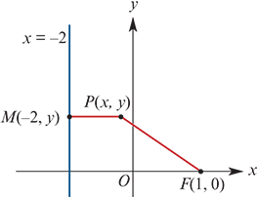
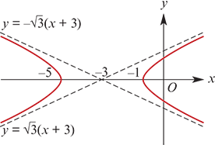
Example
Find the equation of the locus of points P(x,y) that satisfy the property that the distance from P to the point F(1,0) is twice the distance MP, the perpendicular distance from P to the line with equation x=−2. That is, FP=2MP.
Solution
Let (x,y) be the coordinates of point P.
If FP=2MP, then
$\sqrt{{\left(x−1\right)}^{2}+y^{2}}$=2 $\sqrt{{\left(x+2\right)}^{2}}$
Squaring both sides gives
${\left(x−1\right)}^{2}+y^{2}$=4${\left(x+2\right)}^{2}$
$x^{2}$−2x+1+ $y^{2}$ =4($x^{2}$+4x+4)
3$x^{2}$+18x− $y^{2}$+15 =0
By completing the square, we obtain
3($x^{2}$+6x+9)−27− $y^{2}$+15 =0
3 ${\left(x+3\right)}^{2}$− $y^{2}$ =12
$\frac{{\left(x+3\right)}^{2}}{4}−\frac{y^{2}}{12}=1$
This is a hyperbola with centre (−3,0).

Slide 15
Section summary
A hyperbola is the locus of a point P that moves so that the difference between its distances from two fixed points $F_{1}$ and $F_{2}$ (called the foci) is a constant. That is, ∣ $F_{2}$P− $F_{1}$P∣=k
The graph of
$\frac{{\left(x−h\right)}^{2}}{a^{2}}−\frac{{\left(y−k\right)}^{2}}{b^{2}}=1$
is a hyperbola centred at the point (h,k). The asymptotes are y−k=± $\frac{b}{a}$(x−h).

