Slide 1
Parametric equations
15F

Slide 2
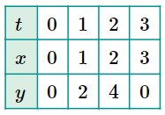
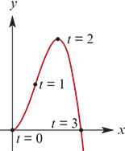
A parametric curve
A parametric curve in the plane is a pair of functions
x=f(t) and y=g(t)
The variable t is called the parameter, and for each choice of t we get a point in the plane (f(t),g(t)). The set of all such points will be a curve in the plane.
For instance, we can plot points on the curve defined by the parametric equations
x=t and y=3$t^{2}$− $t^{3}$
by letting t=0,1,2,3.
In this instance, it is possible to eliminate the parameter t to obtain a Cartesian equation in x and y alone. Substituting t=x into the second equation gives y=3$x^{2}$− $x^{3}$.

Slide 3
A parametric curve

Slide 4
Example -- Lines
Find the Cartesian equation for the curve defined by the parametric equations
a. x=t+2 and y=2t−3
b. Find parametric equations for the line through the points A(2,3) and B(4,7).
Solution
a. Substitute t=x−2 into the second equation to give
y=2(x−2)−3=2x−7
Thus every point lies on the straight line with equation y=2x−7.
b. The gradient of the straight line through points A(2,3) and B(4,7) is
m=$\frac{7−3}{4−2}$=2
Therefore the line has equation
y−3 =2(x−2) → y =2x−1
We can simply let x=t and so y=2t−1.

Slide 5
Example -- Parabola
Find the Cartesian equation of the parabola defined by the parametric equations
x=t−1 and y= $t^{2}$+1
Solution
Substitute t=x+1 into the second equation to give y= ${(x+1)}^{2}$+1.

Slide 6
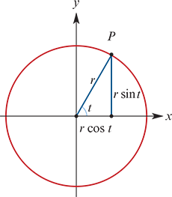
Circles
We have seen that the circle with radius r
and centre at the origin can be written in Cartesian form as
$x^{2}$+ $y^{2}$= $r^{2}$
We now introduce the parameter t and let
x=rcost and y=rsint
As t increases from 0 to 2π, the point P(x,y) travels from (r,0) anticlockwise around the circle and returns to its original position.
To demonstrate that this parameterises the circle, we evaluate
$x^{2}$+ $y^{2}$= $r^{2} \cos^{2}{t}$+ $r^{2} \sin^{2}{t}$= $r^{2}$($\cos^{2}{t}$+ $\sin^{2}{t}$)= $r^{2}$
where we have used the Pythagorean identity $\cos^{2}{t}$+ $\sin^{2}{t}$=1.

Slide 7
Example
a. Find the Cartesian equation of the circle defined by the parametric equations
x=cost+1 and y=sint−2
b. Find parametric equations for the circle with Cartesian equation
${(x+1)}^{2}$+ ${(y+3)}^{2}$=4
Solution
a. We rearrange each equation to isolate cost and sint respectively. This gives
x−1=cost and y+2=sint
Using the Pythagorean identity:
${(x−1)}^{2}$+ ${(y+2)}^{2}$= $\cos^{2}{t}$+ $\sin^{2}{t}$=1
So every point on the graph lies on the circle with equation ${(x−1)}^{2}$+ ${(y+2)}^{2}$=1.
b. We let
cost= $\frac{x+1}{2}$ and sint= $\frac{y+3}{2}$
giving
x=2cost−1 and y=2sint−3
We can easily check that these equations parameterise the given circle.

Slide 8
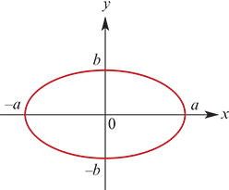
Ellipses
An ellipse can be thought of as a squashed circle.
This is made apparent from the parametric equations for an ellipse:
x=accost and y=bsint
As with the circle, we see the sine and cosine functions, but these are now scaled by different constants, giving different dilations from the x- and y-axes.
We can turn this pair of parametric equations into one Cartesian equation as follows:
$\frac{x}{a}$=cost and $\frac{y}{b}$=sint
giving
$\frac{x^{2}}{a^{2}}$+ $\frac{y^{2}}{b^{2}}$= $\cos^{2}{t}$+ $\sin^{2}{t}$=1
which is the standard form of an ellipse centred at the origin with axis intercepts at x=±a and y=±b.

Slide 9
Example
a. Find the Cartesian equation of the ellipse defined by the parametric equations
x=3cost+1 and y=2sint−1
b. Find parametric equations for the ellipse with Cartesian equation
$\frac{{(x−1)}^{2}}{4}$+ $\frac{{(y+2)}^{2}}{16}$=1
Solution
a. We rearrange each equation to isolate cost and sint respectively. This gives
$\frac{x−1}{3}$=cost and $\frac{y+1}{2}$=sint
Using the Pythagorean identity:
${(\frac{x−1}{3})}^{2}$+ ${(\frac{y+1}{2})}^{2}$= $\cos^{2}{t}$+ $\sin^{2}{t}$=1
So every point on the graph lies on the ellipse with equation $\frac{{(x−1)}^{2}}{3^{2}}$+ $\frac{{(y+1)}^{2}}{2^{2}}$=1.
b. We let
cost= $\frac{x−1}{2}$and sint= $\frac{y+2}{4}$
giving
x=2cost+1 and y=4sint−2

Slide 10
Hyperbolas
We can parameterise a hyperbola using the equations
x=asect and y=btant
From these two equations, we can find the more familiar Cartesian equation:
$\frac{x}{a}$=sect and $\frac{y}{b}$=tant
giving
$\frac{x^{2}}{a^{2}}$ − $\frac{y^{2}}{b^{2}}$= $\sec^{2}{t}$− $\tan^{2}{t}$=1
which is the standard form of a hyperbola centred at the origin.

Slide 11
Example
a. Find the Cartesian equation of the hyperbola defined by the parametric equations
x=3sect−1 and y=2tant+2
b. Find parametric equations for the hyperbola with Cartesian equation
$\frac{{(x+2)}^{2}}{4}$ − $\frac{{(y−3)}^{2}}{16}$=1
Solution
We rearrange each equation to isolate sect and tant respectively. This gives
$\frac{x+1}{3}$=sect and $\frac{y−2}{2}$=tant
and therefore ${(\frac{x+1}{3})}^{2}$ − ${(\frac{y−2}{2})}^{2}$= $\sec^{2}{t}$− $\tan^{2}{t}$=1
So each point on the graph lies on the hyperbola with equation $\frac{{(x+1)}^{2}}{3^{2}}$ − $\frac{{(y−2)}^{2}}{2^{2}}$=1.
b. We let sect= $\frac{x+2}{2}$and tant= $\frac{y−3}{4}$
Giving x=2sect−2 and y=4tant+3

Slide 12
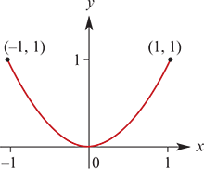
Example -- Parametric equations with restricted domains
Eliminate the parameter to determine the graph of the parameterised curve
x=t−1,y= $t^{2}$−2t+1 for 0≤t≤2
Solution
Substitute t=x+1 from the first equation into the second equation, giving
y= ${(x+1)}^{2}$−2(x+1)+1= $x^{2}$+2x+1−2x−2+1= $x^{2}$
Since 0≤t≤2, it follows that −1≤x≤1.
Therefore, as t increases from 0 to 2, the point travels along the parabola y= $x^{2}$ from (−1,1) to (1,1).

Slide 13
Intersections of curves defined parametrically
It is often difficult to find the intersection of two curves defined parametrically. This is because, although the curves may intersect, they might do so for different values of the parameter t.
In many instances, it is easiest to find the points of intersection using the Cartesian equations for the two curves.

Slide 14
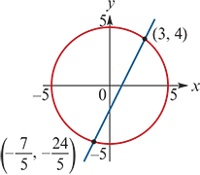
Example
Find the points of intersection of the circle and line defined by the parametric equations:
Circle x=5cost and y=5sint
Line x=t−3 and y=2t−8
The Cartesian equation of the circle is $x^{2}$+ $y^{2}$=25.
The Cartesian equation of the line is y=2x−2.
Substituting the second equation into the first gives
$x^{2}$+ ${(2x−2)}^{2}$ =25
$x^{2}$+4$x^{2}$−8x+4 =25
5$x^{2}$−8x−21 =0
(x−3)(5x+7) =0
This gives solutions x=3 and x=− $\frac{7}{5}$.
Substituting these into the equation y=2x−2 gives y=4 and y= − $\frac{24}{5}$ respectively.
The points of intersection are (3,4) and (− $\frac{7}{5}$, − $\frac{24}{5}$).

Slide 15
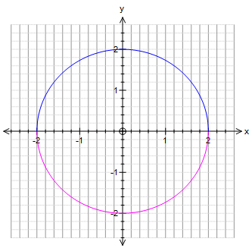
Example
Plot the graph of the parametric curve given by x=2cos(3t) and y=2sin(3t).
${(\frac{x}{2})}^{2}$ + ${(\frac{y}{2})}^{2}$=1
$\frac{x^{2}}{4}$ + $\frac{y^{2}}{4}$ =1
$x^{2}$+ $y^{2}$= $2^{2}$

Slide 16
Section summary
A parametric curve in the plane is a pair of functions
x=f(t) and y=g(t)
where t is called the parameter of the curve. For example:
We can sometimes find the Cartesian equation of a parametric curve by eliminating t and solving for y in terms of x.
 | Cartesian equation | Parametric equations
Circle | $x^{2}$+ $y^{2}$= $r^{2}$ | x=rcost and y=rsint
Ellipse | $\frac{x^{2}}{a^{2}}$ + $\frac{y^{2}}{b^{2}}$= 1 | x=acost and y=bsint
Hyperbola | $\frac{x^{2}}{a^{2}}\text{−}\frac{y^{2}}{b^{2}}$= 1 | x=asect and y=btant

