Slide 1
Graphing using polar coordinates
15H

Slide 2
Polar coordinates
Polar coordinates are useful for describing and sketching curves in the plane, especially in situations that involve symmetry with respect to the origin. Suppose that f is a function. The graph of f in polar coordinates is simply the set of all points (r,θ) such that r=f(θ).

Slide 3
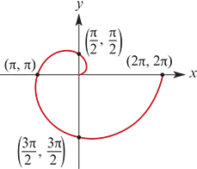
Example
Sketch the spiral with polar equation r=θ, for 0≤θ≤2π.
Solution
The distance r from the origin exactly matches the angle θ. So as the angle increases, so too does the distance from the origin.
Note that the coordinates on the graph are in polar form.

Slide 4
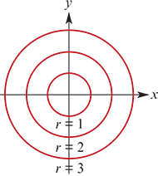
Circles
If a circle is centred at the origin, then its polar equation could not be simpler.
A circle of radius a centred at the origin has polar equation
r=a
That is, the distance r from the origin is constant, having no dependence on the angle θ. This illustrates rather forcefully the utility of polar coordinates: they simplify situations that involve symmetry with respect to the origin.
For circles not centred at the origin, the polar equations are less obvious.

Slide 5
Example
A curve has polar equation r=2sinθ. Show that its Cartesian equation is $x^{2}+{\left(y−1\right)}^{2}$=1.
Solution
The trick here is to first multiply both sides of the polar equation by r to get
$r^{2}$=2rsinθ
Since $r^{2}$= $x^{2}$+ $y^{2}$ and rsinθ=y, this equation becomes
$x^{2}$+ $y^{2}$=2y
$x^{2}$+ $y^{2}$−2y =0
$x^{2}$+ ($y^{2}$−2y+1)−1 =0 (completing the square)
$x^{2}$+ ${\text{(}\text{y}\text{−1)}}^{2}$ =1
This is a circle with centre (0,1) and radius 1.

Slide 6
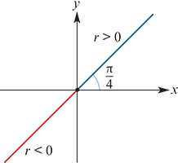
Lines
For a straight line through the origin, the angle θ is fixed and the distance r varies. Because we have allowed negative values of r, the straight line goes in both directions.
The straight line shown has equation
θ=$\frac{π}{4}$
For a straight line that does not go through the origin, the equation is more complicated. A line in Cartesian form ax+by=c can be converted into polar form by substituting x=rcosθ and y=rsinθ.

Slide 7
Example
a. Express x+y=1 in polar form.
b. Express r= $\frac{2}{3cosθ−4sinθ}$ in Cartesian form.
Solution
a. Since x=rcosθ and y=rsinθ, the equation x+y=1 becomes
rcosθ+rsinθ =1
r(cosθ+sinθ) =1
Therefore the straight line has polar equation r = $\frac{2}{cosθ+sinθ}$
b. Since $\frac{x}{r}$=cosθ and $\frac{y}{r}$=sinθ, the equation becomes
r = $\frac{2}{\frac{3x}{r} − \frac{4y}{r}}$ → r = $\frac{2r}{3x−4y}$ → 1 = $\frac{2}{3x−4y}$
Therefore the Cartesian equation is 3x−4y=2

Slide 8
Section summary
For a function f, the graph of f in polar coordinates is the set of all points (r,θ) such that r=f(θ).
Polar coordinates are useful for describing graphs that are symmetric about the origin. For example:
The circle centred at the origin with radius a has equation r=a.
The line through the origin at angle α to the positive x-axis has equation θ=α.
To convert between the polar form and the Cartesian form of an equation, substitute x=rcosθ and y=rsinθ.

