Slide 1
Further graphing using polar coordinates
15I

Slide 2
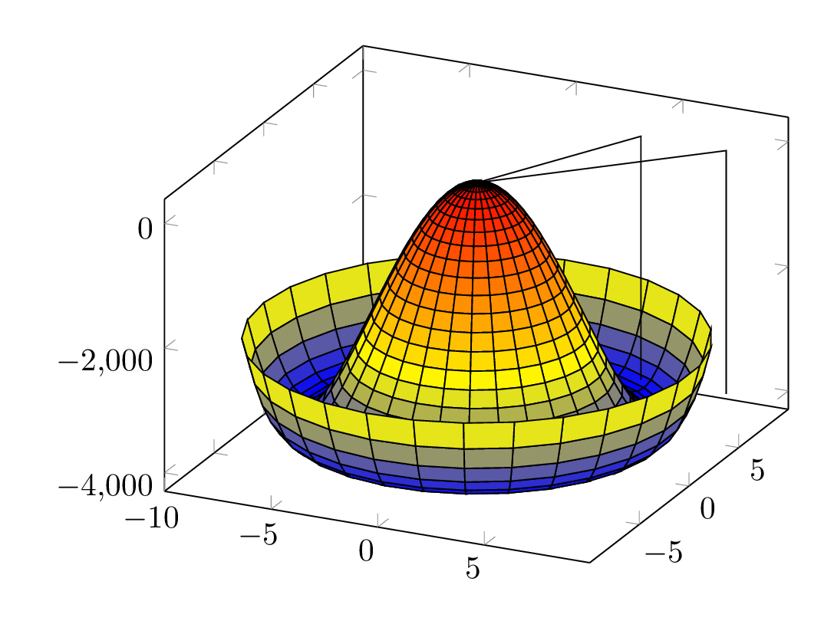
Cardioids
The name cardioid comes from the Greek word for heart. A cardioid is the curve traced by a point on the perimeter of a circle that is rolling around a fixed circle of the same radius.

Slide 3
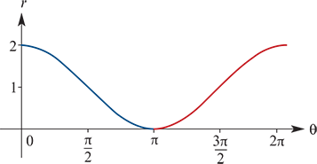
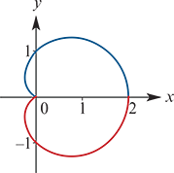
Example
Graph the cardioid with equation r=1+cosθ, for θ∈[0,2π].
Solution
To help sketch this curve, we first graph the function r=1+cosθ using Cartesian coordinates, as shown on the left. This allows us to see how r changes as θ increases.
As the angle θ increases from 0 to π, the distance r decreases from 2 to 0.
As the angle θ increases from π to 2π, the distance r increases from 0 to 2.
This gives the graph of the cardioid shown on the right.

Slide 4
Roses
This impressive curve is fittingly called a rose. It belongs to the family of curves with polar equations of the form
r=cos(nθ)
For the example shown, n=$\frac{5}{8}$.

Slide 5
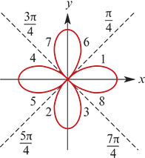
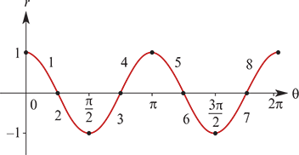
Example
A curve has polar equation r=cos(2θ).
a. Sketch the graph of the curve.
a. To help sketch this curve, we first graph the function r=cos(2θ) using Cartesian coordinates, as shown on the left. This allows us to see how r changes as θ increases.
Using numbers, we have labelled how each section of this graph corresponds to a section of the rose shown on the right.

Slide 6
Example
A curve has polar equation r=cos(2θ).
b. Show that its Cartesian equation is ${\left(x^{2}+y^{2}\right)}^{3}$= ${\left(x^{2}\text{−}y^{2}\right)}^{2}$.
Solution
b. Using the double angle formula cos(2θ)=$\cos^{2}{θ}\text{−}\sin^{2}{θ}$, we have
r =cos(2θ)
r =$\cos^{2}θ{{\text{−} sin}^{2}{θ}}$
r =${\left(\frac{x}{r}\right)}^{2}−{\left(\frac{y}{r}\right)}^{2}$
$r^{3}$ = $x^{2}−y^{2}$
${\left(\sqrt{x^{2}+y^{2}}\right)}^{3}$ = $x^{2}−y^{2}$
${\left(x^{2}+y^{2}\right)}^{3}$ = ${\left(x^{2}−y^{2}\right)}^{2}$
Note: This example further illustrates how polar coordinates can give more pleasing equations than their Cartesian counterparts.
The curve in this example is a four-leaf rose. More generally, the equations r=cos(nθ) and r=sin(nθ) give 2n-leaf roses if n is even, and give n-leaf roses if n is odd.

Slide 7
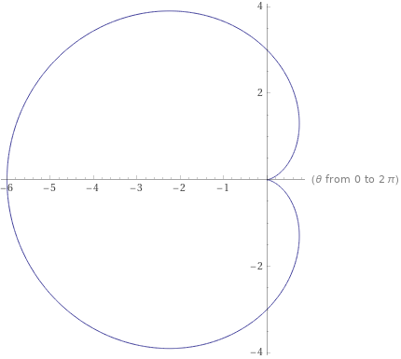
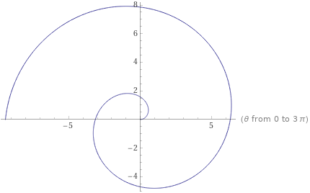
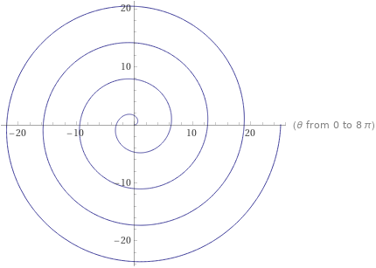
Example-- Mathematica
Plot the graph of r=3(1−cosθ).
Plot the graph of r=θ for 0≤θ≤6π.
https://www.wolframalpha.com/input/?i=plot+r+%3D+theta

Slide 8
Section summary
To sketch the curve r=f(θ) in polar coordinates, it helps to first sketch the graph in Cartesian coordinates.

