Slide 1
How to know if a guy likes you
Lesson 2 Travelling names

Slide 2
How?
zěn me
to know
zhī dào
one
yī
Measure word
gè
male
nán
child
hái zi
nǐ zěn me zhī dào yí gè nán hái zi xǐ huān nǐ?
if
rú guǒ

Slide 3
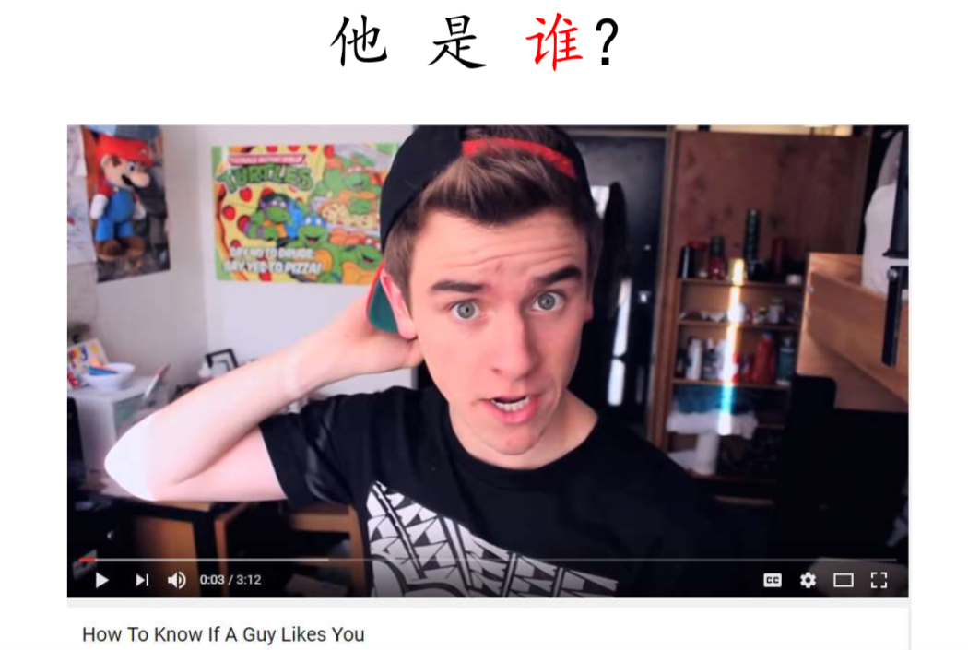
to be
shì
tā shì shéi?

Slide 4
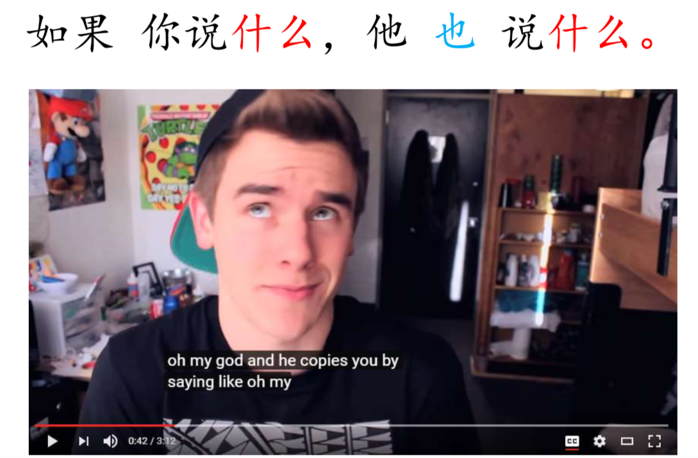
rú guǒ nǐ shuō shén me, tā yě shuō shén me.

Slide 5
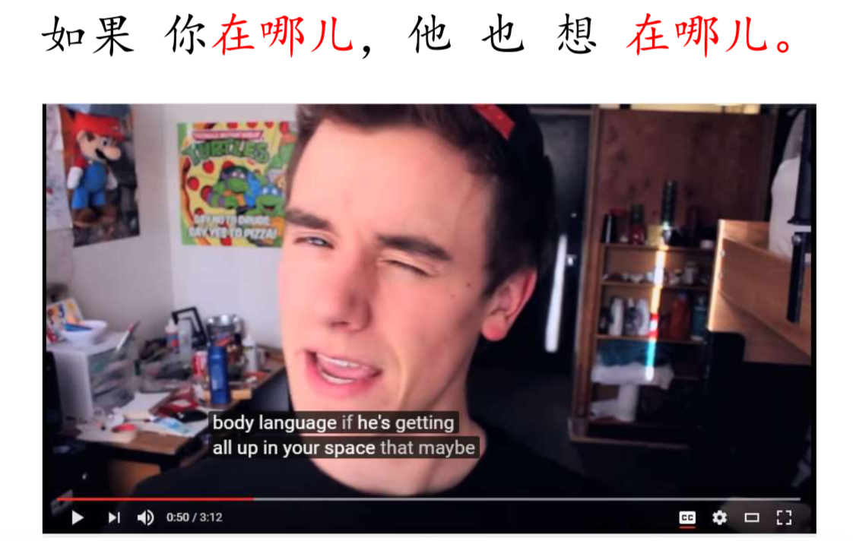
where?
nǎ er
rú guǒ nǐ zài nǎ er, tā yě xiǎng zài nǎ er.
Want/think
xiǎng
at
zài

Slide 6
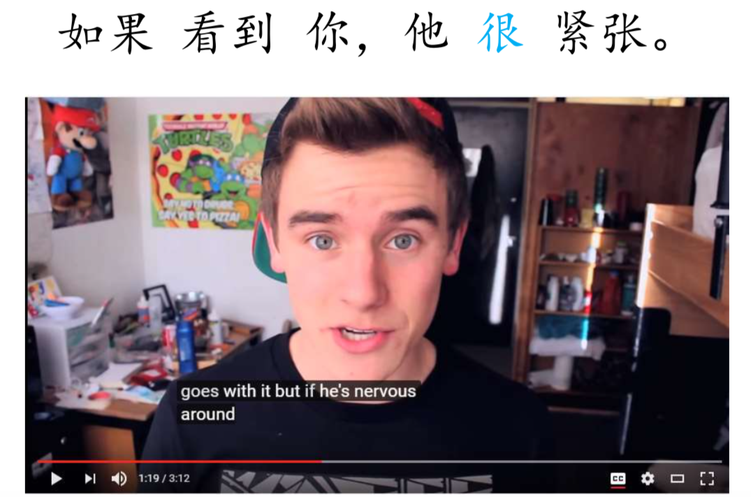
saw
kàn dào
rú guǒ kàn dào nǐ, tā hěn jǐn zhāng.
very
hěn
nervous
jǐn zhāng

Slide 7
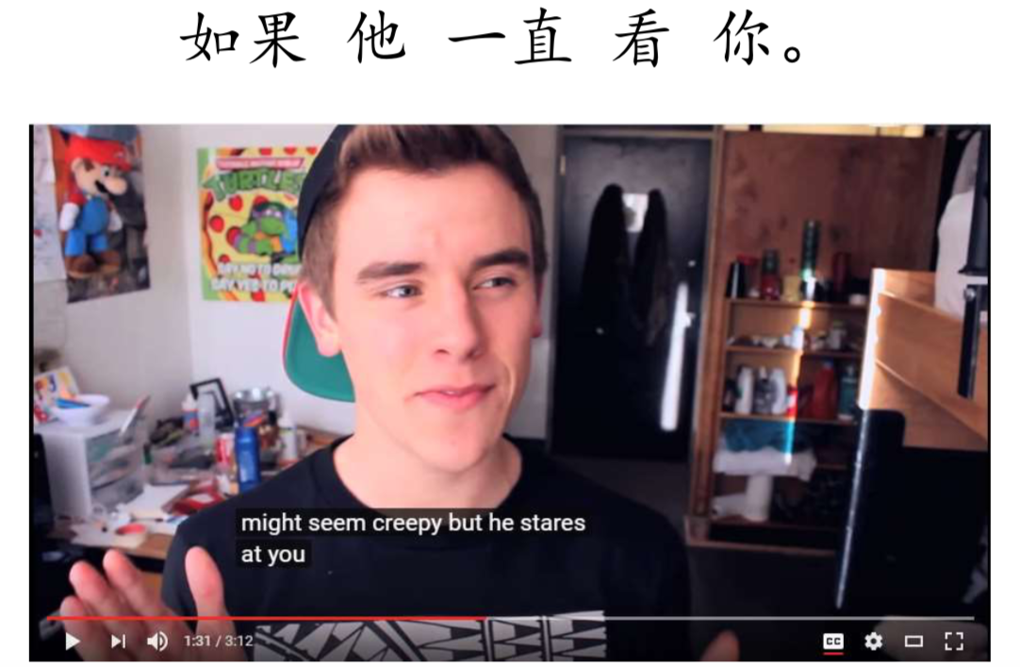
see
kàn
rú guǒ tā yì zhí kàn nǐ.
All the time
yì zhí

Slide 8
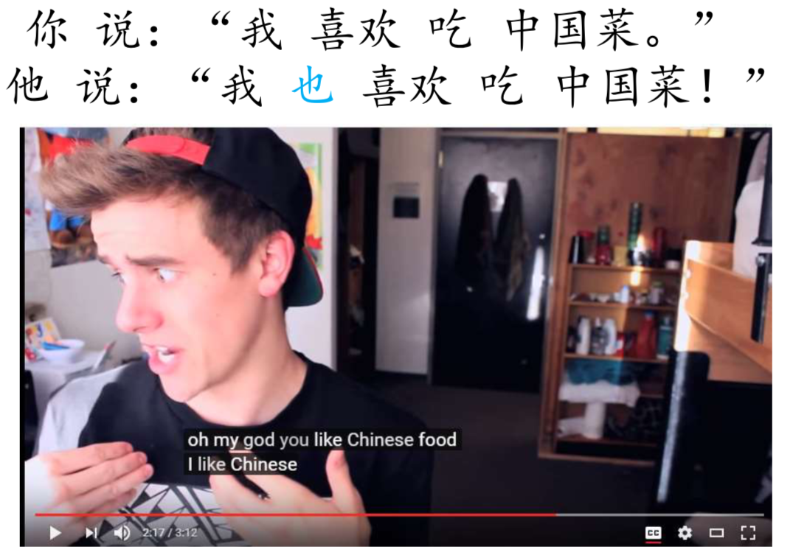
nǐ shuō:’wǒ xǐ huān chī zhōng guó cài.’
tā shuō:’wǒ yě xǐ huān chī zhōng guó cài.’
eat
chī
China
zhōng guó
dish
cài

Slide 9
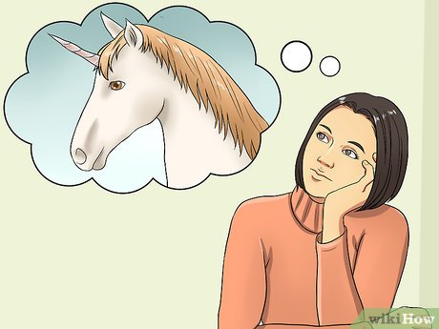
Perhaps
yě xǔ
white
bái
horse
mǎ
prince
wáng zi
tā
xǐ huān
nǐ.
bái mǎ wáng zi

Slide 10
