Slide 1
Wǒ de jiā wǒ de gù shì
Story
gù shì
Family
jiā
My family
My story

Slide 2
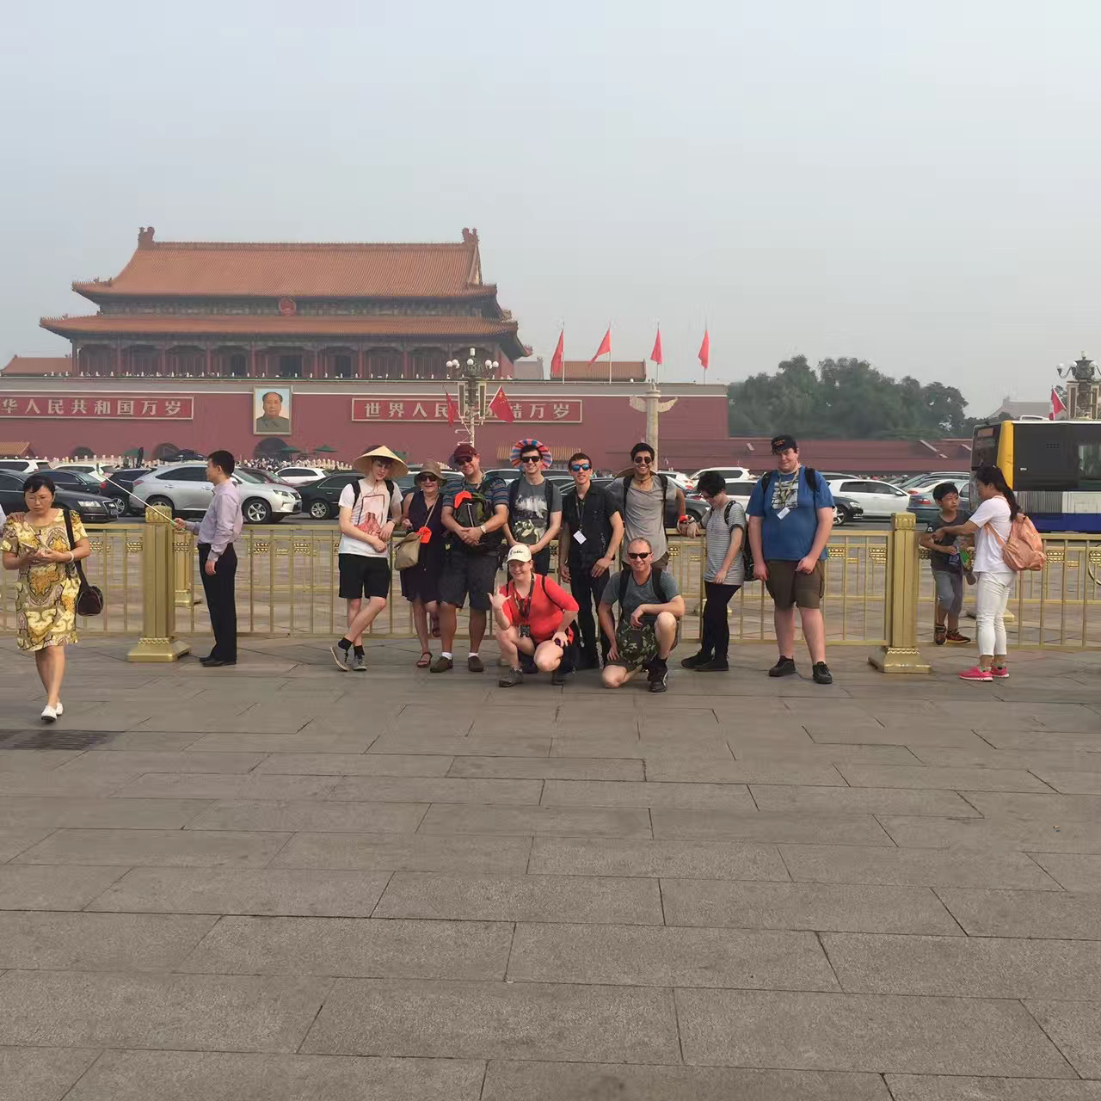
Zài běi jīng
this
zhè

Slide 3
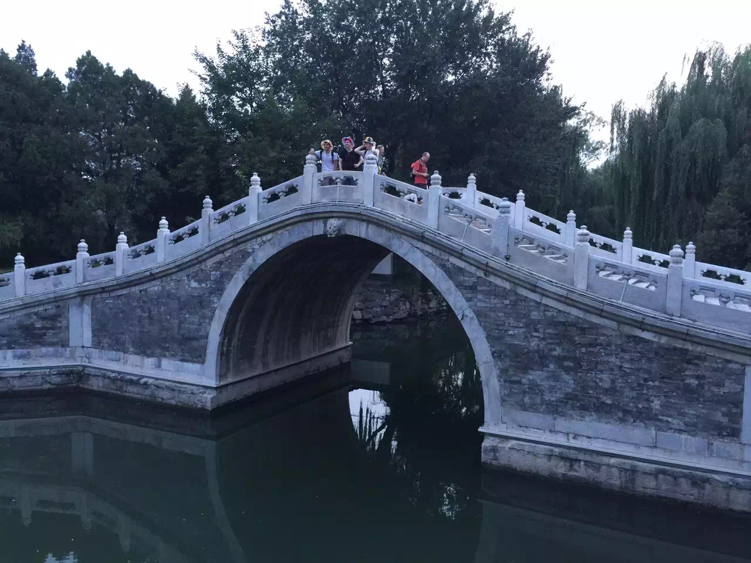
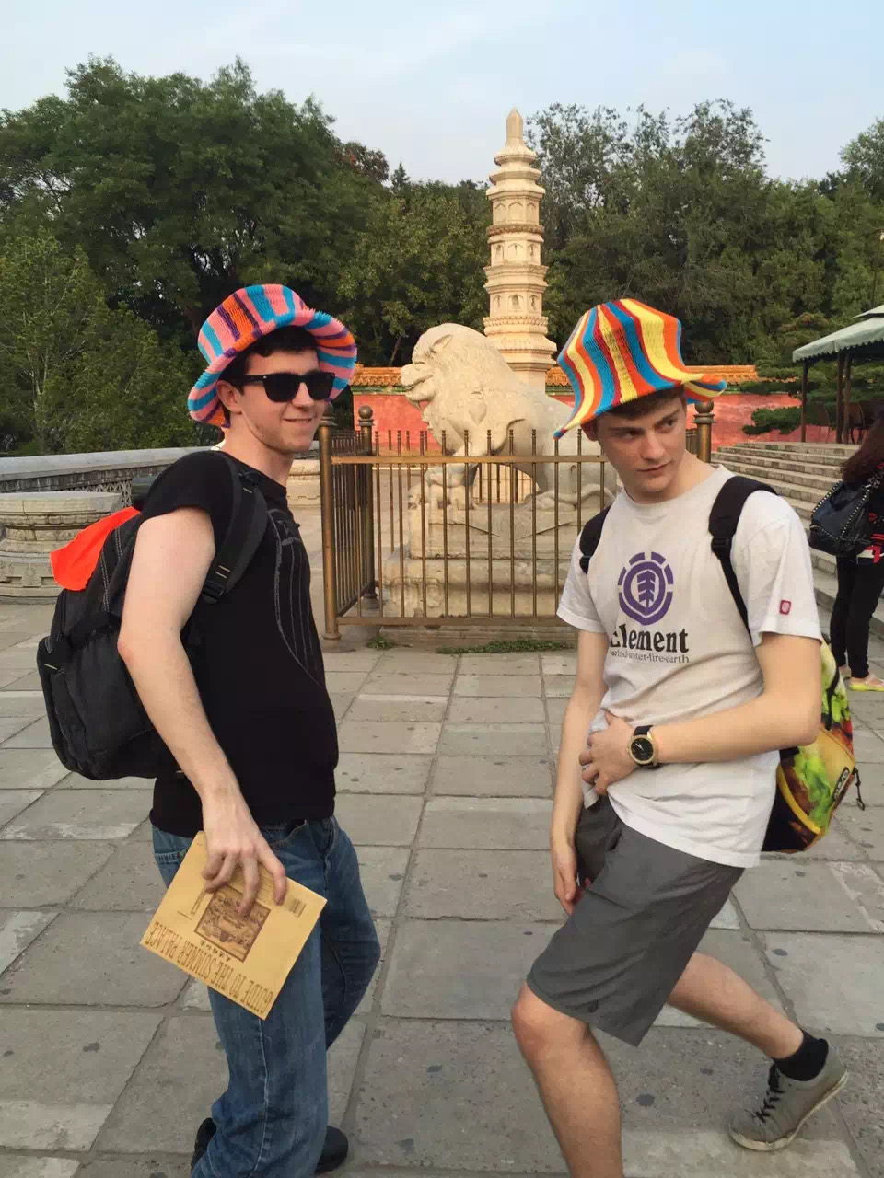
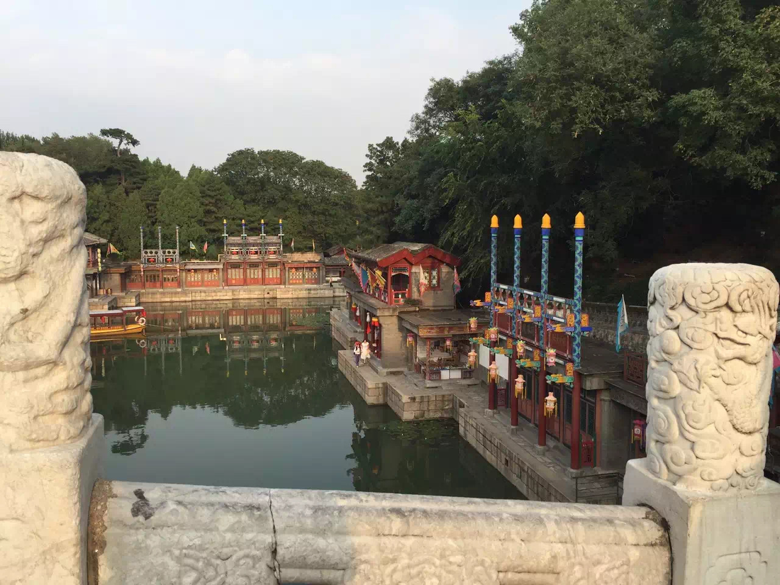
Wǒ mén zài běi jīng

Slide 4
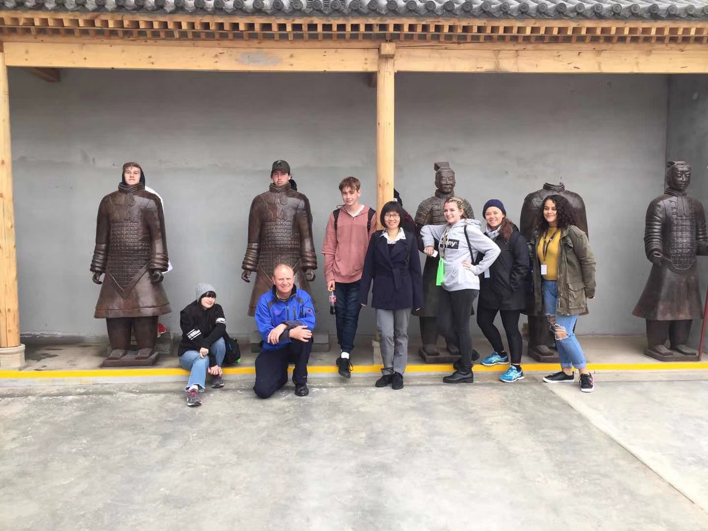
Wǒ mén zài zhōng guó-xī ān hé běi jīng
and
hé

Slide 5
Wǒ mén ---yuè nán

Slide 6
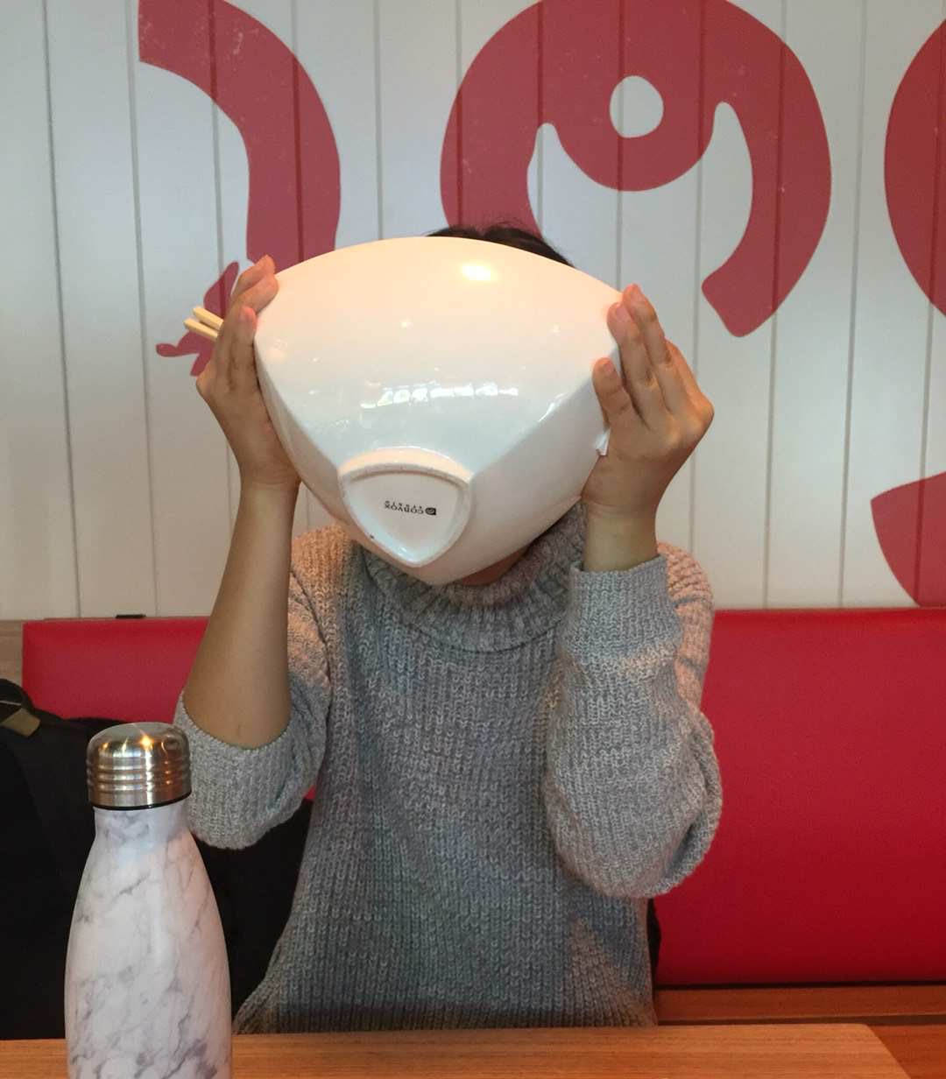
Nǚ ér
How many
jǐ
have
yǒu
Years old
suì
son
ér zi
Don’t have
méi yǒu
daughter
nǚ ér

Slide 7
Wǒ de gǒu
dog
gǒu

Slide 8
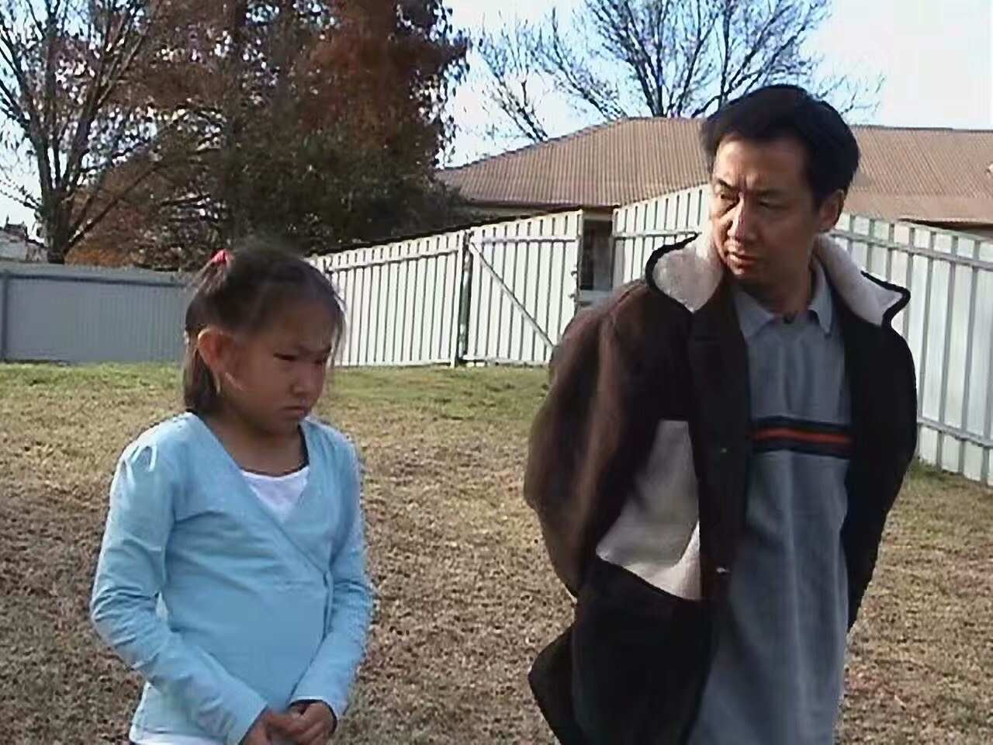
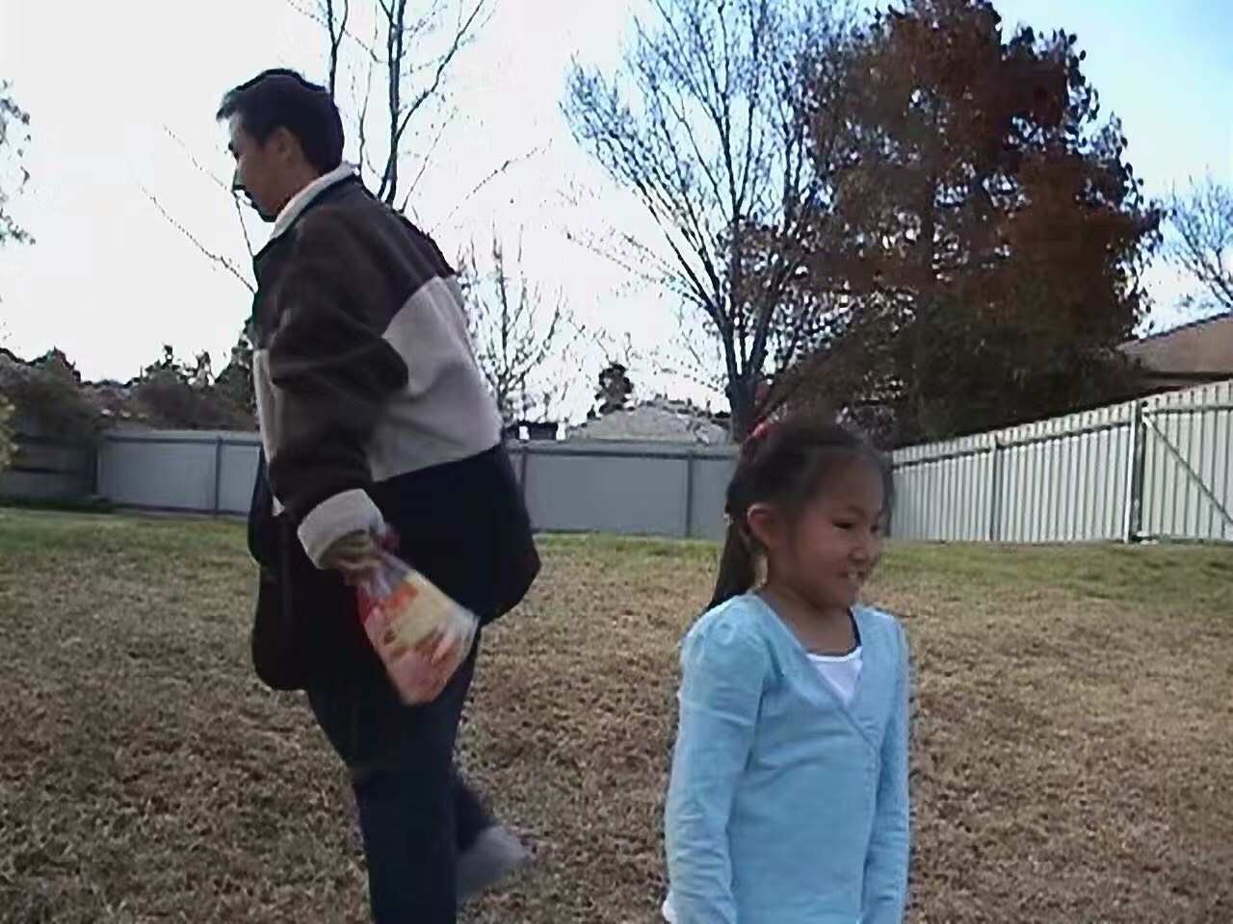
Nǚ ér
husband
lǎo gōng

Slide 9
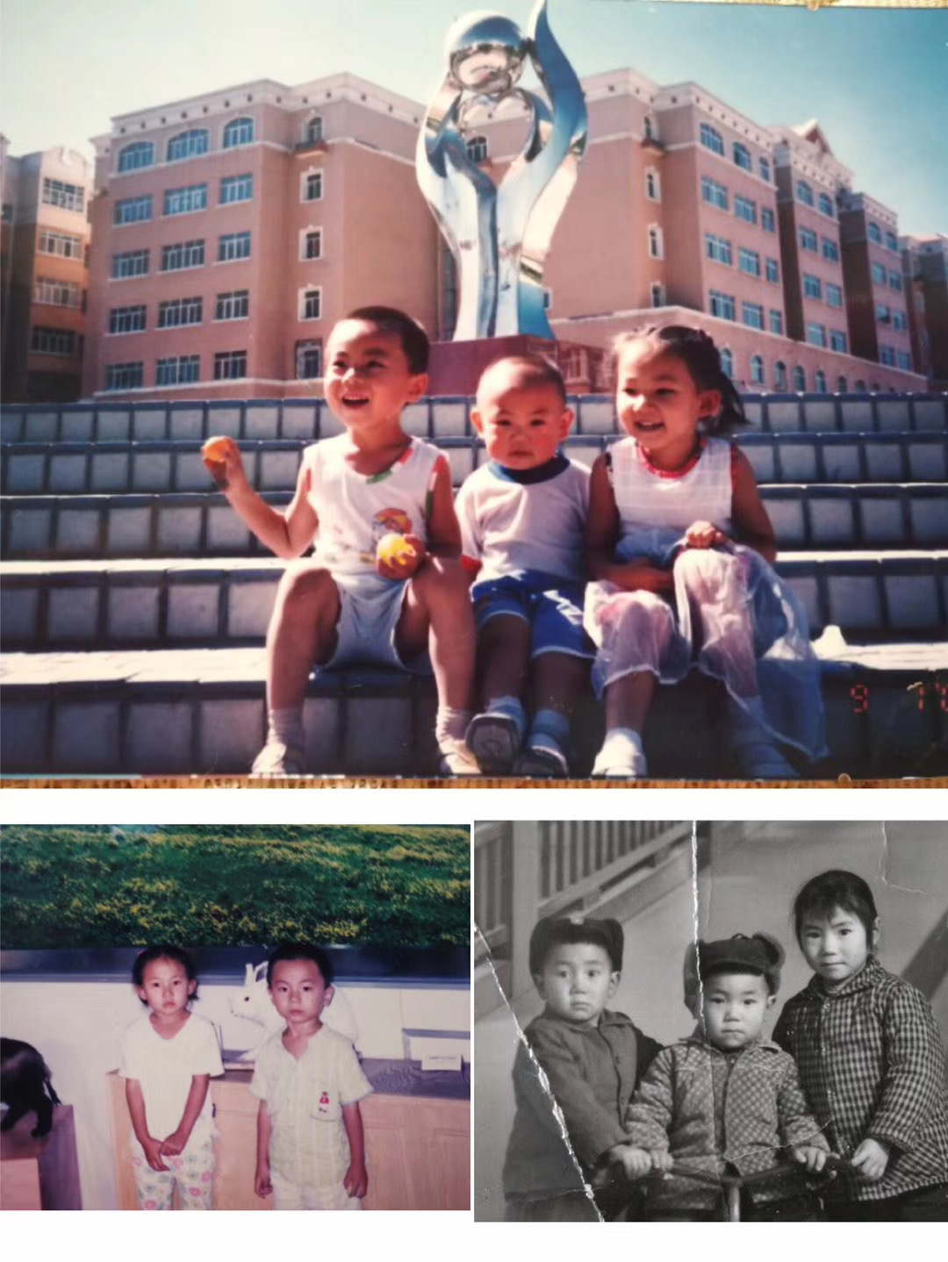
Nǚ ér
Older sister
jiě jie
Younger brother
dì di

Slide 10
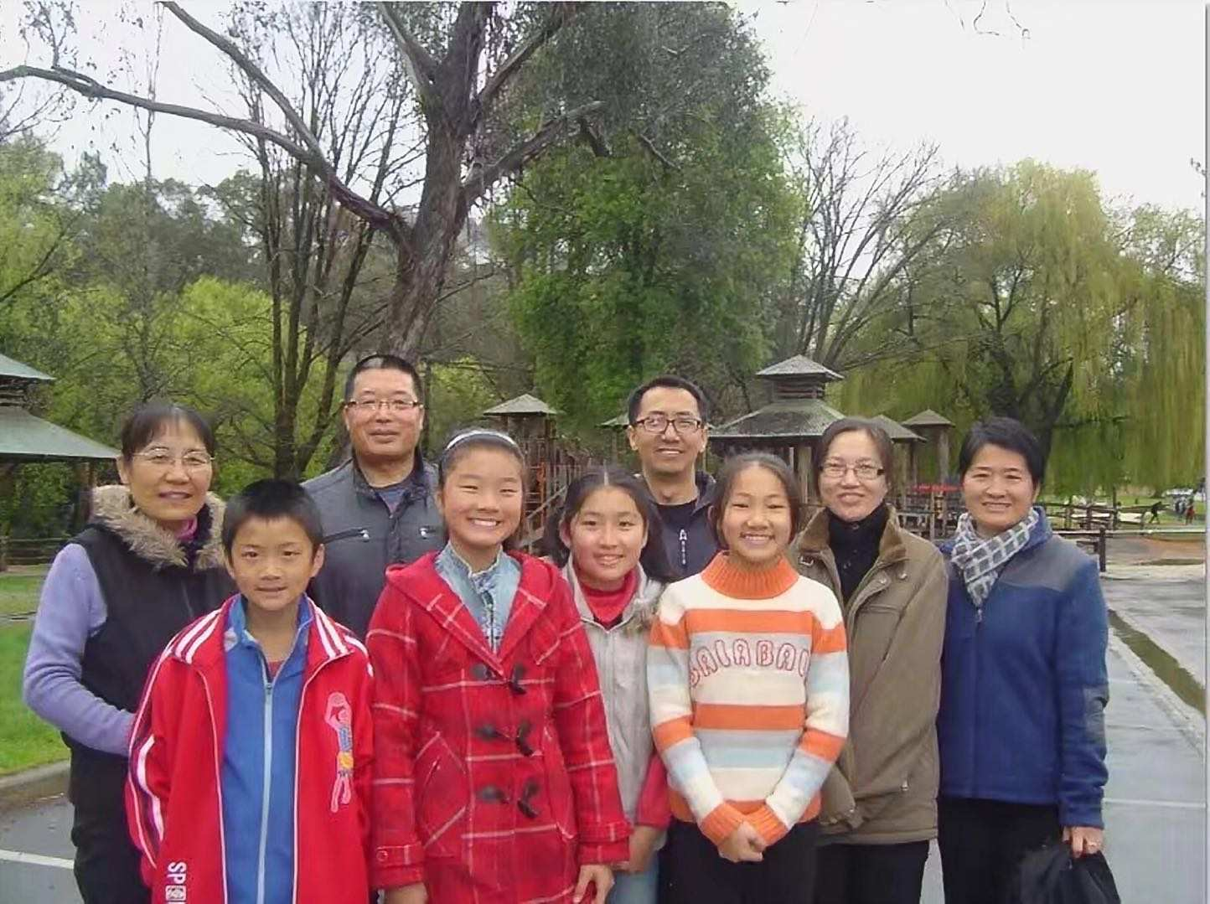
Péng you
friend
péng you

Slide 11
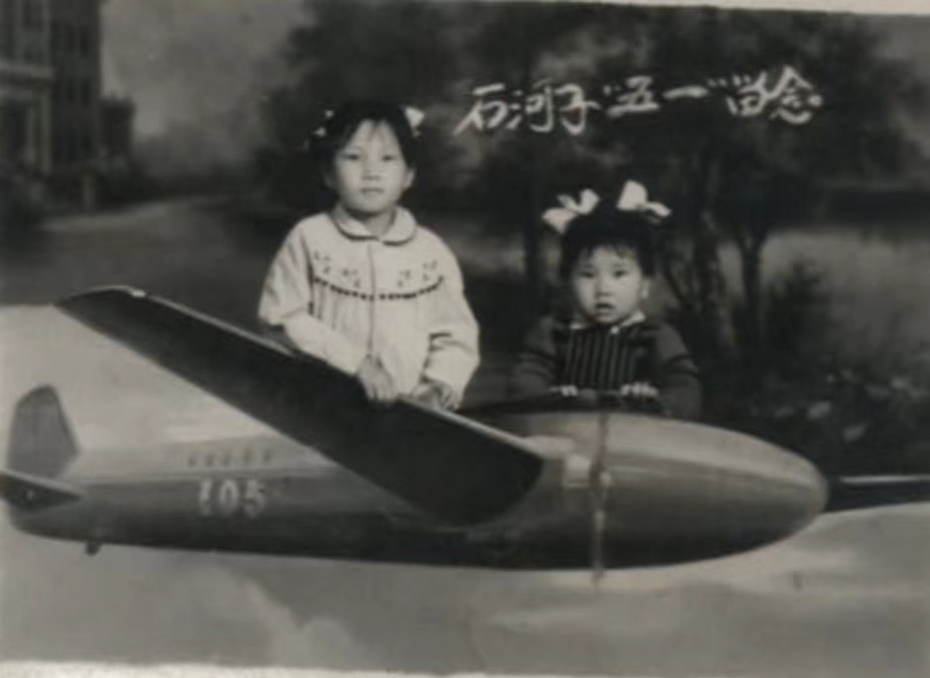
Wǒ de jiā
dad
bà ba
mum
mā ma
Younger sister
mèi mei
good
hǎo
look
kàn

Slide 12
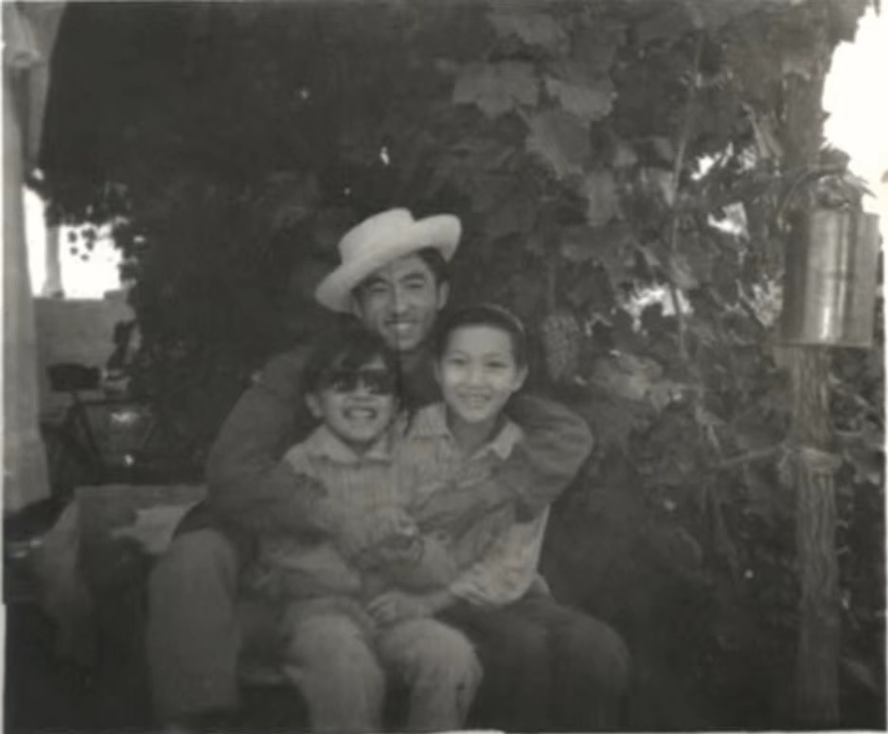
Wǒ de jiā
Older brother
gē ge

Slide 13
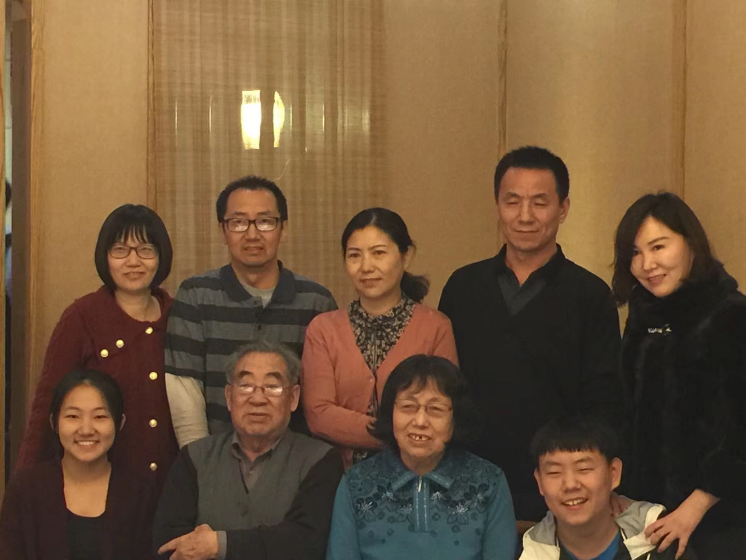
Tā de jiā
wife
lǎo pó

Slide 14
wǒ

Slide 15
Your turn for your family and story in class
Write your family and story in sentences with pictures.
Record your sentences in your slides.
Due time will be 16/02/21 next Tuesday.

