Slide 1
Characters
8
200
1000

Slide 2
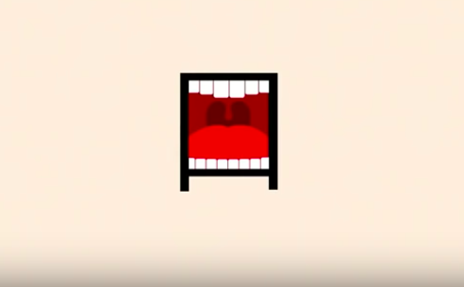

Slide 3
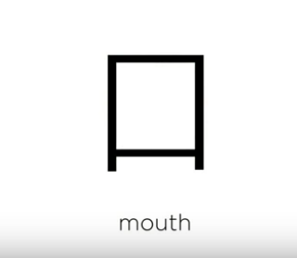
kǒu

Slide 4
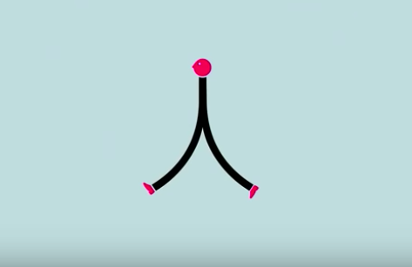

Slide 5
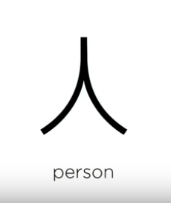
rén

Slide 7
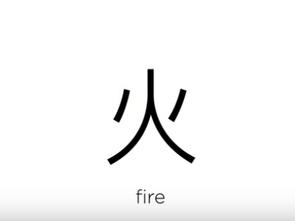
huǒ

Slide 8
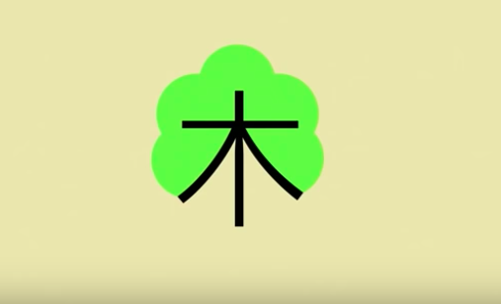

Slide 9
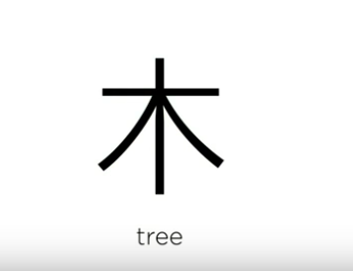
mù

Slide 10
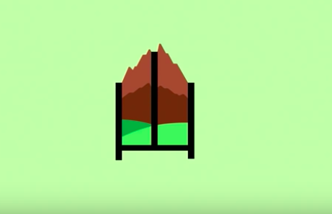

Slide 11
shān

Slide 13
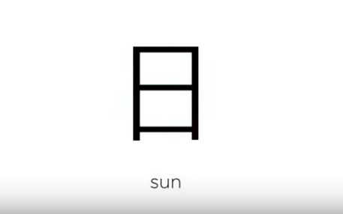
rì

Slide 15
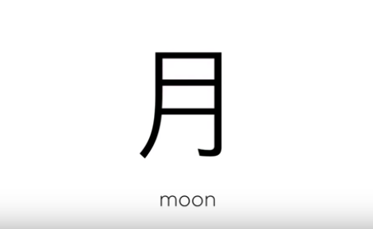
yuè

Slide 17
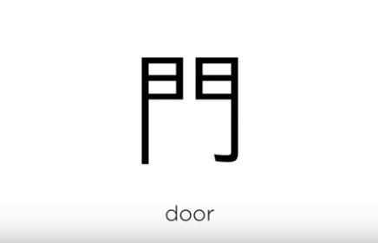
mén
门

Slide 18
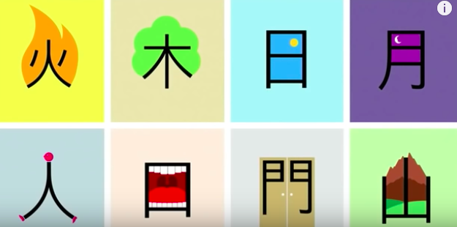

Slide 19
rén
cóng
qiú
囚
zhòng
dà

Slide 20
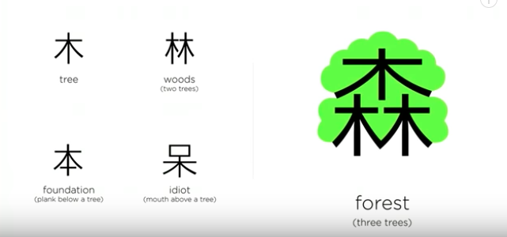
mù
lín
sēn
běn
dāi

Slide 21
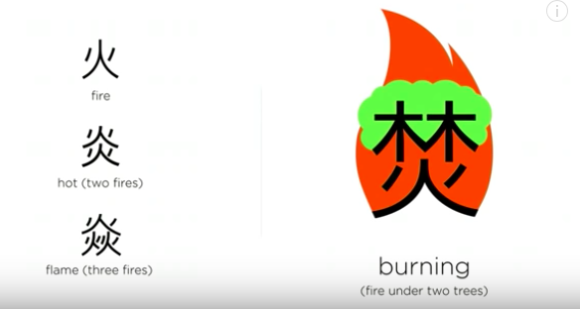
huǒ
yán
fén
yàn

Slide 22
rì
chāng
dàn
jīng
míng

Slide 23
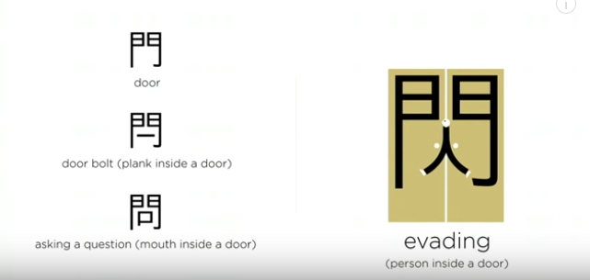
门
闩
问
mén
shǎn
闪
shuān
wèn

Slide 24
口 kǒu mouth
吅 xuān noisy
品 pǐn taste
回 huí return

Slide 25
dāo knife
叨 dāo talkative

Slide 26
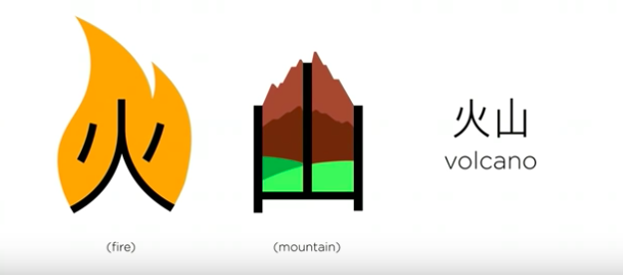
huǒ
shān

Slide 27
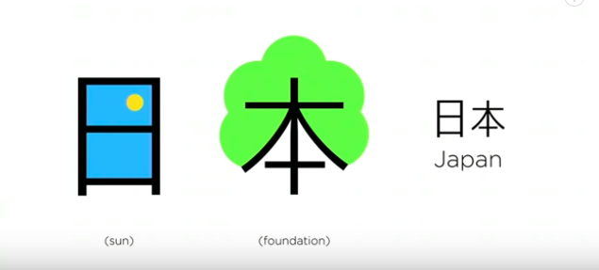
rì
běn

Slide 28
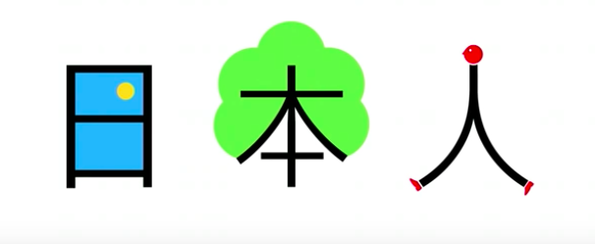
rì
běn
rén

Slide 29
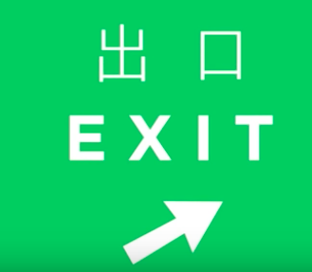
chū
kǒu

Slide 30
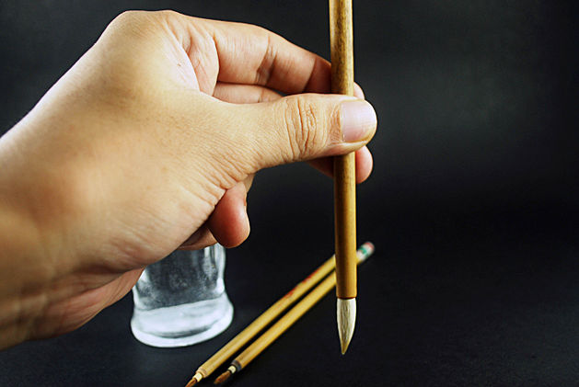
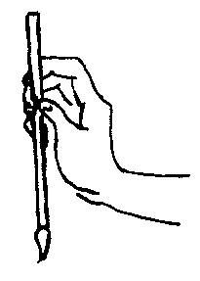
Calligraphy Water brush to write

Slide 31
Calligraphy Water Cloth

Slide 32
Website to check how to write your character with calligraphy brush or pen.
http://www.strokeorder.info/mandarin.php?q=%E5%B1%B1

Slide 33
Website to check how to write your character with calligraphy brush or pen.
http://www.strokeorder.info/mandarin.php?q=%E5%B1%B1

Slide 34
EP to practice new Characters

Slide 35
Word Cloud to find familiar word and write them down in Character and English

Slide 36
Word Cloud to find familiar word and write them down in Character and English

Slide 37
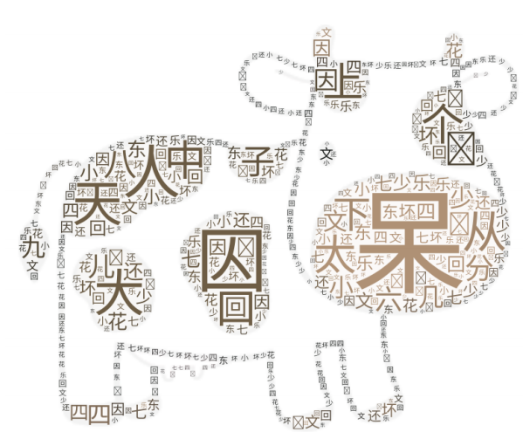
Word Cloud to find familiar word and write them down in Character and English

Slide 38
Type all new characters here and insert audio recording to practice the pronunciation.

