Slide 1

Chuang zao ying 2021
tā shì shéi？
他 是 谁 ？

Slide 2
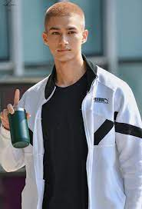
Mika mǐ kǎ 米卡
think
xiǎng
want
yào
Good looking
hǎo kàn
handsome
shuài
short
duǎn
more
duō
https://www.youtube.com/watch?v=qa50RCvmfNw
cold
lěng
USA
měi guó
dance
tiào wǔ
sing
chàng gē
Japan
rì běn 日本

Slide 3
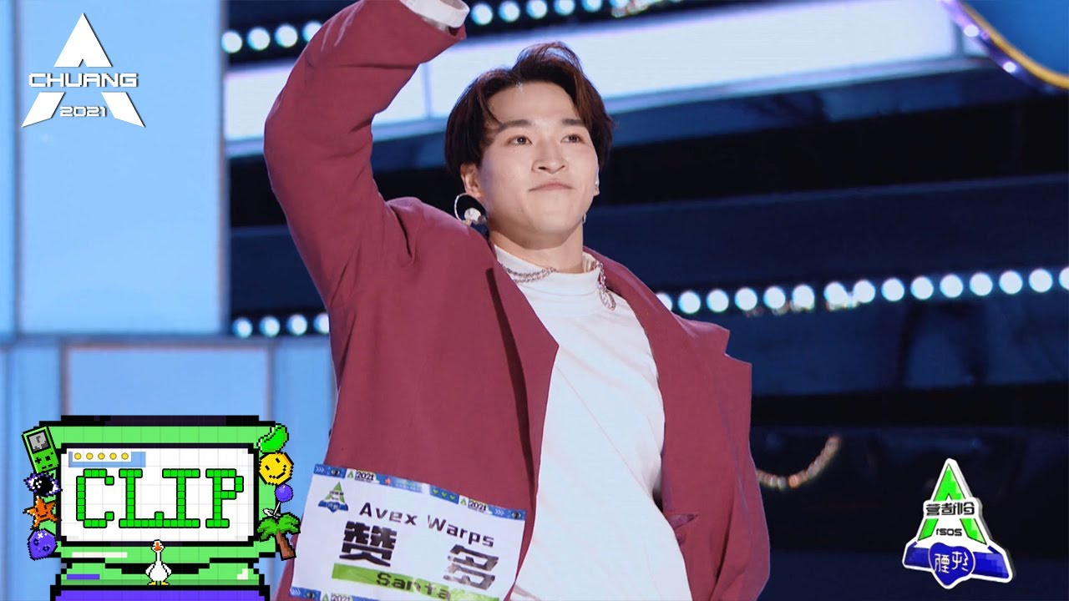
Santa zàn duō 赞多
famous
yǒu míng de
teacher
lǎo shī
help
bāng
student
xué shēng
learn, study
xué
love
ài
https://www.youtube.com/watch?v=0td5dXJtCSU
cute
kě ài
first
dì yī míng
dance
tiào wǔ
sing
chàng gē
Japan
rì běn 日本

Slide 4

lì wán 力丸
famous
yǒu míng de
teacher
lǎo shī
help
bāng
student
xué shēng
learn, study
xué
love
ài
https://www.youtube.com/watch?v=utM5jOHCHRY
cute
kě ài
dance
tiào wǔ
sing
chàng gē
Japan
rì běn 日本

Slide 5
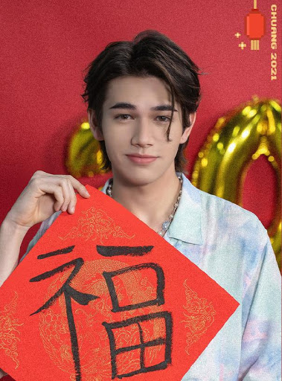
Caelan qìng lián 庆怜
famous
yǒu míng de
teacher
lǎo shī
help
bāng
student
xué shēng
learn, study
xué
love
ài
https://www.youtube.com/watch?v=_V4o19zToQs
https://www.youtube.com/watch?v=GH4hE7NTsTQ
cute
kě ài
first
dì yī míng
rap
Shuō chàng
draw
huà huà
Japan
rì běn 日本

Slide 6
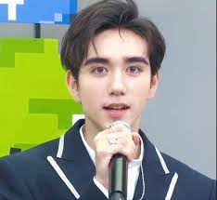
hé mǎ 和马
help
bāng
student
xué shēng
learn, study
xué
love
ài
https://www.youtube.com/watch?v=Abkwzku6an8
cute
kě ài
rap
Shuō chàng
Japan
rì běn 日本

Slide 7
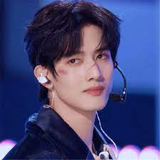
gān wàng xīng 甘望星
vampire
guǐ
monster
guài wù
strange
qí guài
https://www.youtube.com/watch?v=DNN_qJlL-Ns

Slide 8
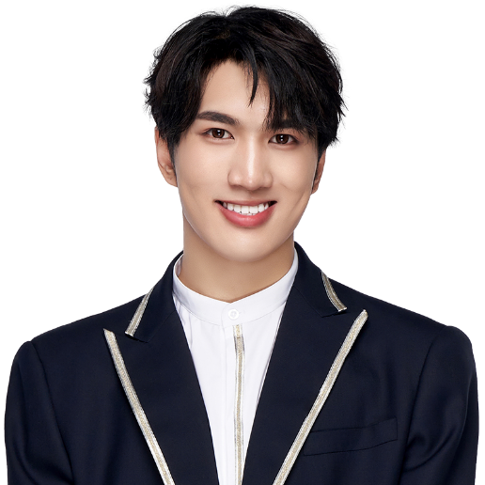
hán pèi quán 韩佩泉
grandma
nǎi nǎi
when
de shí hōu
to look
kàn
good looking
hǎo kàn
to laugh
xiào
funny
hǎo xiào
https://www.youtube.com/watch?v=3SfFNmFZOVk
to play
wán
amusing
hǎo wán
big
dà
small
xiǎo
to leave
zǒu
to die
sǐ
mouth
zuǐ ba

Slide 9
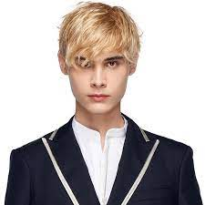
Lelush lì lù xiū 利路修
Russia
é luó sī
two
liǎng
Chinese
zhōng wén
Japanese
rì wén
Russian
é wén
https://www.youtube.com/watch?v=VGiYak8M4Gs

Slide 10

David dà wèi 大卫
Russia
é luó sī
English
yīng wén
Chinese
zhōng wén
Japanese
rì wén
Russian
é wén
https://www.youtube.com/watch?v=kRsjPlLRuOA

Slide 11
ABCD

Slide 12

tā shì shéi？

Slide 13
tā shì shéi？

Slide 14
tā shì shéi？

Slide 15
tā shì shéi？

Slide 16
tā shì shéi？

Slide 17
tā shì shéi？

Slide 18
tā shì shéi？

Slide 19
tā shì shéi？

Slide 20
tā shì shéi？

Slide 21
tā shì shéi？
Answer Q’s in English？
tā hěn shuài. tā shì yī gè "guǐ", bú shì "guài wù". zhōng guó rén xǐ huān tā. tā shì yī gè zhōng guó wǎng hóng.
Zài chuàng èr líng èr yī de stage, tā tiào wǔ qí guài(strange), tā chàng gē bú shì zuì hǎo de. dàn shì rén rén xǐ huān tā. hěn duō rén ài tā.
tā de gè xìng hěn self-conscious hé bú zì xìn (confident)
Who is this and “what” is he?
What is his ability of dancing and singing?
What is his likability of the stage?
。

Slide 22
tā shì shéi？
Answer Q’s in English ？
tā shì měi guó rén.tā yǒu duǎn duǎn de,huáng sè de hair. kàn tā hěn kù, hěn lěng.tā shì yī gè hěn nuǎn xīn(warm) de rén.
tā chàng gē zuì hǎo. tā bǐ hěn duō gèng mature. tā shì yī gè hěn hǎo de trainees. tā yì zhí zhī dào tā xiǎng yào shén me.
Who is this and which country is he from?
What is his appearance and personality?
What is his dancing or singing skills?

Slide 23
tā shì shéi？
Answer Q’s in English ？
tā shì rì běn rén.tā xǐ huan tiào wǔ.zài rì běn shì yǒu míng de tiào wǔ lǎo shī. tā rén hěn hǎo.tā bang hěn duō
Rén tiào wǔ.tā hěn kě ài, hěn shuài.tā bù xǐ huan shuō, dàn shì tā tiào wǔ de shí hòu hěn zì xìn(confident).yīn wèi tā tiào wǔ hěn kù.tā chàng gē de shí hòu bú zì xìn (confident),yīn wèi tā shuō:”wǒ chàng gē bù hǎo.”
Who is this and what is his occupation?
What is his ability of dancing and singing?
What is his personality or appearance?
。

Slide 24
tā shì shéi？
Answer Q’s in English ？
tā bú shi zhōng guó rén.tā shì rì běn rén.tā world level
tiào wǔ dì yī. Tā zhōng wén gèng hǎo le.tā shì tiào wǔ zuì hǎo de rén. wǒ men xǐ huan tā.
Who is this?
What is his ability of dancing and singing?
What is his likability of the stage?

Slide 25
tā shì shéi？
Answer Q’s in English ？
tā shì é luó sī rén.yīn wèi xǐ huan zhōng wén,tā zài zhōng guó xué zhōng wén.tā yě shì zhōng wén lǎo shī. tā shì sān gè rì běn trainees de lǎo shī. tā hěn shuài. tā de gè xìng hěn hǎo wán. Tā yì zhí yì zhí yì zhí yào huí jiā.dàn shì tā de fans xǐ huan tā.
Who is this and what is his occupation?
What is his ability of dancing and singing?
What is his likability of the stage?
What is his appearance and personality?
What does he want?

Slide 26
tā shì shéi？
Answer Q’s in English ？
tā xiǎo de shí hou yīn wèi zuǐ ba bù hǎo,yī gè yuè de shí hòu, mā ma zǒu le,bú yào tā le. shí sì suì de shí hòu bà ba sǐ le. Tā de nǎi nai zuì ài tā. tā shì yī gè wǎng hóng,
yǒu hěn duō hǎo xiào de video. tā shì yī gè hǎo wán de rén. wǒ men xǐ huan tā,dàn shì tā huí jiā le.
Who is this and what is his story?
What is his appearance and personality?
What is his likability of the stage?

Slide 27
tā shì shéi？
Answer Q’s in English ？
tā yě shì rì běn rén,shuō yīng wén,rì wén hé zhōng wén.tā
shuō chàng hěn hǎo,tiào wǔ yě hǎo.tā men sān gè rén shì
rì běn group. tā zuì xiǎo, shì xiǎo dì di.gē ge chàng gē de shí hòu,tā kū le.tā shì art xué sheng. huà huà hěn hǎo. Design le péng you de tì xù.
Who is this and what languages does he speak?
What is his ability of dancing and singing?
When did he cry?
What is his occupation and what is he good at for that?

Slide 28
tā shì shéi？
Answer Q’s in English ？
tā shì rì běn rén.tā shì Harvard de xué sheng, tā yě shì group de rén.tā de zhōng wén zuì hǎo.tā de zhōng wén bǐ tā de gē ge hé dì di gèng hǎo.dàn shì tā huí jiā le.
Who is this and what is his occupation?
What is he good at? Why?
Where is he now?

Slide 29
tā shì shéi？
Answer Q’s in English ？
tā shuō zhōng wén,rì wén,é wén,yīng wén.dàn shì tā chàng gē tiào wǔ bù hǎo.tā yǒu hěn duō péng you.tā de péng you yì zhí shuō:”wǒ bù zhī dào tā shuō shén me.nǐ bang wǒ.”
Who is this and what languages does he speak?
What is his ability of dancing and singing?
What did his friends ask him for?

Slide 30
Education Perfect

Slide 31
Quizlet

Slide 32
Introduction of one member of Chuang Zao Ying 2021
https://www.youtube.com/watch?v=2aux6onRCEE

Slide 33
kāi Caelan shuō shén me.
https://www.youtube.com/watch?v=GH4hE7NTsTQ

Slide 34
Fans=fěn sī
Caelan de fans jiào shén me?
https://www.cpophome.com/caelan-moriarty-profile/
Qìng lián xǐ huān shuō xiào. Tā de péng yǒu shuō:”kids or children” de shí hōu. Qìng lián shuō:”èn, hǎo, bà bà.”
Qìng lián yǒu le sān gè bà bà----yí gè shì mǐ kǎ; yí gè shì tā de zhōng wén lǎo shī; yí gè shì hán jiāng.
Yǒu hěn duō rén xǐ huān qìng lián----hěn duō hěn duō nǚ rén. Nǚ rén mén shuō:” qìng lián yǒu hěn duō bà bà, dàn shì méi yǒu mā mā. Wǒ mén shì qìng lián de mā mā mén!”
Qìng lián de fěn sī jiào shén me?

Slide 35
Nǐ jué de tā Dì jǐ míng?

Slide 36
kāi hái shì guān
https://www.youtube.com/watch?v=2aux6onRCEE

Slide 37
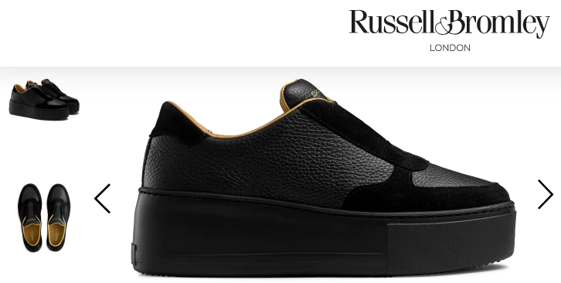
Fēi jī=flight nǐ xǐ huān tā de yī fú ma?
https://www.youtube.com/channel/UC0QhU7ee8rr7Bl0DYN8oi7w
Tā jiào Trinny Woodall. Shì yīng guó rén. Tā shì yí gè yǒu míng de presenter. Tā wǔ shí qī suì. Tā yǒu hěn duō yī fú hé xié zi. Wǒ zuì xǐ huān tā, yīn wéi tā yǒu shí liù gè closet de yī fú. Wǒ zuì xǐ huān tā de xié zi. Dàn shì ào dà lì yà méi yǒu zhè gè xié zi.
Wǒ email yīng guó de xié zi company. Tā mén shuō: nǐ xǐ huān shén me xié zi? Yán sè shì shén me? Size shì shén me? Yǒu fēi jī de shí hōu, wǒ mén gěi nǐ post xié zi.

