Slide 1
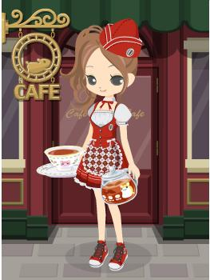
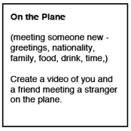
Ordering food and drinks

Slide 2
ào dà lì yà

Slide 3
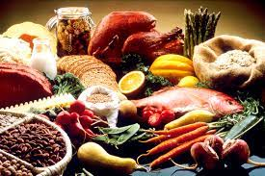
shí wù----food

Slide 4
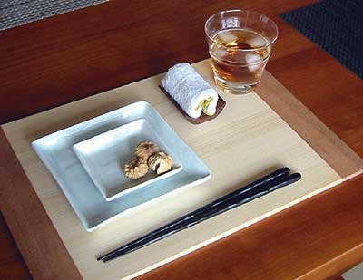
zhōng guó -- kuài zi

Slide 5
Can you guess
the following
food and drinks
that have been taken
from English?

Slide 6
Kā fēi

Slide 7
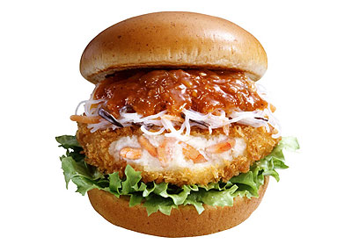
Hàn bǎo bāo

Slide 8
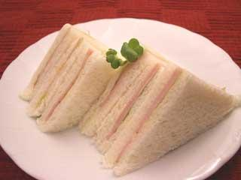
Sān míng zhì

Slide 9
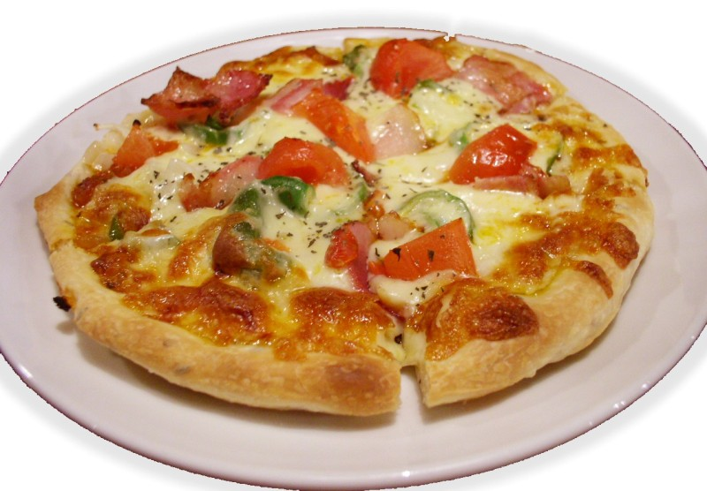
pī sà

Slide 10
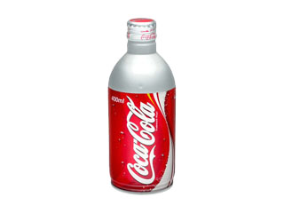
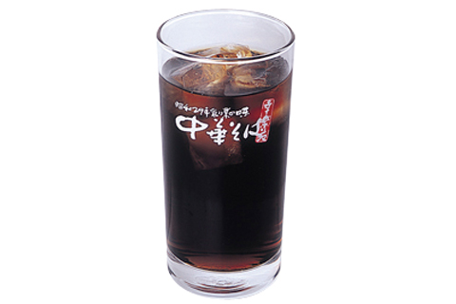
kě kǒu kě lè / kě lè

Slide 11
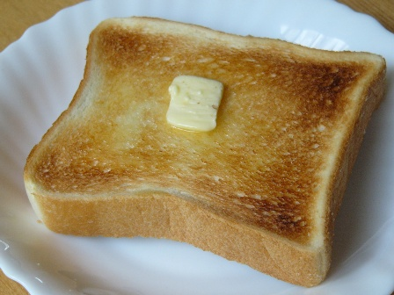
Tǔ sī

Slide 12
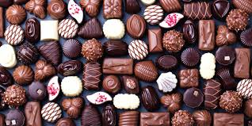
Qiǎo kè lì

Slide 13
Now we go random

Slide 14
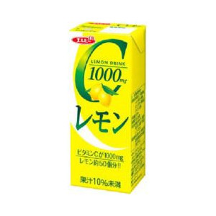
guǒ zhī

Slide 15
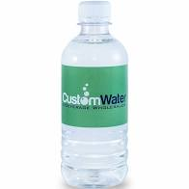
shuǐ

Slide 16
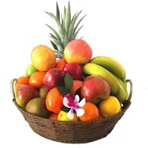
Shuǐ guǒ

Slide 17
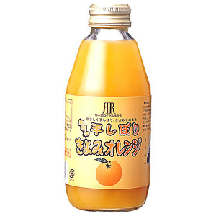
Chéng zhī

Slide 18
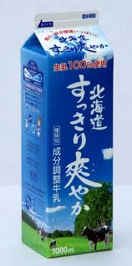
Niú nǎi

Slide 19
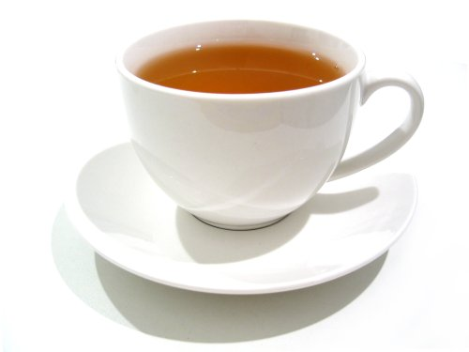
chá

Slide 20
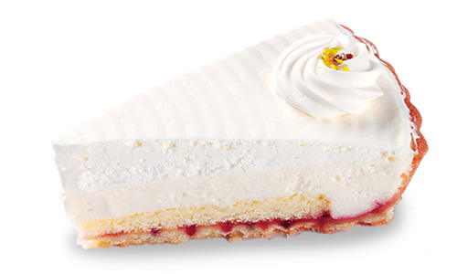
Dàn gāo

Slide 21
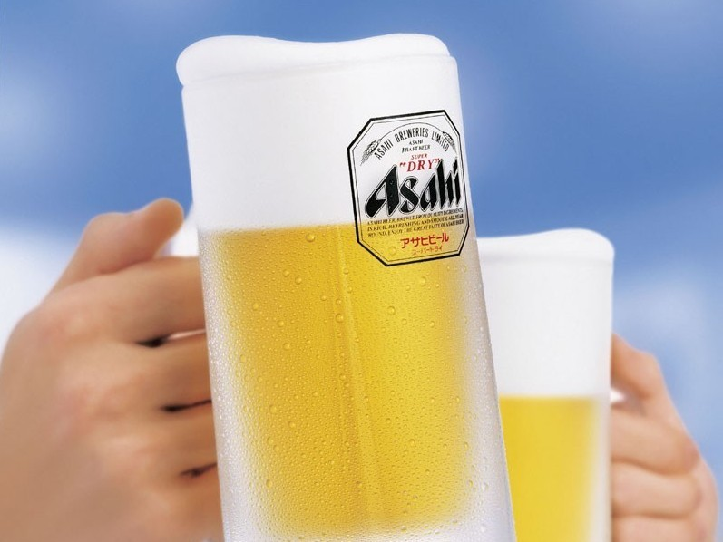
pí jiǔ

Slide 22
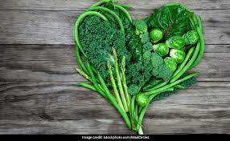
qīng cài

Slide 23
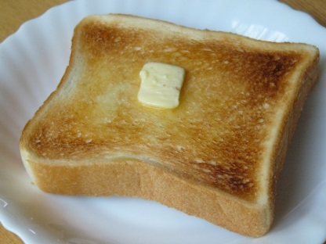
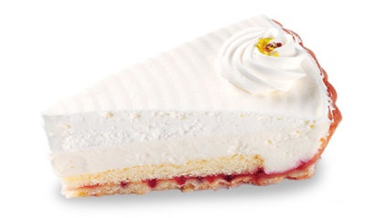
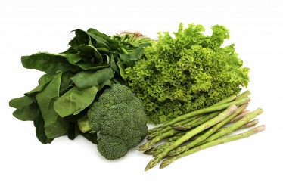
1
2
3
4
5
6
7
8
9
10
11
12
13
14
15
16

Slide 24
chinese foods

Slide 25
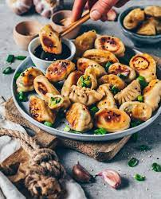
Jiǎo zi

Slide 26
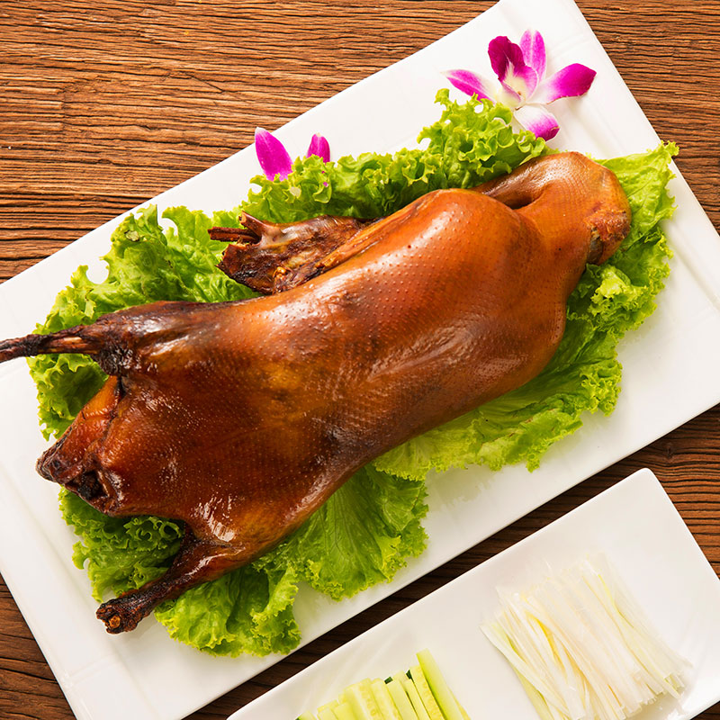
Kǎo yā

Slide 27
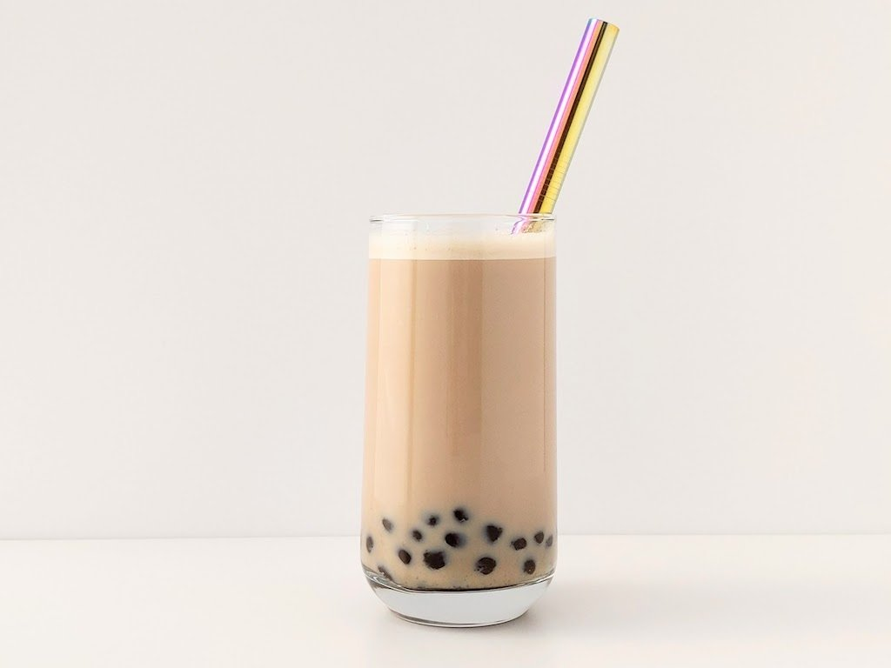
nǎi chá

Slide 28
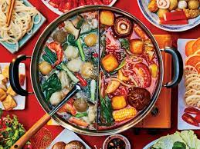
Huǒ guō

Slide 29
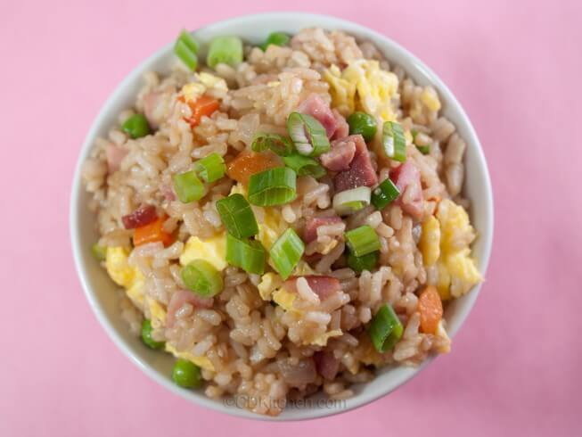
Chǎo fàn

Slide 30
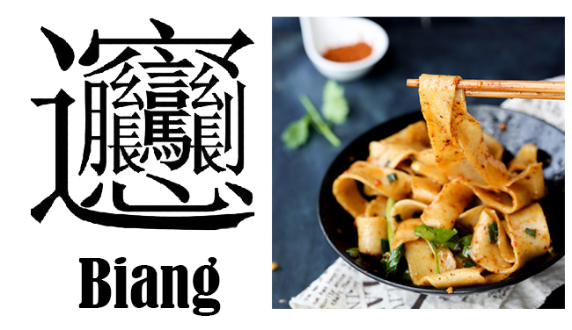
Miàn tiáo

Slide 31
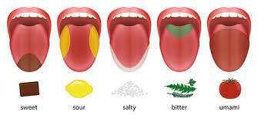
Wèi dào

Slide 32
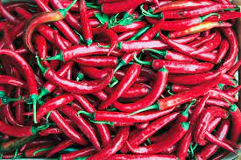
là

Slide 33
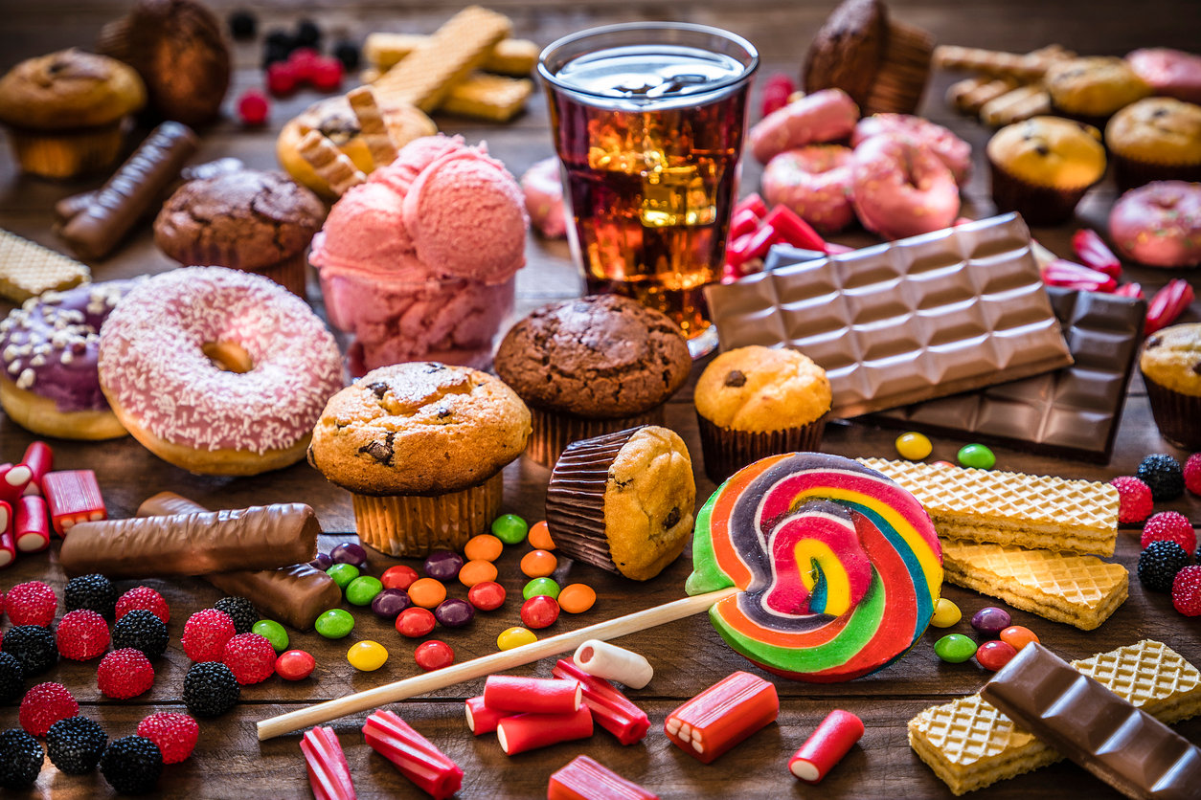
tián

Slide 34
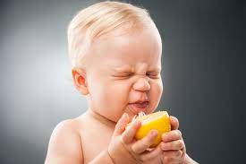
suān

Slide 35
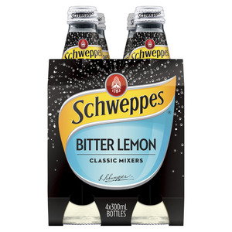
kǔ

Slide 36
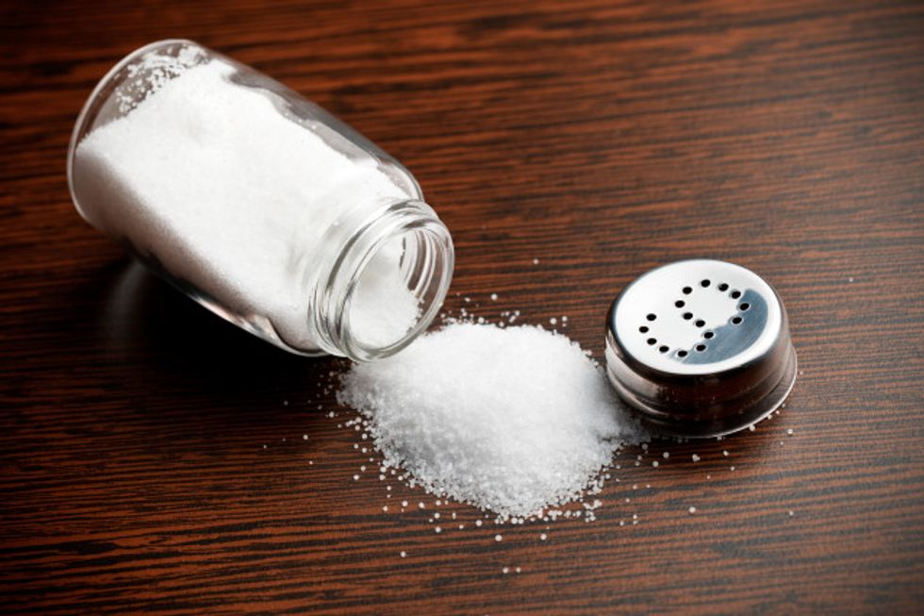
xián

Slide 37
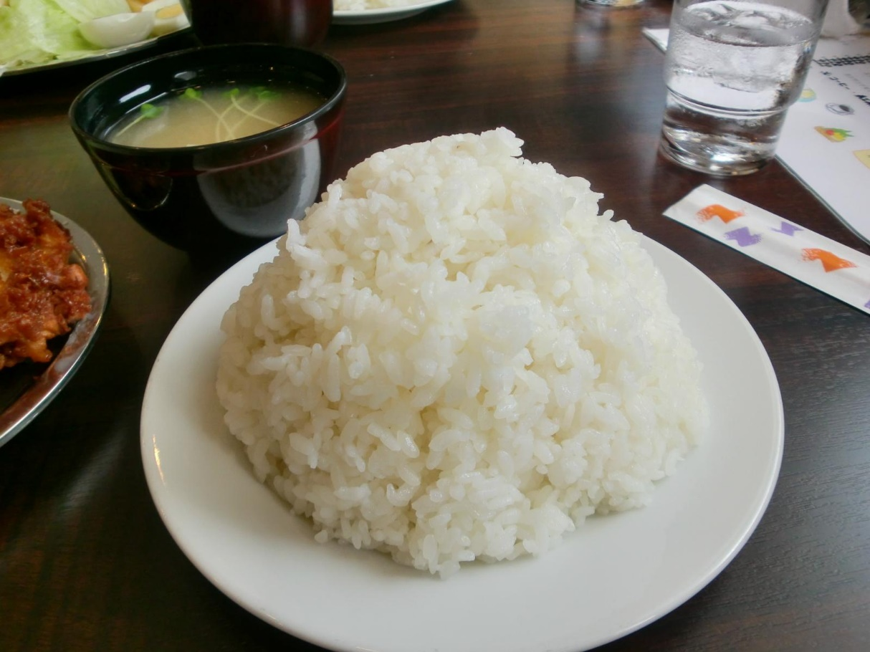
Mǐ fàn

Slide 38
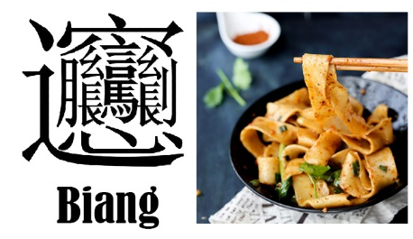
1
2
3
4
5
6
7
8
9
10
11
12
13
14
15
16

Slide 39
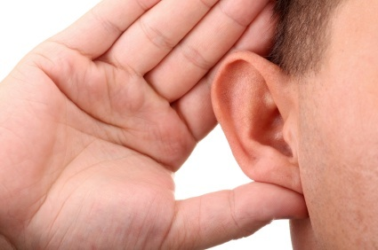
Listening!
https://youtu.be/_VRftrfzrvc
https://youtube.com/watch?v=oMqleVBkd9k&feature=share
https://www.youtube.com/watch?v=3mH6PL9wP4s

