Slide 1

Cān tīng----Restaurant
Let’s order at a restaurant.
Restauran
Cān tīng

Slide 2
Chī shén me? Hē shén me?
What to eat/drink?

Slide 3
Huān yíng guāng lín!!!
Welcome to come
Huān yíng guāng lín
Welcome to come!
Welcome!
Huān yíng!
May I ask, How many people (are in your group?)
Qǐng wèn Jǐ wèi?
welcome
Huān yíng
please
qǐng
ask
wèn
MW for Respect People
wèi

Slide 4
Chī shén me?
What do you eat?
Nǐ chī shén me?
What would you like to eat?
Nǐ xiǎng chī shén me?
think
xiǎng

Slide 5
Hē shén me?
What do you drink?
Nǐ hē shén me?
What would you like to drink?
Nǐ xiǎng hē shén me?

Slide 6
OK
hǎo。
I’ve got it.
Hǎo de。

Slide 7
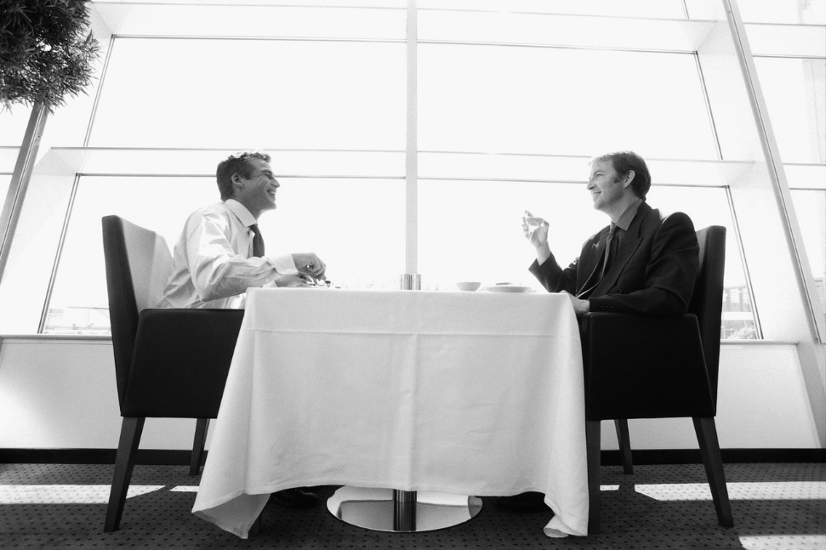
Nǐ de wǔ fàn zěn me yang?
Customer expressions
How is your lunch like?

Slide 8
Xiǎng--think yào--want。
What are you going to eat?
Nǐ yào chī shén me?
I will get chicken noodles.
Wǒ yào chī jī ròu miàn tiáo.
What do you want to eat?
Nǐ xiǎng chī shén me?
I want to eat beef rice.
Wǒ xiǎng chī niú ròu mǐ fàn.
meat
ròu
chicken
Jī ròu
want
yào
beef
Niú ròu

Slide 9
hungry—è full--bǎo
Wǒ è le。
I am hungry.
Wǒ bǎo le。
I am full.
hungry
è
full
bǎo

Slide 10
…. Menu—cài dān
Nǐ yǒu cài dān ma?
Do you have the menu?
Wǒ yào chī zhū ròu mǐ fàn。
I will have the pork rice.
Wǒ yào hē hóng jiǔ。
I will have the red wine.
mebu
Cài dān
pork
Zhū ròu
Red wine
Hóng jiǔ

Slide 11
Meal expressions
Action suggestion
ba
Chī ba!
Let’s eat (no English translation)
Wǒ chī bǎo le!/ wǒ chī hǎo le!
I have finished eating (no English translation)
Gān beī
Cheers
cheers
Gān bēi

Slide 12
Hǎo chī/hē。
Miàn tiáo hěn hǎo chī。
The noodles are delicious.
Zhè gè hóng jiǔ hěn hǎo hē。
This red wine is delicious.
this
zhè
MW
gè

Slide 13
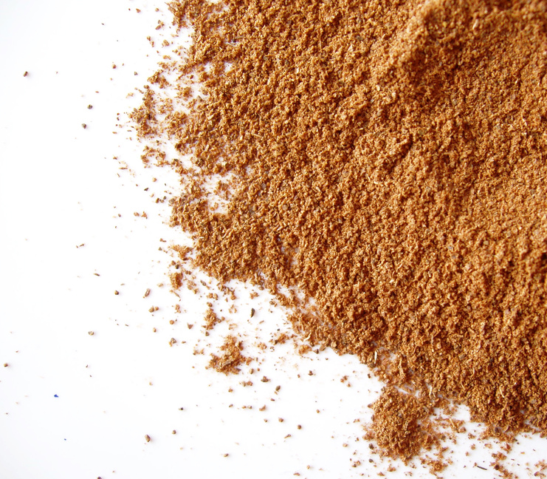
Taste—wèi dào。
Hǎo chī/hē delicious
Bù hǎo chī/hē not delicious
Là hot/ spicy
Tián sweet
Xián salty
suān sour/acid
Tài xián le! too salty!
Méi yǒu wèi dào tasteless (boring)

Slide 14
Smell appetizing--xiāng
Hěn xiāng
Has a good smell.
Kǎo yā hěn xiāng。
Roast duck has an appetizing smell.
fragrant
xiāng

Slide 15
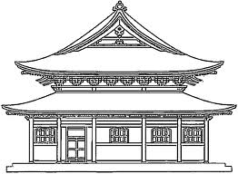
A Restaurant in China
Chinese people love food and enjoy visiting restaurants with their friends to try many different kinds of food.
Your Task:
• You will be working individually or in groups.
• Design a restaurant in China and think about the type of food your restaurant will sell.
• Design a menu for your restaurant that can be used by customers at your restaurant. The prices of food and drink must also be included. This should be written in Chinese.
• Design a short play that involves all members of your group that takes place at your restaurant. Your play must include a waiter/waitress and at least one customer who orders from the restaurant. Use as many of the words and phrases you have learnt in class as possible. This should be in Chinese.
• Perform your play in front of the class. You may use props if you wish.

