Slide 1
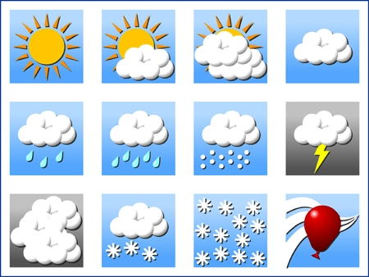
Tiān qì 天气 weather

Slide 2
When you want to ask somebody what the weather is like, you use the following expression:
How is the weather?
……tiān qì zěn me yàng？
City is question marker
weather how

Slide 3
To answer that question is simple:
City + ( weather) + adjectives .
Learn the following vocabulary about weather which will enable you to talk about weather in Japanese

Slide 4
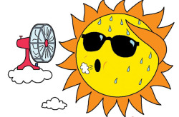
rè hot

Slide 5
Nuǎn huó warm

Slide 6
Yǒu tài yáng sunny

Slide 7
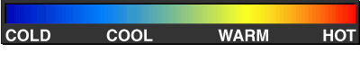
Tiān qì

Slide 8
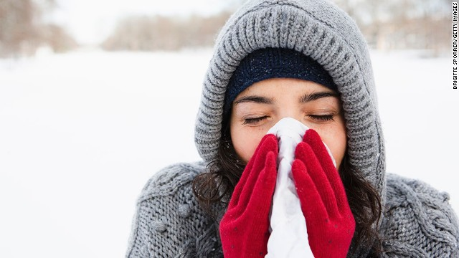
lěng cold

Slide 9
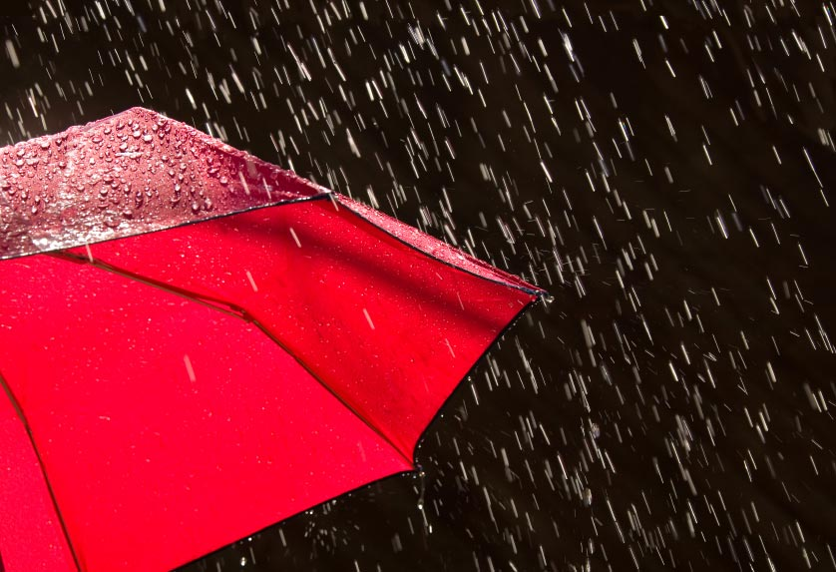
yǔ rain

Slide 10
Duō yún cloudy

Slide 11
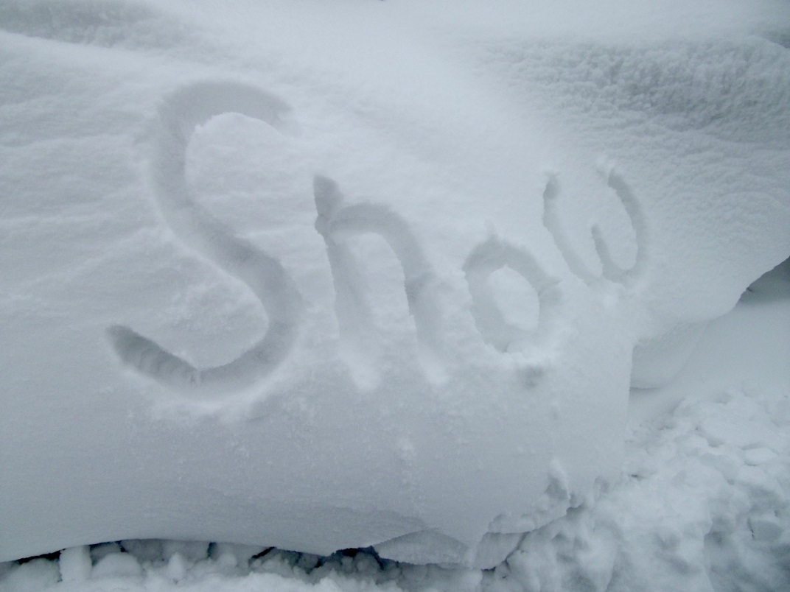
xuě snow

