Slide 1
Livestream preparation
Lesson 13

Slide 2
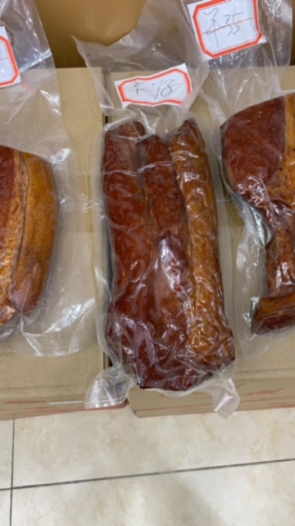
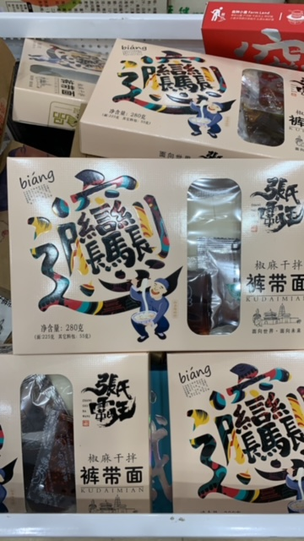
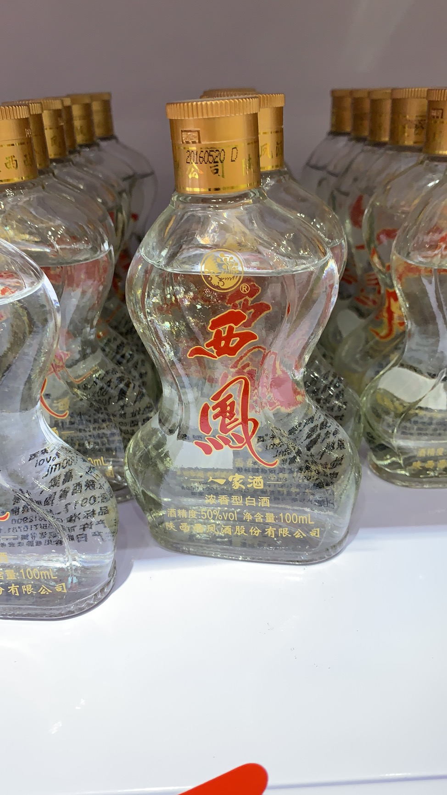
Xī ān de xiǎo chī
Snack
Xiǎo chī
chinese sausage
Là cháng
biang biang noodles
biāng biāng miàn
White wine
Bái jiǔ

Slide 3
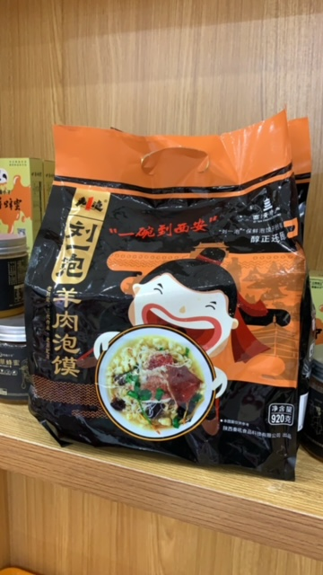
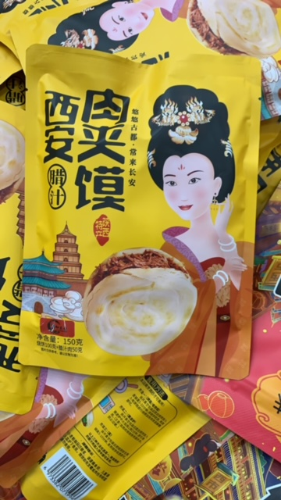
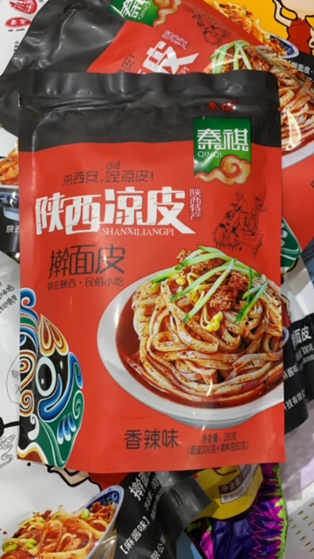
Xī ān de xiǎo chī
Chinese burger
Ròu jiā mó
Cold noodles
Liáng pí
Lamb stew bread
Yáng ròu pào mó

Slide 4
Wǒ yǒu yí gè wèn tí.
boss
Lǎo bǎn
Zhè gè store zài xī ān ma?
Zhè shì xī ān de yí gè store ma?
xīng qī èr store yǒu hěn duō rén ma?
xī ān de miàn tiáo zuì yǒu míng ma?
Nǐ zuì xǐ huān de xiǎo chī shì shén me? Wèi shén me?
Nǐ xīng qī jǐ zuì máng?
Nǐ mén store yǒu yī fú ma?
Nǐ mén store yǒu jǐ gè rén work?
Nǐ shì lǎo bǎn ma?

Slide 5
Wǒ yǒu yí gè wèn tí.
Xī ān yǒu hěn duō xiǎo chī ma?
Xī ān de xiǎo chī yǒu shén me?
Nǐ zuì xǐ huān xī ān de shén me xiǎo chī?
Rú guǒ nǐ zài ào dà lì yà, nǐ zuì xiǎng yào zuò shén me?
rú guǒ nǐ zài ào dà lì yà, nǐ zuì xiǎng yào chī shén me?
Rú guǒ nǐ zài ào dà lì yà, nǐ zuì xiǎng yào hē shén me?
nǐ xǐ huān hē hóng jiǔ hái shì bái jiǔ?
Nǐ xǐ huān nǐ de job ma?
nǐ hěn máng ma?

Slide 6
Wǒ yǒu yí gè wèn tí.
job
Gōng zuò
nǐ wèi shén me zuò zhè gē gōng zuò?
Nǐ de ér zi jǐ suì?
Nǐ de ér zi shén me shí hōu go to school?
Nǐ de ér zi shén me shí hōu finish school?
Yì bāo biāng biāng miàn duō shǎo qián?
Yì bíng bái jiǔ duō shǎo qián?
Nǐ de store hái yǒu shén me?
Nǐ jǐ suì?
Nǐ xǐ huān chī biāng biāng miàn hái shì ròu jiā mó?
nǐ xǐ huān hē bái jiǔ ma?
How much?
Duō shǎo qián?
MW bag
bāo
MW bottle
píng
MW cup
bēi

Slide 7
Wǒ yǒu yí gè wèn tí.
Xī ān de tiān qì zěn mē yang?
Xī ān de tiān qì jǐ dù?
xī ān de chūn tiān zěn mē yang?
Xī ān de xià tiān hěn rè ma?
Xī ān de xià tiān jǐ dù?
Xī ān de dōng tiān yǒu xuě ma?
Xī ān de dōng tiān jǐ dù?
Nǐ xǐ huān bīng mǎ yǒng ma?
Bīng mǎ yǒng hěn duō rén ma?
wǒ mén hě nǐ qù bīng mǎ yǒng, zěn me yang?
terracotta warriors
Bīng mǎ yǒng

