Slide 1
Data Analysis
Advice

Slide 2

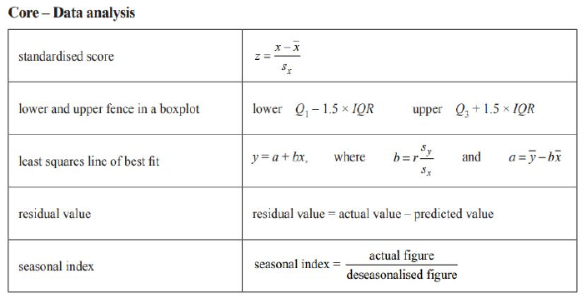
Content Summary: Formula Sheet

Slide 3
Content Summary: See Summary Notes

Slide 4
Exam Advice
Use ruler for graphs & drawing lines
Use statistics to form interpretation & quote the values of statistics
Be aware that tables don’t always have the explanatory variable as the first list of data
Read the value on the horizontal axis of a scatterplot carefully as they may not start at 0

